Slide 1
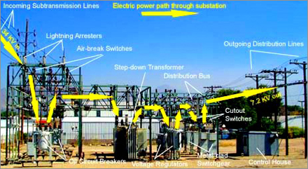
HT Sub Station: Introduction

Slide 2

CONTENTS
1
Introduction
Page 3
2
Type of substation
Page 4
3
Type of transformer
Page 5
4
Substation Characteristics
Page 7
5
Overhead line termination
Page 8
6
Circuit Breaker
Page 9
7
Metering and indication equipment
Page 11
8
Refrence Standard
Page 12
x
About PMG Engineering
#

Slide 3
Introduction
Substations are installations in a Transmission and Distribution System which are involved in the connection of different sections of the transmission and distribution system, usually with the transfer of electrical power from one voltage level to another.
Substations play a vital role in integrating the generating, transmitting and distributing parts of an electrical system.
A substation is generally located in an open area. The substation contains of numerous equipment's such as transformers, breakers, capacitors, measuring and protection devices and so on.
Based on their functions, Substations can be classified into four types
  Distribution Switching Substations
  Switching Substations
  Transmission Substation
  Customer Substation
Notes:
3

Slide 4
Type of Substation
According to the service Requirement
Transformer substation
Switch substation
Power factor correction substation
Frequency change substation
Converting substation
Insudustrial substation
According to the constructional features
Indoor Substation
Outdoor substation
Underground substation
Pole mounted substation
Notes:
4

Slide 5
Type of Transformer
Power transformer
  Single phase transformer
  Three phase transformer
Instrument Transformer
  Current Transformer
  Potential Transformer
Auto Transformer
  Single phase transformer
  Three phase transformer
Notes:
5

Slide 6
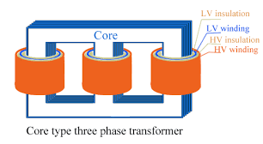
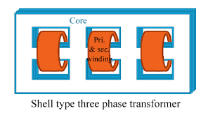
Type of Transformer
On the basis of working
  Step down - Converts high voltage into low voltage
  Step up - Converts low voltage into high voltage
On the basis of structure
Core Type Sheel Type
Notes:
6

Slide 7
Substation Characteristics
Each circuit is protected by its own circuit breaker and hence plant outage does not nessesarily result in loss of supply.
A fault on the feeder or transformer circuit breaker causes loss of the transformer and feeder circuit, one of which may be restored after isolating the faulty circuit breaker.
A fault on the bus section circuit breaker causes complete shutdown of the substation. All circuits may be restored after isolating the faulty circuit breaker.
Maintenance of a feeder or transformer circuit breaker involves loss of the circuit.
Introductions of bypass isolators between bus bar and circuit isolator allows circuit breaker maintenance facilities without loss of that circuit.
Notes:
7

Slide 8
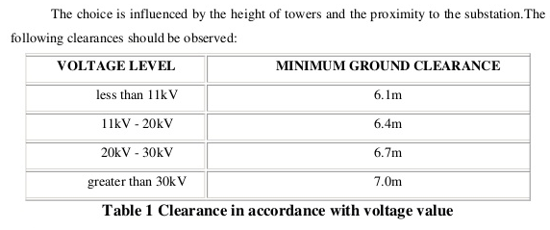
Overhead Line Terminations
Two method are used to terminate overhead lines at a substation.
  Tensioning conductors to substations structure or building.
  Tensioning conductors to ground winches.
The choice is infludenced by the height of towers and the proximity to the substation. The following clearance should be observed.
Notes:
8

Slide 9
Type of Circuit Breaker
Oil circuit breaker
Bulk oil circuit breakers (BOCB) Bulk oil circuit breaker (or BOCB) is a such type of the circuit breakers where oil is used as arc quenching media as well as insulating media between current carrying contacts and earthed parts of the breaker
Air – blast circuit breaker
The type of circuit breaker, which operates in air (where air-blast as an arc quenching medium) at atmospheric pressure, is known to be an Air Circuit Breaker. The main aim of circuit breaker is to prevent re-establishment of arcing after current zero where the contact gap will withstand the system recovery voltage.
Notes:
9

Slide 10
Type of Circuit Breaker
SF6 Breaker
The working of SF6 CB of first generation was quite simple and it is some extent similar to air blast circuit breaker. Here SF6 gas was compressed and stored in a high-pressure reservoir. During operation of SF6 circuit breaker this highly compressed gas is released through the arc in breaker and collected to relatively low-pressure reservoir and then it is pumped back to the high-pressure reservoir for re utilize.
Vaccum circuit breaker
A vacuum circuit breaker is the suitable for mainly medium voltage application circuit breaker where the arc quenching takes place in vacuum. The major parts of Vacuum Circuit Breakers circuit breaker are breaker contacts. ... The vacuum pressure inside a vacuum interrupter is normally maintained at 10 - 6 bar.
Notes:
10

Slide 11
Metering and Indication Equipment
Relay
  Electromagnetic attraction relay.
  Electromagnetic Induction relay.
Relay used in control panel of the substation
  Differential relay.
  Over current realy.
  Directional relay.
  Tripping relay.
  Auxillary relay.
Notes:
11

Slide 12
Reference Documents
IEC 60076-8 Power transformers Application guide.
Detailed information concerning Grounding and Lightning protection can be found in our TM-217.11-1 guideline.
GI-217.0-1 Preparation of Basic Electrical Engineering Design for Factory Projects.
GI-217.12-1 Low Voltage Installation Guidelines.
GI-217.9-1 Electrical Energy Savings.
Notes:
12

