Slide 1
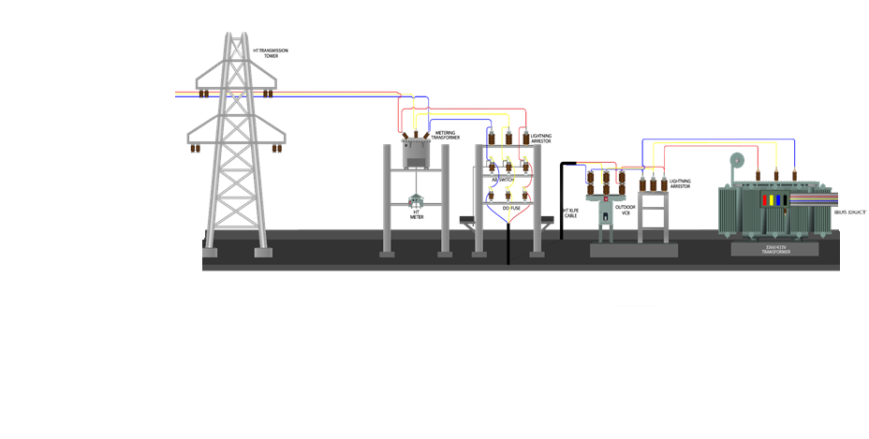
Substation Layout

Slide 2

CONTENTS
1
Design considerations
Page 3
2
MV Switchgear room layout
Page 5
3
LV switchgear room layout
Page 6
4
Transformer room layout
Page 7
X
About PMG Engineering
#

Slide 3
Design Considerations
When a substation is installed inside of a building or structure, it is recommended that the MV switchgear, transformer(s), and LV switchgear are each installed in separate rooms. The separation of main electrical equipment improves reliability by helping to prevent faults or fires associated with one piece of main electrical equipment from damaging the other main electrical equipment. For dry-type transformer applications the MV switchgear can be installed close-coupled to the transformer in the same room.
The substation foundation should be constructed of steel reinforced concrete and should be designed taking the overall weight of the substation equipment into consideration.
Spill containment should be provided for liquid-filled transformers.
Consideration should be given to clear space needs around equipment for maintenance, and access needs for major equipment removal / replacement.
Notes:
3

Slide 4
Design Considerations
Sufficient space should be provided around equipment to allow for the cooling of equipment. The design shall include forced-air ventilation and/or cooling where necessary to keep the air temperature within the equipment design limits.
Substation buildings/rooms must be equipped with a Fire Alarm and Detection and System, and Fire Suppression System in accordance with Fire Codes in the locality.
Substation access should be restricted to qualified persons only. Substation rooms should be provided with locked doors and outdoor substations should be fenced in with a locked gate/door. For personnel safety, it is recommended that doors should be provided at each end of each room or enclosed area to help prevent personnel from being trapped in the event of a fire.
Notes:
4

Slide 5
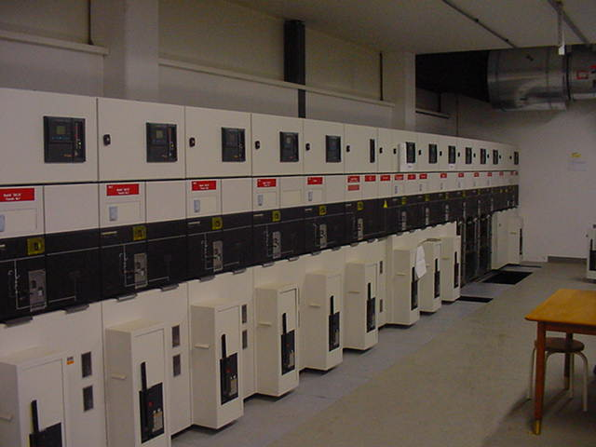
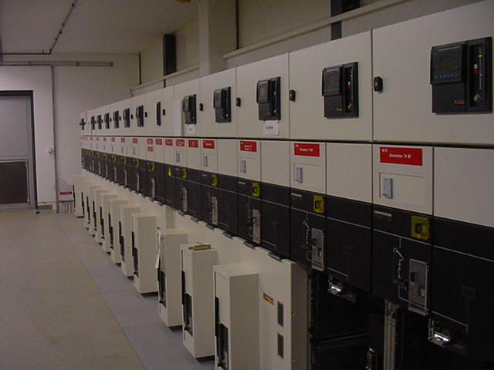
MV Switchgear Room Layout
Front access required for the MV switchgear equipment for maintenance purposes.
On the photos below a typical MV switchgear room layout is presented (Note that depending on the manufacturer and product, both front and rear access may be required):
Notes:
5

Slide 6
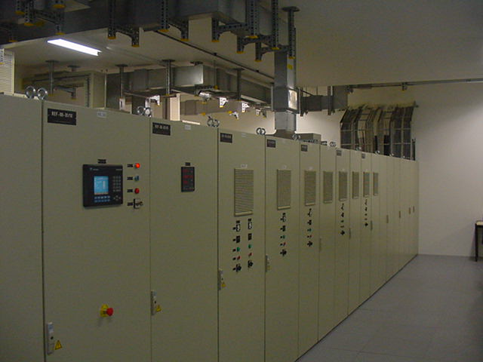
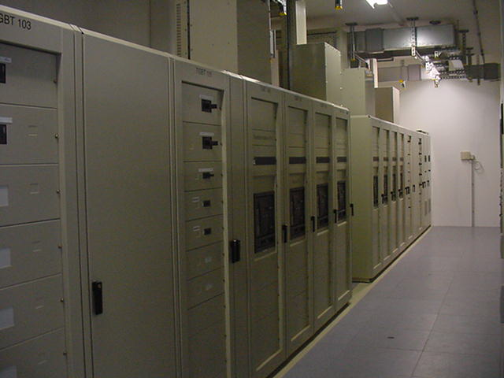
LV Switchgear Room Layout
Front and rear access is required for the low voltage switchgear equipment for maintenance purposes. On the photos below a typical LV switchgear room layout is presented (Note that depending on the manufacturer and product, front and rear access may not be required):
Notes:
6

Slide 7
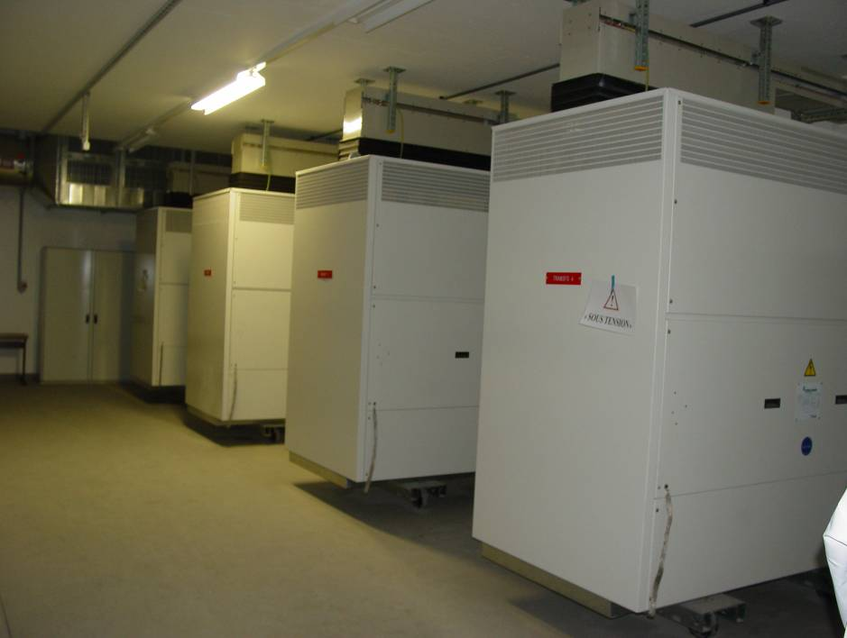
Transformer Room Layout
As was mentioned earlier, it is strongly recommended that indoor dry-type transformers are provided with a metallic enclosure (cage) which provides a degree of protection of at least IP31/NEMA 1. On the photo below we can see such an arrangement within a substation.
Notes:
7

