Slide 1
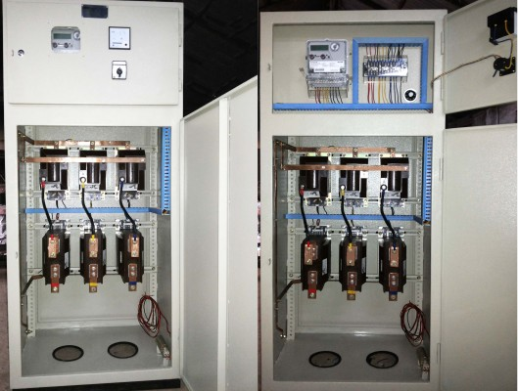
Power Metering & Protection

Slide 2

CONTENTS
1
General Information
Page 3
2
Power-system protection
Page 5
3
Components
Page 6
4
Protective devices
Page 7
5
Protected devices advantage
Page 8
6
Surge protection device (SPD)
Page 9
7
Protection Testing
Page 10
X
About PMG Engineering
#

Slide 3
General Information
A power quality meter must be installed at each substation on the secondary side of each transformer. The secondary main switchgear or main distribution board is the recommended location. The meter should provide three-phase main bus metering and power quality analysis. Some main protective devices have metering capabilities.
The meter should be capable of measuring: Current (A), Tension/Voltage (V),Real Power(W), Watt-hours(WH), Reactive Power (VAR), Volt-Ampere Reactive Hours (VARH), Apparent Power (VA), Volt-Ampere Hours (VAH), Frequency (Hz), Power Factor (pf).
The power analysis features shall include an event recorder, waveform capture, harmonic spectrum display with total harmonic voltage and current distortion, and a data logger function.
Notes:
3

Slide 4
General Information
In order, to measure the power consumption on every cost centre of our plants, it is recommended that an impulse meter be installed on every feeder of the main distribution boards to allow for the measuring and storing of the kWh. These meters for the distribution feeders do not require the power quality analysis features mentioned above.
All meters should be equipped with an interface for connectivity purposes. The communication interface should be compatible with the communication network ( i.e. Ethernet, Mod BUS, Profibus ) and this should be coordinated with the communication network supplier/designer.
Notes:
4

Slide 5
Power-System Protection
Power-system protection is a branch of electrical power engineering that deals with the protection of electrical power systems from faults through the isolation of faulted parts from the rest of the electrical network.
The objective of a protection scheme is to keep the power system stable by isolating only the components that are under fault, whilst leaving as much of the network as possible still in operation. Thus, protection schemes must apply a very pragmatic and pessimistic approach to clearing system faults. For this reason, the technology and philosophies utilized in protection schemes can often be old and well-established because they must be very reliable.
Notes:
5

Slide 6
Components
Protection systems usually comprise five components
Current and voltage transformers to step down the high voltages and currents of the electrical power system to convenient levels for the relays to deal with
Protective relays to sense the fault and initiate a trip, or disconnection, order
Circuit breakers to open/close the system based on relay and auto re-closer commands
Batteries to provide power in case of power disconnection in the system.
Communication channels to allow analysis of current and voltage at remote terminals of a line and to allow remote tripping of equipment.
For parts of a distribution system, fuses are capable of both sensing and disconnecting faults.
Failures may occur in each part, such as insulation failure, fallen or broken transmission lines, incorrect operation of circuit breakers, short circuits and open circuits. Protection devices are installed with the aims of protection of assets and ensure continued supply of energy.
Notes:
6

Slide 7
Protective Devices
Protective relays control the tripping of the circuit breakers surrounding the faulted part of the network
Automatic operation, such as auto-re-closing or system restart
Monitoring equipment which collects data on the system for post event analysis
While the operating quality of these devices, and especially of protective relays, is always critical, different strategies are considered for protecting the different parts of the system. Very important equipment may have completely redundant and independent protective systems, while a minor branch distribution line may have very simple low-cost protection.
There are three parts of protective devices:
  Instrument transformer: current or potential (CT or VT)
  Relay
  Circuit breaker
Notes:
7

Slide 8
Protected Devices Advantage
Advantages of protected devices with these three basic components include safety, economy, and accuracy.
Safety:
  Instrument transformers create electrical isolation from the power system, and thus establishing a safer environment for personnel working with the relays.
Economy:
  Relays on being able to be simpler, smaller, and cheaper given lower-level relay inputs.
Accuracy:
  Power system voltages and currents are accurately reproduced by instrument transformers over large operating ranges.
Notes:
8

Slide 9
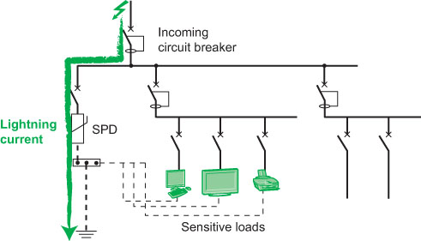
Surge Protection Device (SPD)
The Surge Protection Device (SPD) is a component of the electrical installation protection system.
The load circuits that this device must protect are connected in parallel to the power supply circuit. Additionally, it is applicable across the board in the power supply network.
It is the most effective and widely used kind of overvoltage protection.
Notes:
9

Slide 10
Protection Testing
Impulse voltage with-stand test equipment
The Impulse Voltage Test Equipment is designed to generate impulse voltage (both polarity) of 1.0 KV to 20 KV depending on the model chosen. The waveform generated has a rise time of 1.2 micro second and 50 micro second duration. This instrument (suitable model based on peak voltage) incorporates testing as per the procedure described in IEC 61180, IEC 61010, IEC 60950, IEC 60065, IEC 60335-1, IEC60230.
The equipment also incorporates testing as per the below standards:
  Low Voltage Switchgear and Control gear: IS/IEC 60947 -2004 Cl. No: 8.3.3.4.1
  Circuit Breakers: IS/IEC 60898:2002 Cl.no : 9.7.6.1 & 97.6.2
  Residual Current Operated breakers: IEC 61008 & 61009 : Cl.no: 9.20
Notes:
10

