Slide 1
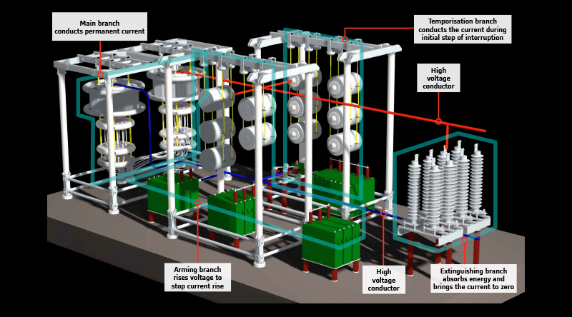
High Voltage Circuit Breaker

Slide 2

CONTENTS
1
Introduction
Page 3
2
Working & principle
Page 4
3
Type of high voltage circuit breaker
Page 5
4
Vacuum Circuit Breakers - Advantages/Disadvantages
Page 6
5
SF6 Circuit Breakers - Advantages/Disadvantages
Page 8
6
Oil Circuit Breakers Advantages/Disadvantages
Page 10
X
About PMG Engineering
#

Slide 3
Introduction
Electrical Power transmission networks are protected and controlled by High Voltage Circuit Breaker inside electrical grid substation. In substations the protection relay scheme can be complex, protecting equipment and busses from various types of overload or ground/earth fault.
Electrical protection should be provided against the following abnormal conditions:
  overloading (excessive currents not due to faults)
  transformer faults
  short-circuit faults between phases
  short-circuit faults to earth
Notes:
3

Slide 4
Working & Principle
What is a circuit breaker
A circuit breaker is an equipment that breaks a circuit either manually or automatically under all conditions at no load, full load or short circuit.
Operating principle
Two contacts called electrode remains closed under operating conditions. When fault occurs on any part of the system, the trip coil of the circuit breaker get energized and contacts are sperated.
Notes:
4

Slide 5
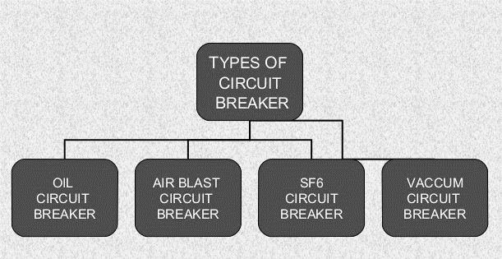
Type of high voltage circuit breaker
Classification
High Voltage Circuit Breaker are available for indoor or outdoor applications and High-voltage breakers are broadly classified by as follows.
Notes:
5

Slide 6
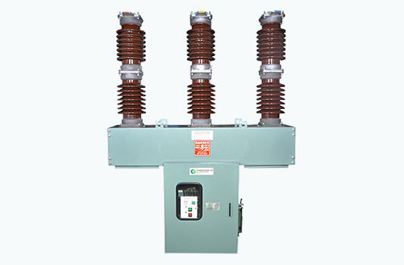
Vacuum Circuit Breakers
Working
Vacuum circuit breakers are commonly used for applications in the voltage range of 5-38KV. But have more recently emerged as an alternative for higher voltages due to their “environmental friendliness.”
Notes:
6

Slide 7
Vacuum Circuit Breakers
Advantages
Disadvantages
Simple construction with less components and little if any maintenance.
Longer operational life with very high number of operating cycles relative to an SF6 breaker.
No fire or explosion hazard.
No environmental hazard.
Compact construction.
No practical method to monitor the vacuum inside the circuit breaker.
Can create large transient voltage spikes when interrupting faults which stresses the electrical system.
Limited application above 38kV.

Slide 8
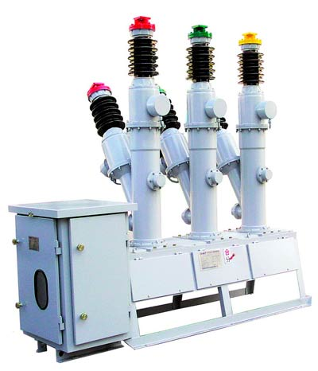
SF6 Circuit Breakers
Working
SF6 circuit breakers are the worldwide leader for application in MV installations but have recently become less popular due to environmental hazards associated with SF6 gas.
Notes:
8

Slide 9
SF6 Circuit Breakers
Advantages
Disadvantages
SF6 is a superior insulating and arc quenching medium than a vacuum.
“Softer” switching while interrupting of faults imposes less electrical stress on the system than vacuum breakers.
SF6 poses no fire or explosion hazard.
SF6 gas pressure can be monitored to ensure integrity of equipment.
SF6 is neutral but becomes highly toxic when exposed to high temperatures (under fault condition). Equipment damaged due to a fault or fire may require special treatment prior to maintenance or disposal.
SF6 has recently been labeled as a major global warming gas.
An SF6 breaker can have up to twice as many components as a similar vacuum breaker.
Risk of SF6 gas leakage at the source and at breaker.
SF6 gas system must be maintained.

Slide 10
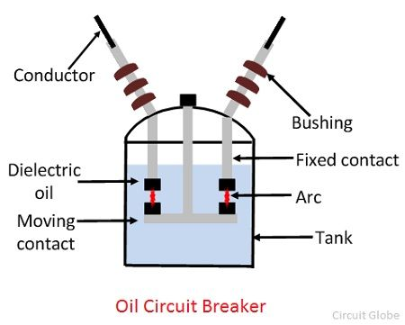
Oil Circuit Breakers
Working
When the contacts of the oil circuit breaker are opened under oil and an arc is struck between them. The heat of the arc evaporates the surrounding oil and dissociates it into a substantial volume of gaseous hydrogen at high pressure.
These are of two types.
  BOCB ( Bulk oil circuit breaker)
  MOCB ( Minimum oil circuit breaker )
Notes:
10

Slide 11
Oil Circuit Breakers
Advantages
Disadvantages
Oil has good dielectric strength.
Low Cost.
Oil is easily available.
It has wide range of breaking capacbility.
Slower operation, take about 20 cycle for arc quenching.
It is inflammable resulting risk of fire.
It may from an explosive mixture with air.
It requires maintenance.
Absorbs moisture, so dielectric strength reduces.
Oil leakage problem.
Oil need to be replaced after some operations because of the carbonization of coil.

