Slide 1
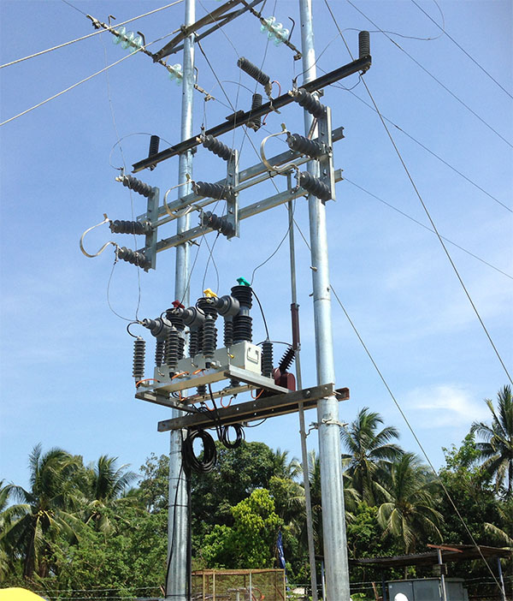
GANG OPERATING DEVICE

Slide 2

CONTENTS
1
Gang operating device
Page 3
2
Working principle
Page 4
3
AB Switch
Page 5
4
Earthing switch
Page 6
5
Drop out fuse
Page 7
6
Applications
Page 8
X
About PMG Engineering
#

Slide 3

Gang operating device
What is a gang operating device ?
Among the substation equipment circuit breakers play a vital role when triggered to switch to
  Control the power transfer based on the load demand situations,
  Isolate faulty circuits,
  Prevent system stability failures in case the system parameters are crossing the permissible limits
  Allow maintenance of substation equipment.
God switch comprises of : -
  Lightning Arrester
  Air-break switch
  Drop out fuse (DO)
  Earthlings
Notes:
3

Slide 4
Working principle
Working principle
Gang operated Switches or G.O Switches as they are commonly known are switching devices used in overhead power lines.
They are called Gang Operated as they are operated in a Gang, all three switches together, using a single mechanism. They are also called air-break switches as they use air as the breaking medium or GOD (Gang operated Disconnect) switch.
These switches do not have any load-breaking capacity. They can only be operated when the transformer is on no-load and only the small magnetizing current flows through them. A substation must be disconnected from the load it is feed and only then can these switches located on the incoming lines of the substation be disconnected.
Notes:
4

Slide 5
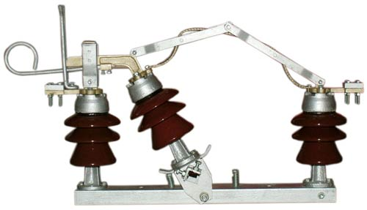
Air-break switch
An “Air-Break Switch' is a switching device that uses air as the dielectric. Air-Break Switches (ABS) are widely installed throughout distribution networks for use as both isolation or switching points.
  They are usually employed in outdoor installations. Special Arcing Horns are provided to quench the arc which occurs when the current is interrupted. These switches are usually operated by a handle which is located at the ground level. Their operation can also be mechanised.
Types of AB Switch
  Air-break switches can be of two types
  Single pole Air-break switch
  Gang operated Air-break switch
It can be operated manually using either a handle/ratchet mechanism or an insulated 'hook stick' made either of wood or fiberglass.
Notes:
5

Slide 6
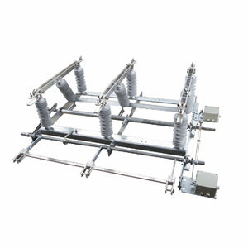
Earthing switches
As earthing ensures safety for people in charge of MV switchgear maintenance, the only real device that can be called a safety device is the earthing switch. In MV switchgear, there are two possibilities to connect the main circuit to the earth.
  Earth switch is used to discharge the voltage on the circuit to the earth for safety.
  Earth switch is mounted on the frame of the isolators.
  Earth switch is located for each incomer transmission line and each side of the bus-bar section.
Notes:
6

Slide 7
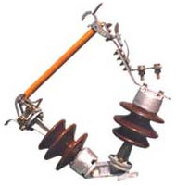
Drop out fuse (DO)
The dropout (swing out) fuse is an expulsion type and its main function is to protect Transformers on rural distribution network. It is also particularly useful for inaccessible Sub-stations where indication of fusing is of advantage.
On blowing of fuse element, the fuse carrier hangs down vertically from the bottom contact. This is advantageous locating the fault as hanging fuse carrier is noticeable from distance and this save times which otherwise would be taken in investigation.
Lift out the fuse carrier by means of the insulated operating rod, rewire the fuse element and swing it up the carrier and thus remake the circuit.
  Reference standard IS _ 9385/1983
  System Voltage 12 / 24 kV, 36 kV.
  Rated Current 100 / 200 Amp.
Notes:
7

Slide 8
Applications
Major areas of application
Grid Guard switches are ideally suited for the following duties.
  Line switching: Parallel or loop switching load splitting, load dropping, and associated charging currents.
  Transformer switching: Load dropping, including associated magnetizing currents.
  Cable switching: Parallel or loop load switching, load dropping, and associated charging currents.
Switches including, five, three, and two-time duty-cycle fault closing capabilities of 15 kA, 20 kA, and 30 kA rms-asym respectively.
Notes:
8

