Slide 1
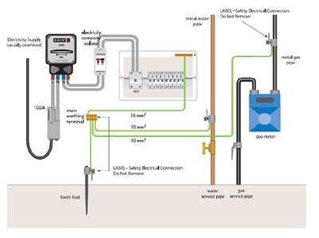
Grounding systems

Slide 2

CONTENTS
1
Introduction
Page 3
2
Working principle
Page 5
3
Why are Grounding systems needed?
Page 6
4
Types of Grounding systems
Page 7
5
Soil Characterstics & Resistivity Measurement (Wenner method)
Page 12
x
About PMG Engineering
#

Slide 3
Introduction
Grounding system
Distribution power systems may be solidly grounded, with one circuit conductor directly connected to an earth grounding electrode system. Alternatively, some amount of electrical impedance may be connected between the distribution system and ground, to limit the current that can flow to earth.
The objective of a grounding system are:
  To provide safety to personnel during normal and fault conditions by limiting step and touch potential.
  To assure correct operation of electrical/electronic devices.
  To prevent damage to electrical/electronic apparatus.
  To dissipate lightning strokes.
  To stabilize voltage during transient conditions and to minimize the probability of flashover during transients.
  To divert stray RF energy from sensitive audio, video, control, and computer equipment.
Notes:
3

Slide 4
Working principle
A safe grounding design has two objectives
To provide means to carry electric currents into the earth under normal and fault conditions without exceeding any operating and equipment limits or adversely affecting continuity of service.
To assure that a person in the vicinity of grounded facilities is not exposed to the danger of critical electric shock.
Why ground at all?
Personnel safety first
Equipment protection second
Notes:
4

Slide 5
Why are grounding systems needed ?
Why are grounding systems needed ?
One of the most important reasons for grounding electrical currents is that it protects your appliances, your home and everyone in it from surges in electricity. If lightning was to strike or the power was to surge at your place for whatever reason, this produces dangerously high voltages of electricity in your system.
What are the three main types of grounding ?
The three main types are:
  Equipment grounding (safety)
  System grounding
  Lightning/surge grounding
Notes:
5

Slide 6

Types of grounding systems
Earth / ground basics
Types of Grounding Systems
  Many different types available
  Choice depends on local conditions and required function
  Simplest form is a single stake
Mostly used for:
  Lightning protection
  Stand alone structures
  Back-up for utility ground
Ground rod
Notes:
6

Slide 7
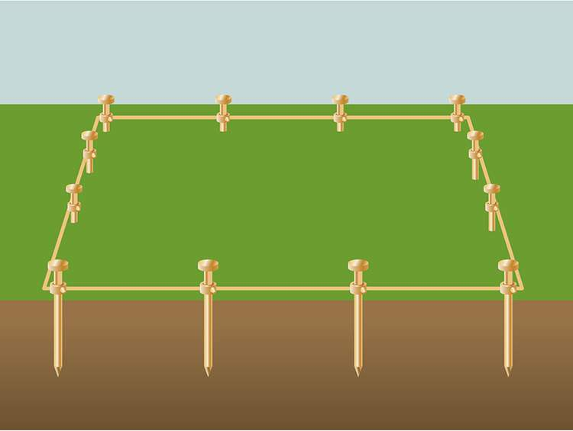
Types of grounding systems
Earth / ground basics
Ground rod group
Typically for lightning protection on larger structures or protection around potential hotspots such as substations.
Ground rod group
Notes:
7

Slide 8
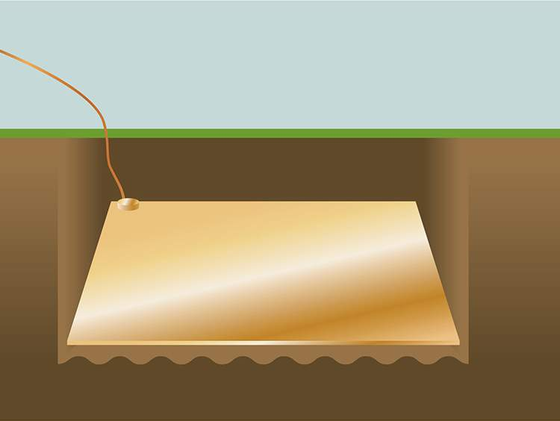
Types of grounding systems
Earth / ground basics
For areas where there is rock (or other poor conducting material) fairly closed to the surface ground plates are preferred as they are more effective
Ground plate
Notes:
8

Slide 9
Soil characteristics
Soil type. Soil resistivity varies widely depending on soil type, from as low as 1 ohmmeter for moist loamy topsoil to almost 10,000 ohm-meters for surface limestone.
Moisture content is one of the controlling factors in earth resistance because electrical conduction in soil is essentially electrolytic.
Notes:
9

Slide 10
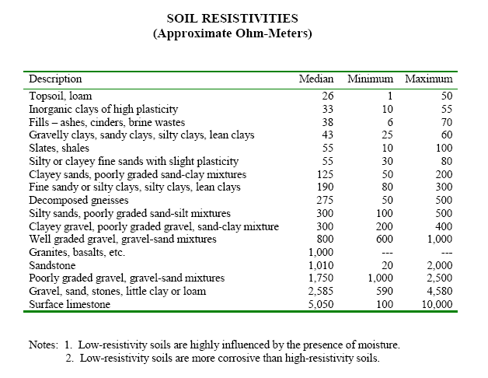
Soil characteristics
Notes:
10

Slide 11
Earthing test
Lightning arrestor earthing clamp tester
Cable(Earthing conductor)
Clamp
Test link
Rod(Earthing electrode)
Rod coupler
Notes:
11

Slide 12
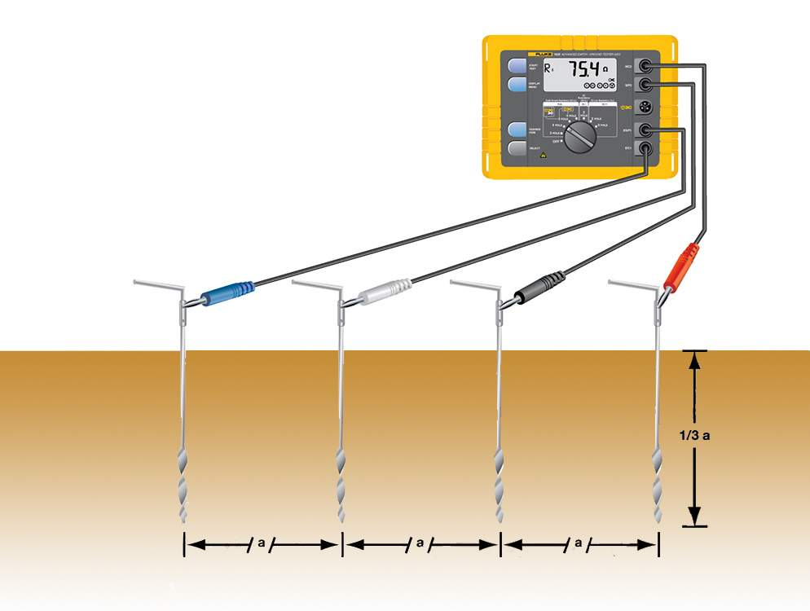
Earthing tester
Resistivity measurement (wenner method)
Resistivity measurements are performed by using a four wired method.
  Used to determine which kind of earthing should be used, so before placing earth stakes.
Notes:
12

