Slide 1
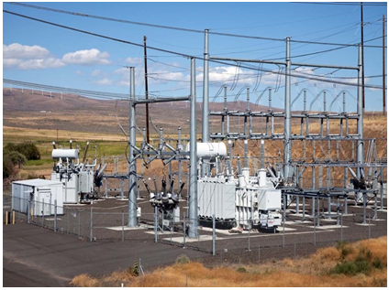
MV Substation Commissioning

Slide 2

CONTENTS
1
Introduction
Page 3
2
Substation commissioning
Page 4
3
Testing of Substation commissioning
Page 6
x
About PMG Engineering
#

Slide 3
Introduction
What is substation commissioning
Proving the proper operation of a newly
  Installed
  Replaced
  Modified
  Repaired
piece of equipment before it is placed into service.
Safety
Always mitigate safety concerns.
  LOTO
  Clearance, Hold, Tag out
  May require help from other departments
  When in doubt, stop

Slide 4
Substation commissioning
Levels of commissioning
  Simple
  Moderate
  Difficult
Simple Checklist
  Fans/Pumps working properly
  All stages
  SCADA alarms
  Simple component replacement should be checked for proper operation.

Slide 5
Substation commissioning
Moderate to difficult commissioning
Intense familiarity with all aspects of the task at hand isn’t always necessary. Sometim es there are other groups involved in the commissioning process. General familiarity with other work groups responsibilities is highly encouraged.
Thorough knowledge and expertise in the responsibilities of the relay technician is required.
Testing proccedure
Communication Processor Programming.
Meter testing.
TOP‐006 testing.
Communication circuit testing.
End to end testing.
Pre check alarm circuits.

Slide 6
Testing of substation commissioning
Measurement of earth-electrode resistances. Reference relevant standards for acceptable values of the earth-electrode resistance values.
Test continuity of all equipotential earth and safety bonding conductors to ground.
Inspection and testing MV and LV switchgear, circuit breakers, and conductors (bus or cable) in accordance with the manufacture’s recommendations.
Inspection and testing of the transformer(s) and associated components. Confirm proper operation of all interlocks (mechanical key and electrical) and all automatic sequences.
Check settings of all protective-relays to ensure proper protection of equipment. Protective relay settings should be based on manufacturer’s recommendations or a short circuit and coordination study.
If applicable, inspection and testing for proper operation of all Fire Alarm and Detection System components of the substation.
Inspection of electrical Personal Protection Equipment.
Verification of phase rotation of all connected equipment.

