Slide 1
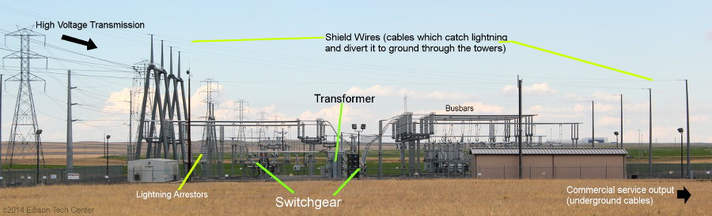
HT Lightning Arresstor

Slide 2

CONTENTS
1
Lightening Arrestor
Page 3
2
Working principle
Page 4
3
Why are lightening arrestors needed?
Page 5
4
Types of lightning arrestors
Page 6
5
Applications
Page 14
x
About PMG Engineering
#

Slide 3

Lightening arrestor
What is a lightening arrestor ?
Device used on electrical power systems to protect the insulation and conductors of the system from the damaging effects of lightning.
The typical lightning arrester has a high-voltage terminal and a ground terminal.
Surge protectors
Smaller versions of lightning arresters, also called surge protectors, are devices that are connected between each electrical conductor in power and communications systems and the Earth.
Notes:
3

Slide 4
Working principle
Working principle
When a lightning surge travels along the power line to the arrester, the current from the surge is diverted through the arrestor, in most cases to earth.
The surge arrester/ protector does not absorb all of the high voltage that passes through it.
It simply diverts it to the ground or clamps it to minimize the voltage that passes through it.
The secret to the arrester's success in diverting lightning or high electrical surges is the MOV or the Metal Oxide Varistor.
Metal Oxide Varisator (MOV):
  The Metal Oxide Varistor or MOV for short, is a voltage dependant resistor in which the resistance material is a metallic oxide, primarily zinc oxide (ZnO) pressed into a ceramic like material.
Notes:
4

Slide 5
Why are lightening arrestors needed?
Lightning is one of nature's most powerful and destructive phenomena
Even though a lightning discharge is of a very short duration (typically 200 microseconds) it is a very real cause of damage and destruction.
Effects of lightning:
  buildings damaged,
  trees blown apart,
  personal injuries and even death.
To protect from all the above stated damages, every major set up requires lightening arrestors.
Notes:
5

Slide 6
Types of lightening arrestors
Major types of arrestors for outdoor applications
Rod arrester
Horn gap arrester
Multi gap arrester
Expulsion type lightning arrester
Valve type lightning arrester
Notes:
6

Slide 7
Types of lightening arrestors
Major types of arrestors for outdoor applications
Rod arrester
  It is one of the simplest forms of the arrester
  There is an air gap between the ends of two rods.
  The one end of the arrester is connected to the line and the second end of the rod is connected to the ground.
  The gap setting of the arrester should be such that it should break before the damage.
  When the high voltage occurs on the line, the gap sparks and the fault current passes to the earth. Hence the equipment is protected from damage.
Notes:
7

Slide 8
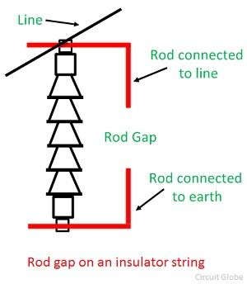
Types of lightening arrestors
Major types of arrestors for outdoor applications
Rod arrester
Notes:
8

Slide 9
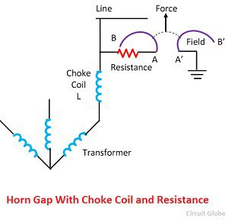
Types of lightening arrestors
Major types of arrestors for outdoor applications
Horn gap arrester
  It consists of two horns shaded piece of metal separated by a small air gap and connected in shunt between each conductor and earth.
  The distance between the two electrodes is such that the normal voltage between the line and earth is insufficient to jump the gap.
  But the abnormal high voltage will break the gap and so find a path to earth.
Notes:
9

Slide 10
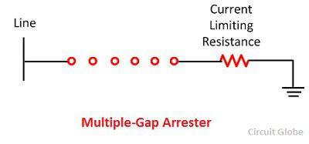
Types of lightening arrestors
Major types of arrestors for outdoor applications
Multi gap arrester
  It consists a series of small metal cylinder insulated from one another and separated by an air gap.
  The first and the last of the series is connected to ground. The number of gaps required depends on the line voltage.
Notes:
10

Slide 11
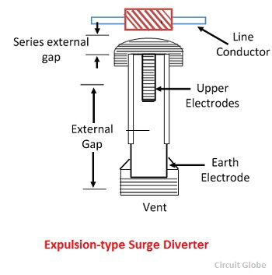
Types of lightening arrestors
Major types of arrestors for outdoor applications
Expulsion type lightning arrester
  It is an improvement over the rod gap in that it seals the flow of power frequency follows the current.
  This arrester consists of a tube made up of fiber which is very effective, isolating spark gap and an interrupting spark gap inside the fiber tube.
Notes:
11

Slide 12
Types of lightening arrestors
Major types of arrestors for outdoor applications
Valve type lightning arrester
  Such type of resistor is called nonlinear diverter.
  It consists of a divided spark gap in series with a resistance element having the nonlinear characteristic.
  The divided spark gap consists of some identical elements coupled in series.
  Each of them consists two electrodes with the pre-ionization device. Between each element, a grading resistor of high ohmic value is connected in parallel.
  During the slow voltage variations, there is no sparks-over across the gap. But when the rapid change in voltage occurs, the potential is no longer evenly graded across the series gap.
Notes:
12

Slide 13
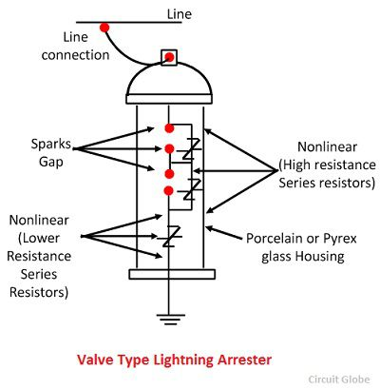
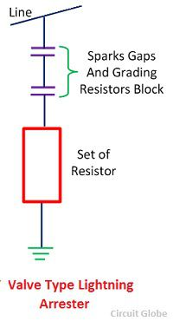
Types of lightening arrestors
Major types of arrestors for outdoor applications
Valve type lightning arrester
Notes:
13

Slide 14
Applications
Major areas of application
Protection of AIS and GIS substation equipment
HVDC protection
Protection of series capacitor banks
Protection of cables
Protection of transmission lines
Polluted areas and areas with high seismic activities
Reference Standard: The designs are type tested according to the IEC 60099-4 , ANSI/IEEEC62.11 and comply with customer specific standards.
Notes:
14

