Slide 1
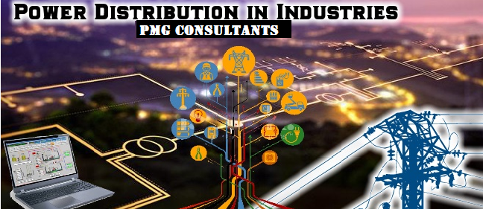
Power Distribution Network

Slide 2

CONTENTS
1
Hierarchy of electrical distribution
Page 3
2
Transformer
Page 4
3
Uninterupted Power Supply (UPS)
Page 6
4
Diesel Generator
Page 8
5
Capacitor Bank
Page 9
X
About PMG Engineering
#

Slide 3

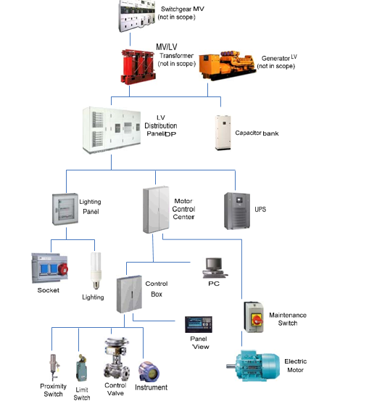
Hierarchy of Electrical Distribution
Electrical distribution- Top to bottom
Notes:
3

Slide 4
Transformer
Working principle
A transformer consists of two electrically isolated coils and operates on Faraday's principle of “mutual induction”
The magnetic flux generated in the primary coil due to voltage & current flowing through it induces EMF in the secondary coil.
Types of Transformers
Transformers are classified into two main categories
  Power transformer
  Distribution transformer
Notes:
4

Slide 5
Transformer
Power transformer
A static piece of apparatus with two or more windings which, by electromagnetic induction, transform a system of alternating voltage and current into another system of voltage and current for the purpose of transmitting electrical power.
Distribution transformer
Also called as a service transformer, it provides the final voltage transformation in the electric power distribution system.
It steps down the voltage used in the distribution lines to the level used by the customer.
Notes:
5

Slide 6
Uninteruppted Power Supply (UPS)
UPS
UPS or battery/flywheel backup, is an electrical apparatus that provides emergency power to a load when the input power source or mains power fails.
Types of UPS
UPS systems can be:
  Online UPS
  Off-line UPS
Notes:
6

Slide 7
Uninteruppted Power Supply (UPS)
Online UPS
The term 'online' comes from the fact that the rectifier (which turns AC into DC) and the inverter (which converts DC into AC) are always being used, even when there is sufficient mains power.
An on-line UPS should have no switch, and the load is supplied via the battery all the time.
Off-line UPS
Also called as standby UPS, it simply passes on the power it receives from the mains directly to the device during normal operations.
In event of blackout, it transfers to battery supply for your equipment
Notes:
7

Slide 8
Diesel Generator
Diesel Generator Set
A combination of diesel engine with electrical generator (often called an alternator) to generate electricity.
DG sets are used in places that have no connection to power grid, and as emergency power-supply if the grid fails.
Distributed Energy Resources
Distributed generation, on-site generation (OSG) or district/decentralized energy is generated or stored by a variety of small, grid-connected devices referred to as distributed energy resources (DER) or distributed energy resource systems.
Notes:
8

Slide 9
Capacitor Bank
Capacitor bank
A group of several capacitors of the same rating that are connected in series or parallel with each other to store electrical energy.
The resulting bank is then used to counteract or correct a power factor lag or phase shift in an alternating current (AC) power supply.
Working
An individual capacitor consists of two conductors which are separated by a dielectric or insulating material.
When current is sent through the conductors, an electric field that is static in nature then develops in the dielectric which acts as stored energy.
Notes:
9

