Slide 1
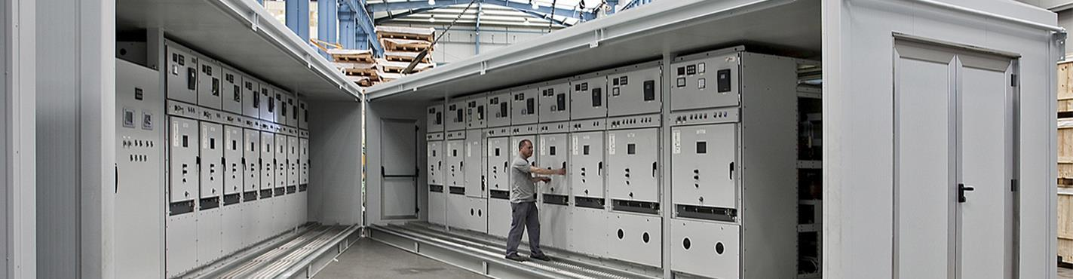
LV/ HV Power Distribution Panels

Slide 2

CONTENTS
1
LT Panel & HT Panel
Page 3
2
Synchronizing Panel
Page 4
3
APFC (Automatic Power Factor Control) Panels
Page 5
4
PCC (Power Control Center) Panels
Page 6
5
MCC (Motor Control Centre) Panel
Page 8
6
VFD Control Panels
Page 10
X
MLDB
Page 10
X
About PMG Engineering
#

Slide 3

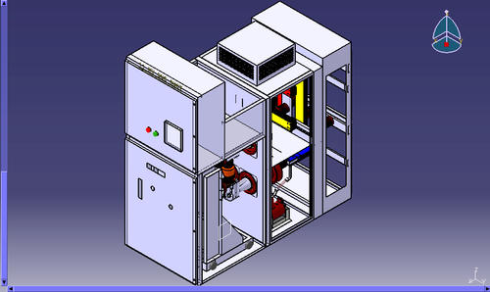
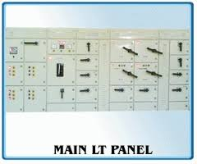
LT Panel & HT Panel
Working
An electrical distribution board that receives power from generator or transformer and distributes the same to various electronic devices and distribution boards. Such panels are used in industries both for internal and external use and, therefore, they are quite rugged to withstand different climatic conditions.
Notes:
3

Slide 4

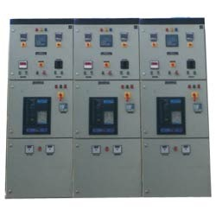
Synchronizing Panel
Working
A Synchronizing Panel works between two or more different power sources like DG sets to manage power supply. Synchronization helps in making different DG sets behave as a virtual single unit and eliminates subdivision of total load. It helps in transferring load from one unit to another as during service period, so that the unit requiring service can be easily shut off. In this way the critical load need not be interrupted and there is no production loss. During low load we can run any single unit and synchronize more units as the load increases. This can be manual or automatic.
Notes:
4

Slide 5
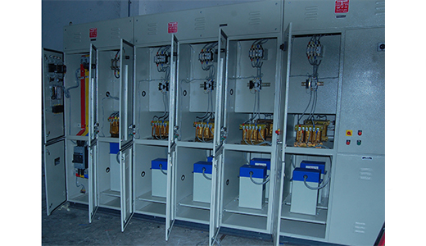
Automatic Power Factor Control Panels
Working
A APFC Panels are used in commercial buildings and industries where there is fluctuation in voltage and power supply. The electrical load required by a unit depends upon the type of machineries, cooling plants and other devices installed. There is always a possibility of damage of these equipment's if power fluctuates. In case of fixed loads, which they can be safeguarded using capacitors, but in case of varied loads, a mechanism to switch in and switch out the capacitors is required which is basically handled using APFC panels.
Notes:
5

Slide 6
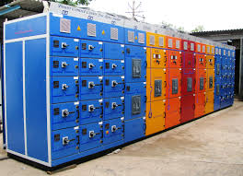
Power Control Center Panels
Working
A Power Control Centre (PCC ) is used for distribution and control of various power source used in industry. Normally Power Control Centers is installed near power source hence fault level is high. It is designed to suit fault level of 50KA or 65 KA for 1 sec. Busbar system in Power Control Centers are designed to suit the fault level as well as temperature rise to 40°c above ambient. Ample space is provided for cable termination. Various protections viz short circuit, overload, earth fault, under voltage etc are provided to protect source and equipment.
Notes:
6

Slide 7
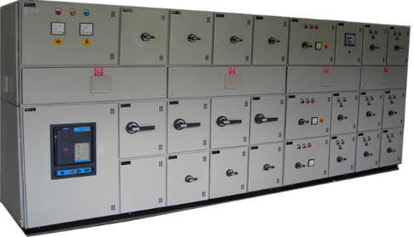
Motor Control Centre Panel
Working
A motor control center (MCC) is an assembly of one or more enclosed sections having a common power bus and principally containing motor control units. Motor control centers are in modern practice a factory assembly of several motor starters. A motor control center can include variable frequency drives, programmable controllers, and metering and may also be the electrical service entrance for the building.
Notes:
7

Slide 8
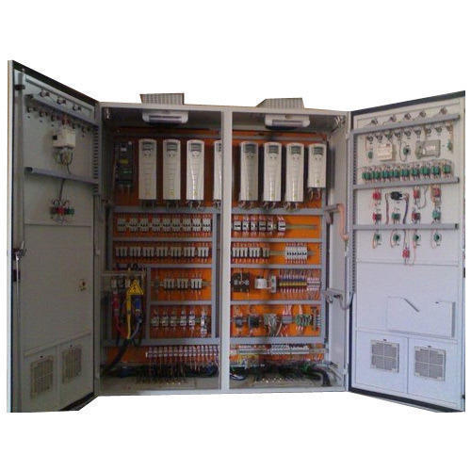
VFD Control Panels
Working
A variable-frequency drive (VFD) also termed adjustable-frequency drive, variable speed drive, AC drive, micro drive or inverter drive) is a type of adjustable-speed drive used in electro-mechanical drive systems to control AC motor speed and torque by varying motor input frequency and voltage.
Notes:
8

Slide 9
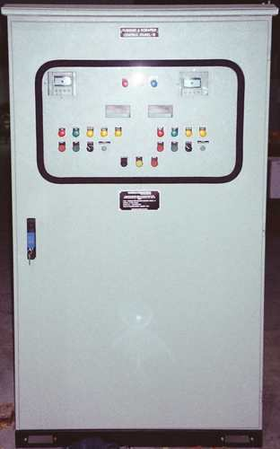
MLDB
working
A distribution board (also known as panel board, breaker panel, or electric panel) is a component of an electricity supply system that divides an electrical power feed into subsidiary circuits, while providing a protective fuse or circuit breaker for each circuit in a common enclosure. Normally, a main switch, and in recent boards, one or more residual-current devices(RCD) or residual current breaker with overcurrent protection(RCBO), are also incorporated.
Notes:
9

