Slide 1
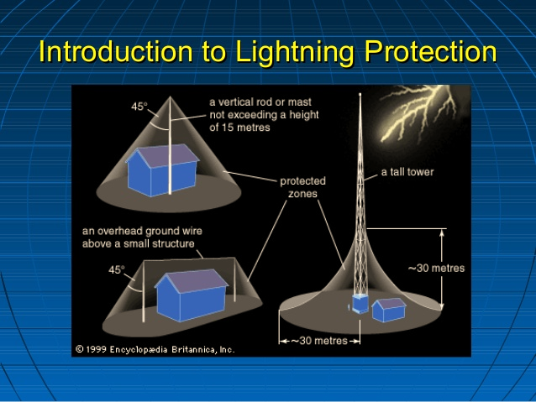
Building Lightning Protection System

Slide 2

CONTENTS
1
Introduction
Page 3
2
Working & principle
Page 4
3
Why are lightning protection system needed?
Page 5
4
Types of lightning arrestors lightning protection system
Page 6
5
Applications
Page 8
X
About PMG Engineering
#

Slide 3

Introduction
What is a lightning protection system?
He role of the building protection system is to protect it against direct lightning strokes.
  The system consists of:
  the capture device: the lightning protection system;
  down-conductors designed to convey the lightning current to earth;
  "crow's foot" earth leads connected together;
  links between all metallic frames (equipotential bonding) and the earth leads.
  When the lightning current flows in a conductor, if potential differences appear between it and the frames connected to earth that are located in the vicinity, the latter can cause destructive flashovers.
Notes:
3

Slide 4
Working Principle
Protection against effects of lightning
The principle consists in creating one or more preferred impact points for a lightning strike using low impedance, conductor elements. These then conduct and dissipate the lightning current into the ground. This coherent system enables the lightning to be captured and dissipated whilst providing protection to the structure. There are five types of lightning protection systems for protecting structures against lightning.
Notes:
4

Slide 5
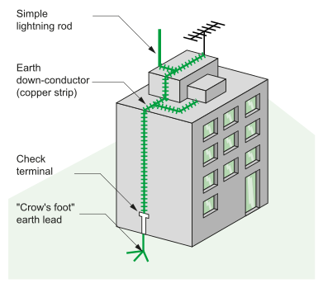
Lightning Protection Types
Lightning protection types
The lightning rod (simple rode or with triggering system).
The lightning rod with taut wires (frame grounded earth belt).
The lightning conductor with meshed cage (faraday cage).
The lightning rod is a metallic capture tip placed at the top of the building. It is earthed by one or more conductors (often copper strips).
Notes:
5

Slide 6
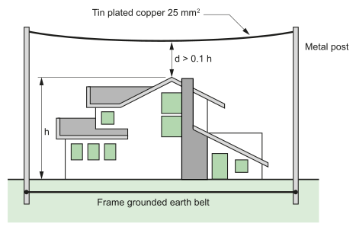
Lightning Protection Types
The Lightning Rod with taut wires (frame grounded earth belt)
These wires are stretched above the structure to be protected. They are used to protect special structures: rocket launching areas, military applications and protection of high-voltage overhead lines.
Notes:
6

Slide 7
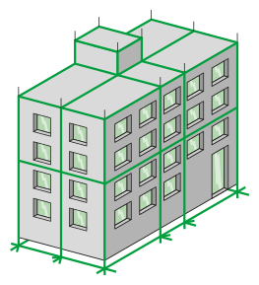
Lightning Protection Types
The Lightning conductor with meshed cage (faraday cage)
This protection involves placing numerous down conductors/tapes symmetrically all around the building. This type of lightning protection system is used for highly exposed buildings housing very sensitive installations such as computer rooms.
Notes:
7

Slide 8
Why Are Building Lightening Arrestors Needed?
In most tropical countries lightning and storm activity is high compared to the more temperate regions the world. For example, in the equatorial belt ten degrees north and south of the equator, thunderday statistics may vary from 150 to 200 days per year.
This may be compared to typical temperature climates where the thundersday may be around 25 or 30 per year.
Since the majority of high technology specialised military, communications, navigational and switching equipment is designed and generally manufactured in these temperate countries, scant regard is often paid to the need to the need to protect this equipment from the devastating effects of lightning strike whether they be direct or indirect.
For this reason, lightning protection against both direct indirect lightning strikes at critical communications and navigational aid sites in tropical regions of the world should be mandatory.
Notes:
8

Slide 9
Lightning Protection Earth Reference Pits
Certain individual down conductors shall be effectively bonded to suitable 3.60m long by 16mm diameter earth rods manufactured from hard drawn copper rod in the form of 1.20m sections. Each section shall be complete with internal screws and socket. The earth reference electrode shall be installed not more than 1.00m away from the building with the earth reference electrode head located not less than 500mm below the ground level. Final connection of the down conductor to the earth reference electrode shall be made by means of a pressure type connector clamp.
The Contract shall include for the supply and delivery of inspection pits manufactured as detailed in the attached Specification Section and/or drawings, these to be handed over to the contractor for installation. An inspection pit shall be supplied for each earth termination. Heavy duty covers suitable to withstand vehicular traffic shall be provided for pits located in the roadway areas. The lid of each pit shall be lockable and jam free construction and supplied with the appropriate key.
Notes:
9

Slide 10
Lightning Protection Earth Reference Pits
Where electrode points are located internally within building floor slabs, they shall comprise a suitable earth rod water seal installed in the base of a pocket formed in the slab, with the pocket and associated cover.
The body of each earth pit shall as a minimum comprise shatter-proof, lightweight, polymer material with a high resistance to chemical damage from such substances as petrol, oil, diesel, bitumen etc. Each unit shall include high ultra-violet stability, wide temperature application and earth bar facility (where necessary) to permit multiple earth tape connections to be made. Where these are not suitable concrete pits shall be provided.
Notes:
10

