Slide 1
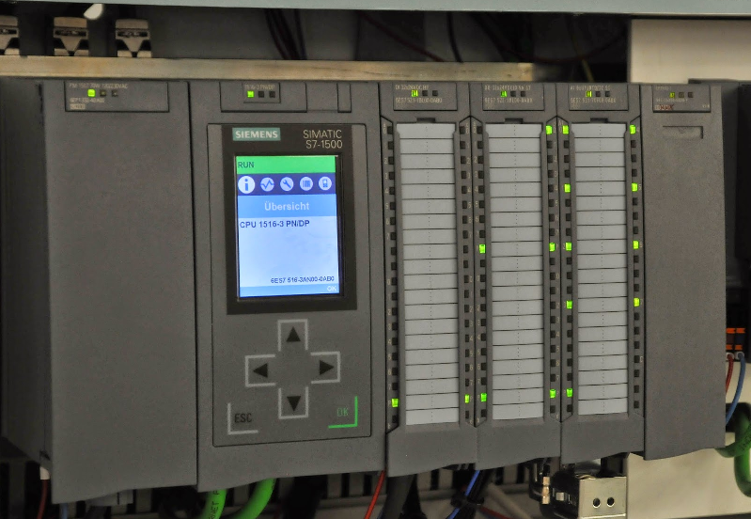
Automation PLC- System

Slide 2

CONTENTS
1
Introduction
Page 3
2
Automation type
Page 4
3
Development of control system
Page 5
4
PLC components
Page 8
5
PLC operation
Page 11
6
Areas of application
Page 12
X
About PMG Engineering
#

Slide 3
Introduction
What is PLC
Programmable Logic Controller (PLC) is an industrial computer that monitors inputs, makes decisions based on its program and controls outputs to automate a process or machine.
The automation of many different processes, such as controlling machines or factory assembly lines is done by using some small computers known as a programmable logic controllers (PLCs).
Why PLC
To reduce human efforts .
To get maximum efficiency from machine and control them with human logic .
To reduce complex circuitry of entire system.
To eliminate the high costs associated with inflexible, relay-controlled systems.
Notes:
3

Slide 4
Automation
Automation
Automation is basically the delegation of human control functions to technical equipment aimed toward achieving:
  Higher productivity.
  Superior quality of end-product.
  Efficient usage of energy and raw materials.
  Improved safety in working conditions etc.
Types of automation
Building automation example: lifts, smoke detectors.
Office automation example: printers, cc TV cameras.
Scientific automation example: rocket launching.
Light automation example: street solar lightening.
Industrial automation example: automated.
Notes:
4

Slide 5
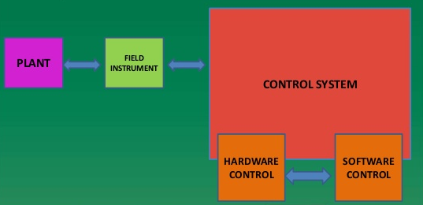
Industrial Automation
The use of computerized or robotic device to complete manufacturing task.
Notes:
5

Slide 6
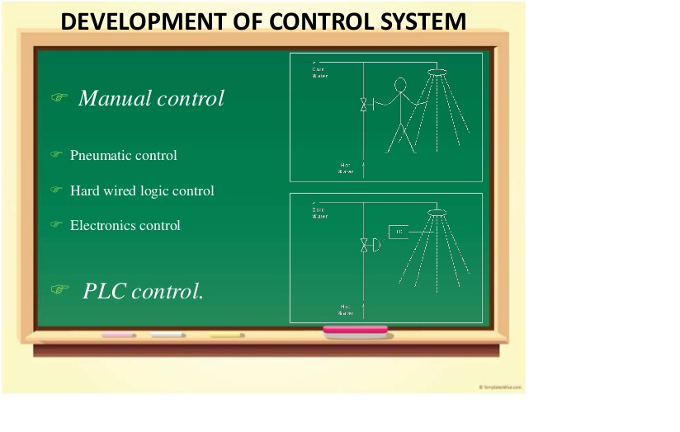
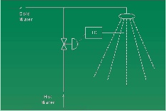
Manual control
Development Of Control System
Manual Control
  Pneumatic control.
  Hard wired logic control.
  Electronics control.
PLC Control

Slide 7
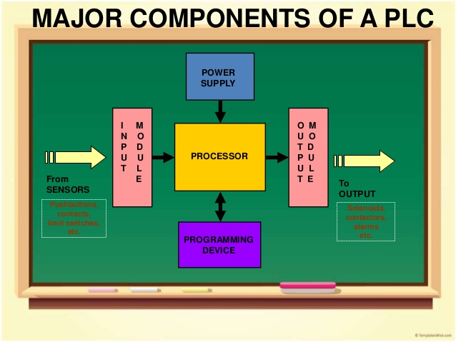
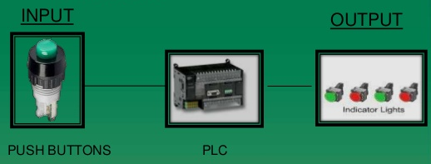
PLC components
Major components of a PLC
Components (input/output)
Input method - Accepts and converts signals from sensor into a logic signal.
  Ex. Switches, Pushbuttons
Output module – that convert control
instructions a signal that can be used by
Actuators.
  Ex. Lamps, alarm
Notes:
7

Slide 8
Components (CPU & Memory)
Central processing unit ( CPU )
It is the brain of PLC and governs the activities of the entire PLC systems
The CPU consists of following blocks :Arithmetic Logic Unit (ALU),Internal memory of CPU Internal timers, counters and Flags
The various operations performed are :Scanning I/O bus traffic control , Program execution, Peripheral and External device communication, Data handling and self diagnostics.
Memory
The component that stores information, programs and data in a PLC.
Types of memories used in PLCs are Read Only Memory (ROM) and Random Access Memory (RAM).
Notes:
8

Slide 9
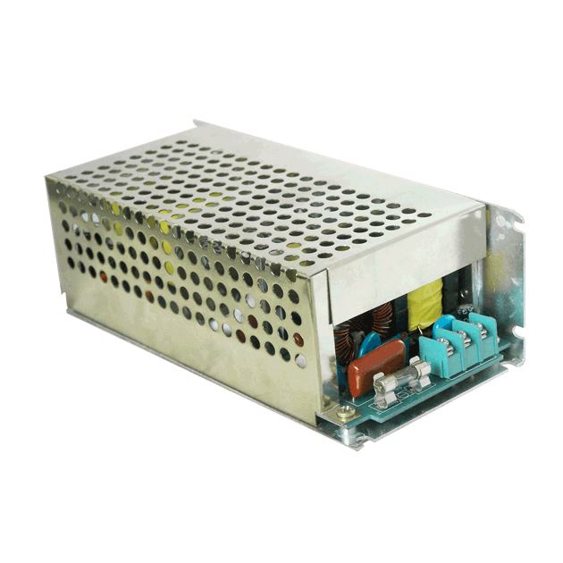
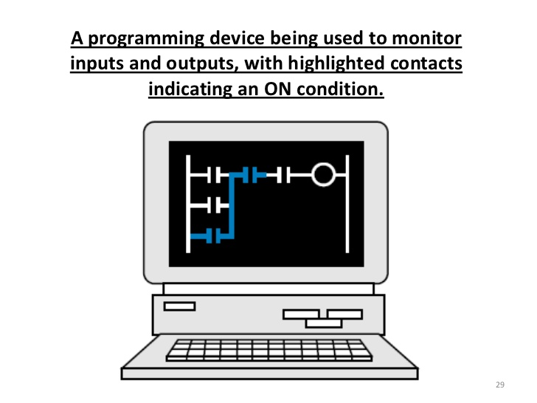
Components (CPU & Memory)
Power supply
Provide the voltage needed to run the primary PLC Components.
Programming device
The programming terminal is used for programming the PLC and monitoring/sequencing PLCs operation.
Notes:
9

Slide 10
PLC Operation
CHECK INPUT STATUS
  First, the PLC takes a look at each I/O to determine if it is on or off.
EXECUTE PROGRAM
  Next, the PLC executes the program one instruction at a time.
UPDATE OUTPUT STATUS
  Finally, the PLC updates the status of the outputs .It updates the outputs based on which inputs were on during the first step.
Notes:
10

Slide 11
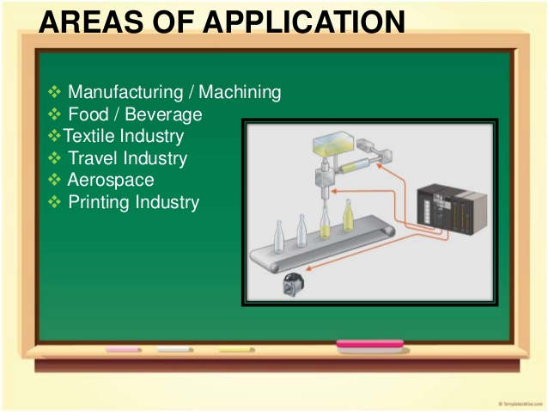
Areas of Application
Manufacturing / Machining.
Food / beverages
Textiles industry
Travel industry
Aerospace
Printing industry
Notes:
11

Slide 12
Areas Of Application
Advantages
Disadvantages
Replacing human operators, dangers environments beyond human capabilities.
Fast
Easily programmed and have an easily understood programming language.
Improves productivity
Improves quality.
PLC devices are proprietary.
Initial costs are high
There's too much work required In connecting wires
Unemployment rate increases
Notes:
12

