Slide 1
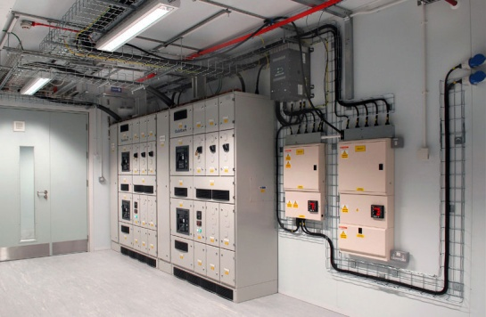
Electrical Room Design

Slide 2

CONTENTS
1
Electrical room definition
Page 3
2
Electrical room design consideration
Page 4
X
About PMG Engineering
#

Slide 3
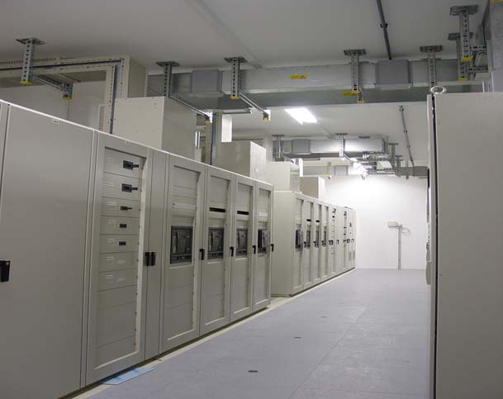
Electrical Room Definition
A room dedicated to containing power distribution equipment mentioned below.
  HT panel room.
  PCC Panel room (main low tension power room)
  UPS room
  PLC (server room)
  Plant MCC room
  Utility MCC room
Electrical room
Notes:
3

Slide 4
Electrical Room Design Consideration
It is good practice to include points of exit from an electrical room at opposite ends of the room. if possible, to help prevent people from being trapped in the event there is a fire.
Electrical room doors must be designed to open in the direction of exit from the electrical room and should be equipped with panic hardware (this must be coordinated with the Architectural engineers, or the person specifying the doors).
Consideration should be given to the potential future need to add or remove major pieces of electrical equipment to rooms/buildings. Doors and access hatches should be sufficiently sized to allow for the removal or addition of large pieces of electrical equipment (transformers, switchgear, generators, etc.). This must be coordinated with the equipment suppliers and Architectural/Structural engineers.
Notes:
4

Slide 5
Electrical Room Design Consideration
Fire alarm and detection (smoke and/or heat) systems are required in all electrical rooms. Some local codes also require fire suppression/ extinguishing systems as well. Where a fire suppression system is provided, it is recommended that a code compliant dry system be installed. Coordinate these requirements with the Fire Protection engineer and Mechanical engineer.
Heat loss calculations for electrical equipment in electrical rooms must be provided in order to properly design the ventilation and cooling system for the room. The heat loss calculations must be given to the responsible Mechanical engineer.
Consult the Lighting GI TM-217.10 for lighting levels in electrical rooms. Lighting fixtures should be located above aisles in electrical rooms and not above electrical equipment. Emergency (battery powered) lighting should be provided in all electrical rooms. Lighting fixture locations must be coordinated with HVAC ductwork, bus trunking, and any piping (fire suppression) which may be located in electrical rooms.
Positive pressurization of electrical rooms near dusty environments is recommended.
Notes:
5

