Slide 1
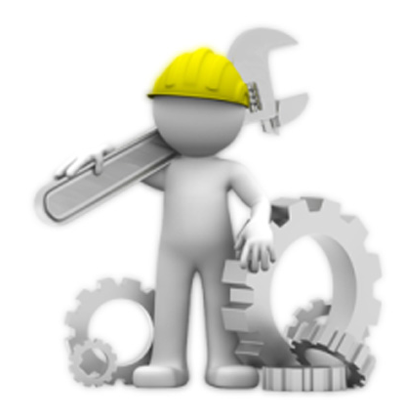
Major\ Minor Electrical Equipment

Slide 2

CONTENTS
1
Major Electrical Equipment
Page 3
2
Minor Electrical Equipment
Page 4
X
About PMG Engineering
#

Slide 3
Major Electrical Equipment
Major electrical equipment
MV/LV Switchgear/Switchboards
Transformers
Motor Control Centers/Panels
Bus bar Trunking
Cable Bus
Generators
UPS (Uninterruptible Power Supplies)
Power Factor Correction equipment (capacitors, controller, contactors, etc.)
Variable Frequency Drives (VFD’s)
Electric Heat Trace
Notes:
3

Slide 4
Minor Electrical Equipment
The following equipment can be considered commodity items which can be covered in a general electrical equipment and installation specification:
  Cable/Wire and Termination kits
  Cable Tray
  Conduit and Conduit Fittings
  Termination/Junction Boxes
  Safety/Disconnect Switches
  Receptacles and Light Switches
  Lighting Fixtures
Notes:
4

