Slide 1
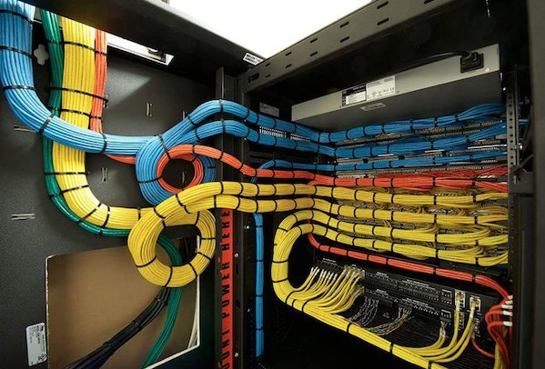
Cable Management

Slide 2

CONTENTS
1
Introduction
Page 3
2
Cable tray material & finishing
Page 4
3
Tray installation applications
Page 5
4
What not to do
Page 7
5
Management types
Page 8
6
Good installation method
Page 19
X
About PMG Engineering
#

Slide 3
Introduction
Cable trays are capable of supporting all types of wiring:
  High Voltage Power Lines.
  Power Distribution Cables
  Sensitive Control Wiring
  Telecommunication Wiring
  Optical Cables
Notes:
3

Slide 4
Cable Tray Material & Finishing
Cable tray materials
Most cable tray systems are fabricated from a corrosion-resistant metal (low- carbon steel, stainless steel or an aluminum alloy) or from a metal with a corrosion-resistant finish (zinc or epoxy).
The choice of material for any particular installation depends on the installation environment (corrosion and electrical considerations) and cost.
  Aluminum.
  Steel
  Stainless Steel
Finishing of Cable Tray
  Galvanized coatings
  Pre-galvanized
  Hot-dip galvanized
Notes:
4

Slide 5
Tray Installation Applications
Cable tray installation applications
A minimum of 300mm of clear space shall be provided from rung-to-rung when multiple cable trays “stacked” vertically.
Cable trays should be bonded at each joint/segment with a bonding plate. This ensures electrical continuity and compliance with the EMC directive.
A sufficiently sized bare copper grounding conductor shall be installed in each cable tray. The ground conductor shall be bonded to each segment of cable tray and shall be bonded to the grounding system its origin and end point. The cable tray shall be bonded to the building structural steel where it enters and exits each room
MV cables shall be installed in dedicated cable trays.
LV power cables and 240/120VAC control cables shall be installed in dedicated cable trays. The LV power cables and AC control cables shall be separated by a metal barrier for the entire length of the installation.
Notes:
5

Slide 6
Installation Applications
Cable tray good installation applications
Signal and network cables shall be installed in dedicated cable trays.
No mixing of electrical cable/wire and pneumatic tubing is permitted within cable trays.
Multiple layers of cables shall be permitted in cables trays in Basic hygiene and lower environments. Care should be taken not to exceed the loading capacity or the allowable cross sectional area fill. Cross sectional area fill limitations are dictated by the IEC and NFPA.
Single-core conductors should be grouped by circuit. All three phases of a circuit should be fastened together in a triangular configuration.
Notes:
6

Slide 7
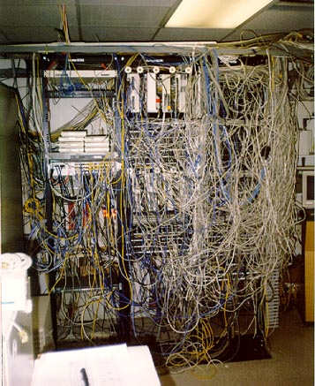
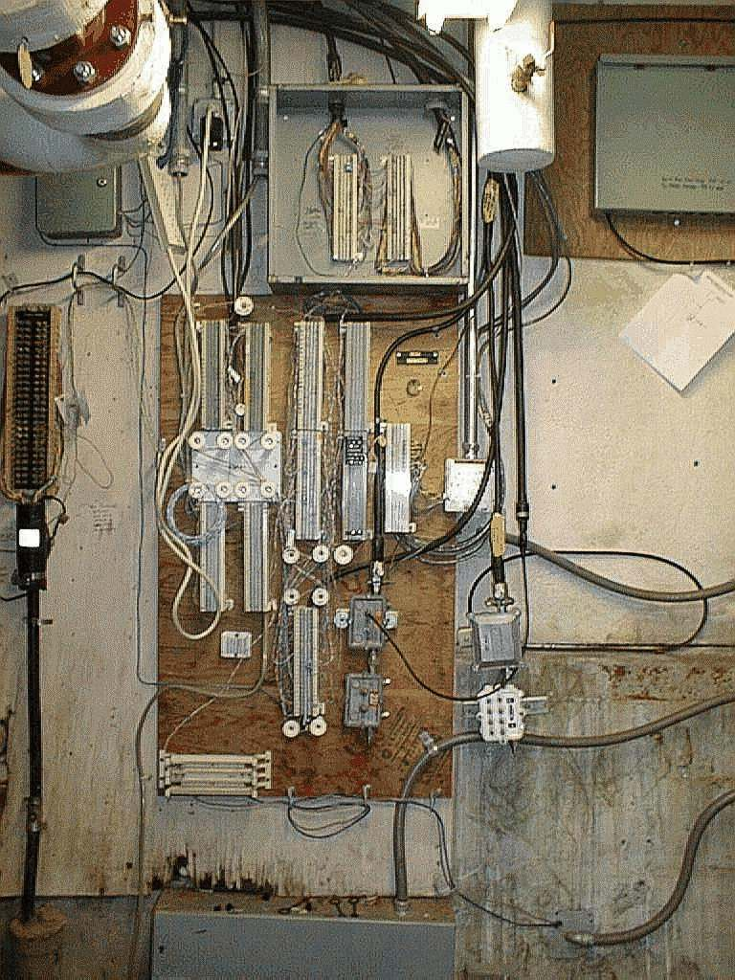
What Not To Do
Notes:
7

Slide 8
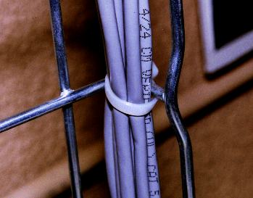
Management Types
There are various types of cable management each giving different degrees and types of protection.
  Used to secure cable to trays, trunking etc.
  Nylon, polypropylene
  Releasable, non-releasable
  Ribbed inner surface to secure cable
Notes:
8

Slide 9
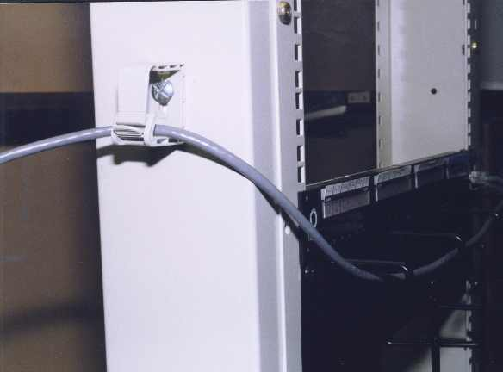
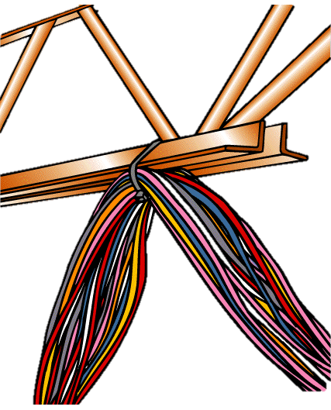
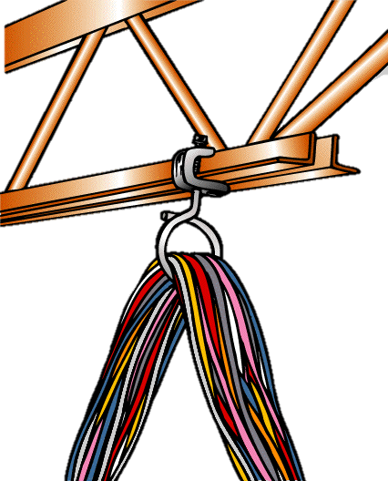
“J” Hook
“J” Hook benefits
Designed for “high performance” cable
Used sparingly over short runs
Limits the need for cable ties
“J” Hooks should not be used as a replacement for cable tray
Notes:
9

Slide 10
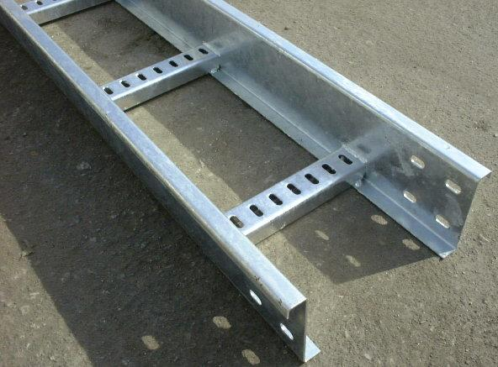
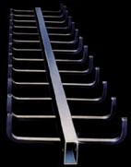
Cable Ladder
Galvanized steel or PVC
Cable secured at rungs
With large bundles cable under pressure at
rungs because its weight is not distributed
along a run.
Notes:
10

Slide 11
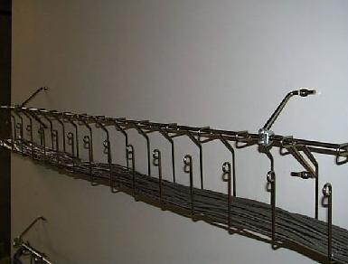
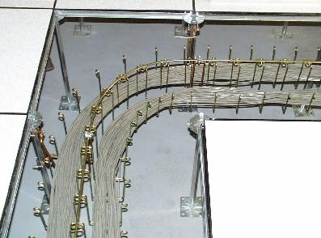
Snake Tray
Similar to cable basket
flexible
easier to install?
Flexible
Notes:
11

Slide 12
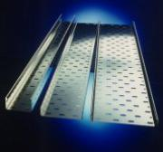
Perforated Tray
Perforated bottom
Horizontal & backbone
Flexible
Access to cable
Curved trays
Asy supports weight of cable along whole run
Notes:
12

Slide 13
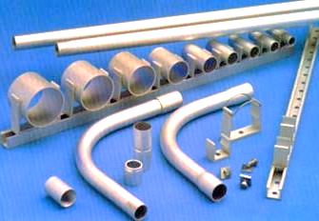
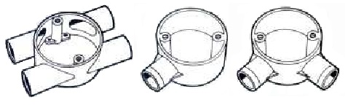
Conduit
Completely Enclosed
No Removable Lid
Galvanized Steel PVC
Access To Cable Limited
Emi protection
Outlet densities low
Medium to long term
Neat & aesthetic
Notes:
13

Slide 14
Conduit Installation Applications
Conduit good installation applications
Rigid metal conduit should use threaded couplings.
Plastic conduit shall only be used underground or embedded in concrete when installed industrial environments.
Local codes should be consulted to ensure conduits are not filled with cable/wire beyond the acceptable levels.
Metal conduit shall not be installed direct buried in earth or encased in concrete, except where the conduit is PVC coated and the conduit terminates at a manhole/ hand hole, or other structure. These PVC coated conduit segments shall be no longer than 3 meters from the point of termination at the structure.
Notes:
14

Slide 15
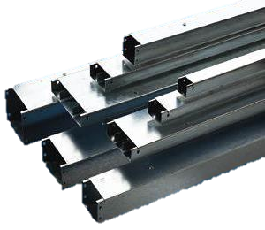
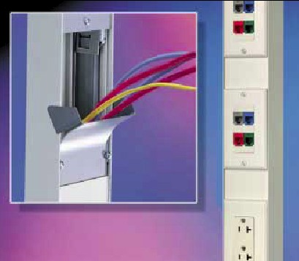
Trunking (Raceway)
Similar to cable tray
Removable lid
  (better protection)
  (EMI & rodent)
Similar to trunking
Visually pleasing
Easily modified
Notes:
15

Slide 16
Raceway Systems
Raceway systems should accommodate the minimum bending radius of cable.
Raceway system supports should be provided at space intervals in accordance with local codes and manufactures recommendations and shall be coordinated with the Structural engineer to ensure that the system is adequately supported.
Expansion and/or deflection fittings shall be provided for raceway systems crossing structural expansion joints, and to account for thermal contraction/expansion in the raceway system.
Separation requirements between MV, LV, extra low voltage (<50V) cable/wire installations vary depending on the country/region. Consult locally adopted codes and standards.
Notes:
16

Slide 17
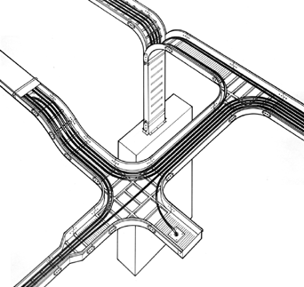
Cable Tray Assemblies
Reference standard - EN 50174
Makes the following recommendations
  European standard submitted to cenelec
  Three parts
    Specification
    Implementation
    Operations
}
Of information
Technology cabling,
Both copper & fibre
Notes:
17

Slide 18
What is EMI?
What is EMI?
Electro magnetic interference
  Describes all kinds of electrical and magnetic interference
Emi is a field that emanates from ‘live’ conductors
  Can travel large distances and interfere with other conductors
Sources of EMI
Some ‘live’ conductors can cause more interference than others
  Depends on several factors, such as the amount of current they are carrying and the amount of screening around the conductor
Fluorescent lighting, substations, motors, switch mode power supplies
Notes:
18

Slide 19
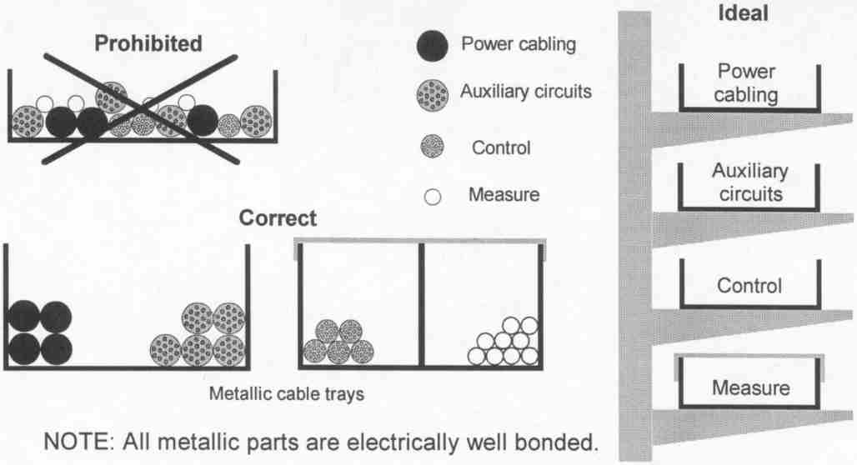
Good Installation Method
Cable tray using method
Notes:
19

Slide 20
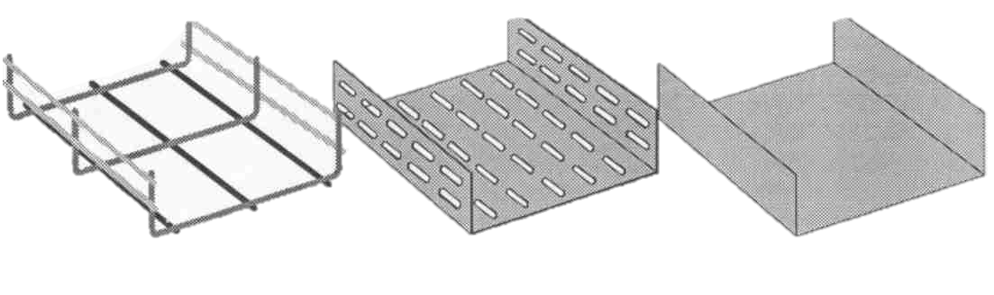
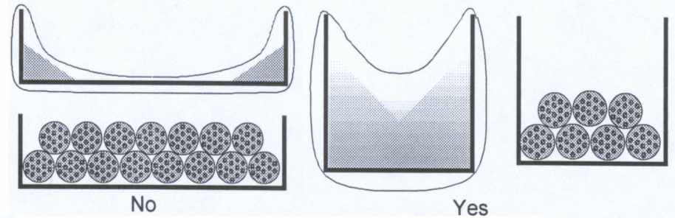
Good Installation Method
Metallic conduits
Emi performance differs with the different tray types
Poor
Good
Better
Notes:
20

Slide 21
Good Installation Method
The bundle height into the cable tray shall be lower than the side walls as illustrated above
Overlapping lids provide more protection
Deep conduits are preferred
Cable support
Proper cat 5 performance will only be achieved with careful cable installation and adequate support
Make sure “your” installations are not part of the 80 % that will not support transmission in the future of 100 mbps and beyond
Notes:
21

