Slide 1
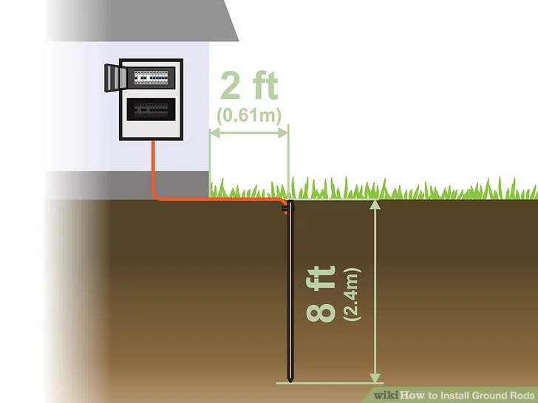
Conventional Earthing And Maintenance Free Earthing

Slide 2

CONTENTS
1
Definition
Page 3
2
Area of Application
Page 4
3
Purpose & Objective
Page 5
4
Conventional Earthing
Page 9
5
Maintenance Free Earthing
Page 14
X
About PMG Engineering
#

Slide 3
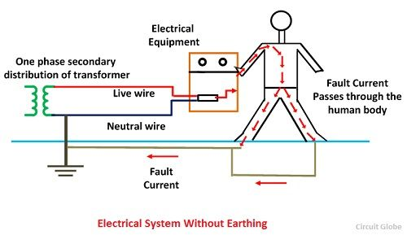
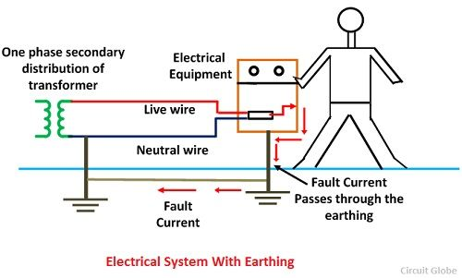
Definition
Electrical Earthing
Process of transferring the immediate discharge of the electrical energy directly to the earth by the help of the low resistance wire.
Done by connecting the non-current carrying part of the equipment or neutral of supply system to the ground
Protects the system and equipment from damage.

Slide 4
AREA OF APPLICATION
Industries
Telecommunication
Transmission
Substations & Power Generations
Transformer Neutral
Lighting Arrestor Earthing
Equipment Body Earthing
Water Treatment Plants
Heavy Industries
College, Hospital, Banks
Residential Building

Slide 5
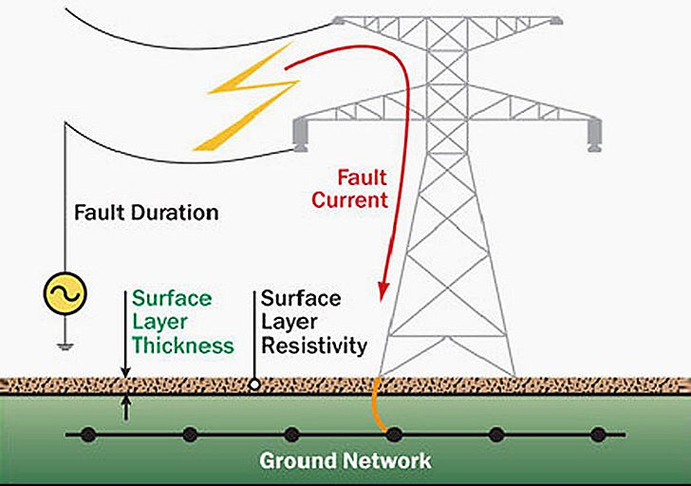
Purpose & Objective
Earthing Helps by
Providing an alternative path for the fault current to flow so that it will not endanger the user.
Ensuring that exposed conductive parts do not reach dangerous potential.
Maintaining the voltage at any part of an electrical system at a known value so as to prevent over current or excessive voltage on the appliances or equipment.

Slide 6
Purpose & Objective
Parameter of Earthing
Must be of low electrical resistance
Must be good corrosion resistance
Must be able to dissipate high fault current repeatedly
Earthing Compound - Bentonite and Marconite. Bentonite is a moisture retaining clay used as an earth electrode back-fill to help lower soil resistivity

Slide 7
Purpose & Objective
Purpose of Earthing
To save human life from danger of electrical shock or death by blowing a fuse i.e. to provide an alternative path for the fault current to flow so that it will not endanger the user.
To protect buildings, machinery & appliance under fault conditions i.e. to ensure that all exposed conductive parts do not reach a dangerous potential.
To provide stable platform for operation of sensitive electronic equipment i.e. to maintain the voltage at any part of an electrical system at a known value so as to prevent over current or excessive voltage on the appliances or equipment
To provide protection against static electricity from friction.

Slide 8
Purpose & Objective
Values for Earthing Resistance
Equipment to be earthed | Max. value of earth resistance to be achieved (in ohm)
Large Power Stations | 0.5
Major Substations | 1.0
Small substations | 2.0
Factories Substations | 1.0
Lattice Steel Tower | 3.0
Industrial Machine and Equipment | 0.5

Slide 9
Conventional Earthing
Why Conventional Earthing
The Conventional system of Earthing calls for digging of a large pit into which a GI pipe or a copper plate is positioned in the middle layers of charcoal and salt.
It requires maintenance and pouring of water at regular interval.
Conventional Earthing uses a copper plate or GI plate buried at the bottom of pit
Optimum conductivity
Proper galvanization
Conventional Earthing has ability to tolerate high current

Slide 10
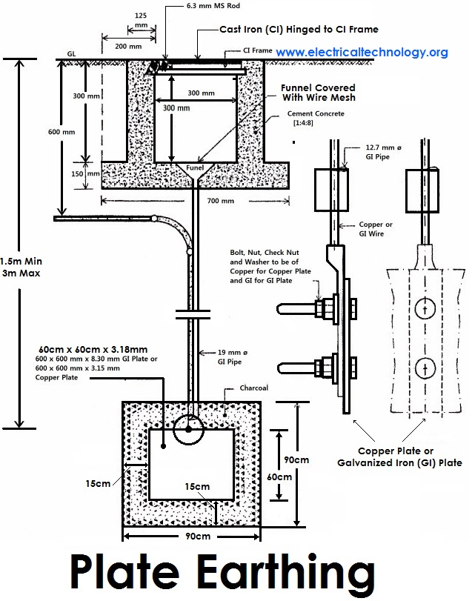
Conventional Earthing
Types of Conventional Earthing
Plate Earthing: Plate of either copper or GI is Used and buried in ground at a depth of not less then 3 M level. Earthing Plate is embedded in alternative layer of coke & Salt of thickness about 15 cm. The earth wire is securely bolted to an earth plate with bolt & nut made of copper or GI.

Slide 11
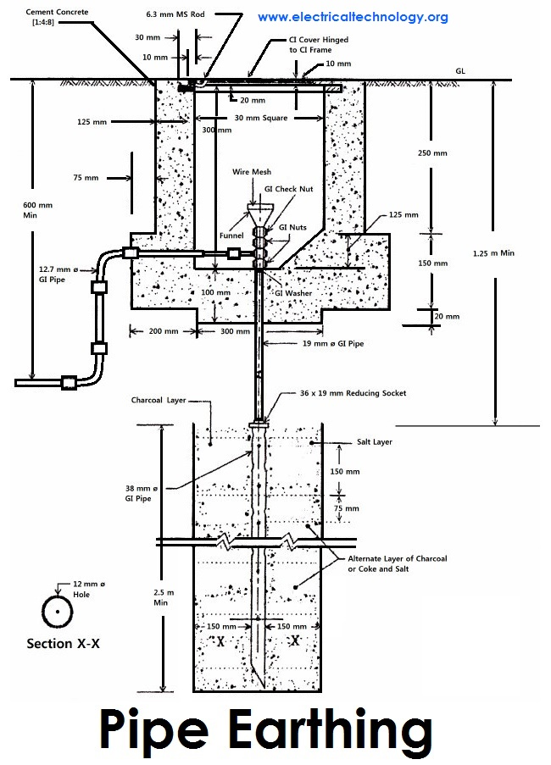
Conventional Earthing
Types of Conventional Earthing
Pipe Earthing: A GI Pipe of 38 mm dia & 2 M length is vertically embedded in ground and wire is embedded upto the wet soil. The earth wire are fastened to the top section of the pipe with nut & Bolts and the Pit area around the pipe is filled with Charcoal and salt.

Slide 12
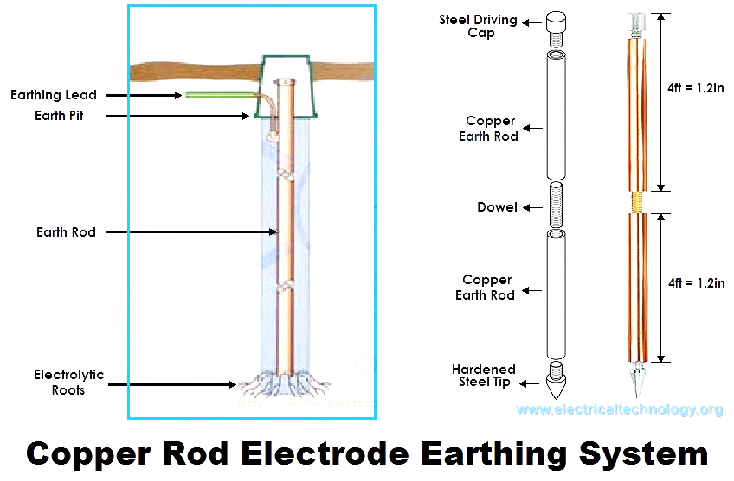
Conventional Earthing
Types of Conventional Earthing
Rod Earthing:- Solid Rod of copper having dimension of 12.5 mm Dia, Solid Rod Of Dia 16 mm or steel hollow section of 25 mm GI Pipe of length not less than 3 m are vertically driven into the earth.

Slide 13
Conventional Earthing
Types of Conventional Earthing
Strip Earthing : A strip Electrod of cross section not less than 25 x 1.6 mm copper or 25 x 4 mm of GI or steel are buried horizontally into trenches of min depth of 0.5 m. The length of buried conductor shall not be less than 15 m.

Slide 14
Maintenance Free Earthing
Why Maintenance Free Earthing
Maintenance free Earthing System is the best alternative of conventional ground rods as it requires lesser space and with few electrodes it can impart excellent resistance.
These systems help in creating a better electrical connection with earth, along with a large conductive surface
Have Maximum Conductivity as the conductive compound creates a conductive zone, which provides the increased surface area for peak current dissipation and also get stable reference point.
Have Great Service Life as there is no need to pour water at regular Interval
Have Optimimum Safety as they maintain stable & consistent earth resistance around the year
And are more Economical

Slide 15
Maintenance Free Earthing
Advantages of Maintenance Free Earthing
Neat & Clean Installation
It is conveniently covered up which can be flagged showing the location of the Earthing
he pipe Earthing is a compact unit & can be installed very near to the equipment
The closeness of the Earthing has a advantage of providing very low resistance value to the system which requires less length of the wire

Slide 16
Maintenance Free Earthing
Why not Conventional Earthing
Use of water makes it bit outdated form of earthing due to alarming rate of water depletion in certain area.
Use of sodium Chloride (common salt) , soft coke & charcoal.
Common Salt is soluble in water causing decay and doesn’t provide consistent ohmic value.
Soft coke & charcoal tend to become ash due to heavy heat generated by heavy electric fault currents generated in the system
Natural rain fall will wash away the charcoal & the soft coke from its main position thereby further deteriorating the functioning.

