Slide 1
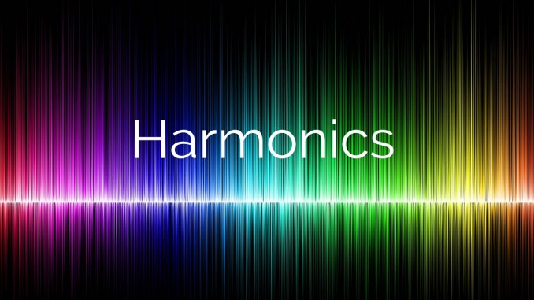
Harmonics

Slide 2

CONTENTS
1
Introduction
Page 3
2
Other factors
Page 5
3
Problems cause by harmonics
Page 6
4
Alert symptoms
Page 8
5
Standards - Harmonic current limits
Page 9
X
About PMG Engineering
#

Slide 3
Introduction
Harmonics definition
Harmonics are deviations from the sinusoidal fundamental ac line voltage and current.
For example, if we consider an electrical power which operates at a frequency of 60 hertz, a harmonic frequency is an integer multiple of this fundamental frequency. So, in a 60-hertz system, the second harmonic would be 120-hertz, the third would be 180-hertz, and so on (similarly, it would be for a 50hz system with harmonic frequencies on 100hz, 150hz, 200hz etc.).
we usually specify these orders by their harmonic number or multiple of the fundamental frequency. for example, a harmonic with a frequency of 180 hz is known as the third harmonic (60x3 = 180). in this case, for every cycle of the fundamental waveform, there are three complete cycles of the harmonic waveforms.
The even multiples of the fundamental frequency are known as even-order harmonics while the odd multiples are known as the odd-order harmonics.
Notes:
3

Slide 4
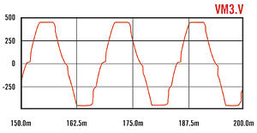
Introduction
Harmonics definition
The addition of any harmonics to the sinusoidal fundamental current or voltage will create distortion. The greater the amplitudes of the harmonics present, the greater the distortion in the electrical waveform. Very simply, whenever a voltage or current does not look like a perfect sinusoidal waveform, it contains harmonics.
Compared to DC motor drives, AC motor drives cause very few problems. However, poorly designed applications can result in power line voltage distortions, as shown in the flat-topped waves on the figure below.
Several flat topping of voltage waveform
Notes:
4

Slide 5
Other factors
These current voltage distortions can cause problems for other equipment connected to the same power lines – resulting in erratic operation of controls, dimming of lights, audible noise on telephone systems, and static on AM and FM radios.
The distribution transformers and cables feeding these drives will also experience additional heating, which reduces the power utilization of those components.
Other factors
As the number of drives employed in automation systems grows, so too does the misconception that drives are the only piece of the puzzle to harmonic problems. While they may comprise a sizable portion of non-linear loads, these are not the only elements in the harmonic equation. That's why it's important to analyze all electrical loads that could potentially cause problems for a system before making any final conclusions.
Notes:
5

Slide 6
Problems cause by harmonics
Harmonic distortion may or may not create a problem for your facility. You may have harmonics present. But experience no adverse effects. However, as harmonic levels increase, the likelihood of experiencing problems also increases. Typical problems include:
  Malfunctioning of microprocessor-based equipment.
  Overheating in neutral conductors. Transformers, or induction motors.
  Nuisance tripping of sensitive equipment causing lost of productivity
  Deterioration or failure of power factor correction capacitors.
  Erratic operation of breakers and relays.
  Pronounced magnetic fields near transformers and switchgear.
Notes:
6

Slide 7
Alert symptoms
Symptoms of harmonic problems include transformers, motors, electrical panels, and building wiring that appears not to be overloaded but are overheating.
Harmonics can cause overloading of conductors and transformers and overheating of utilization equipment, such as motors.
Triple harmonics (3rd, 9th and 15th order) originated by electronic equipment can especially cause overheating of neutral conductors on 3-phase, 4-wire systems. While the fundamental frequency and even harmonics cancel out in the neutral conductor and, odd-order harmonics are additive. Even in a balanced load condition, neutral currents can reach magnitudes as high as 1.73 times the average phase current.
This additional loading may have different implications; such as tripping of protection devices or creation of additional heat, which may eventually break down the insulation of the neutral conductor. In extreme cases, it can break down the insulation between windings of a transformer. The fire hazard in these cases is a major issue.
Notes:
7

Slide 8
Standards
The Institute of Electrical and Electronics Engineers (IEEE) has attempted to define acceptable levels of current harmonic distortion and voltage harmonic distortion.
These limits are now the basis by which most systems are defined. The intent of IEEE Standard 519-1992 is to make users responsible for limiting current harmonics injected into the power system, hence limiting voltage distortions.
Notes:
8

Slide 9
Harmonic current limits
Notes:
9

