Slide 1
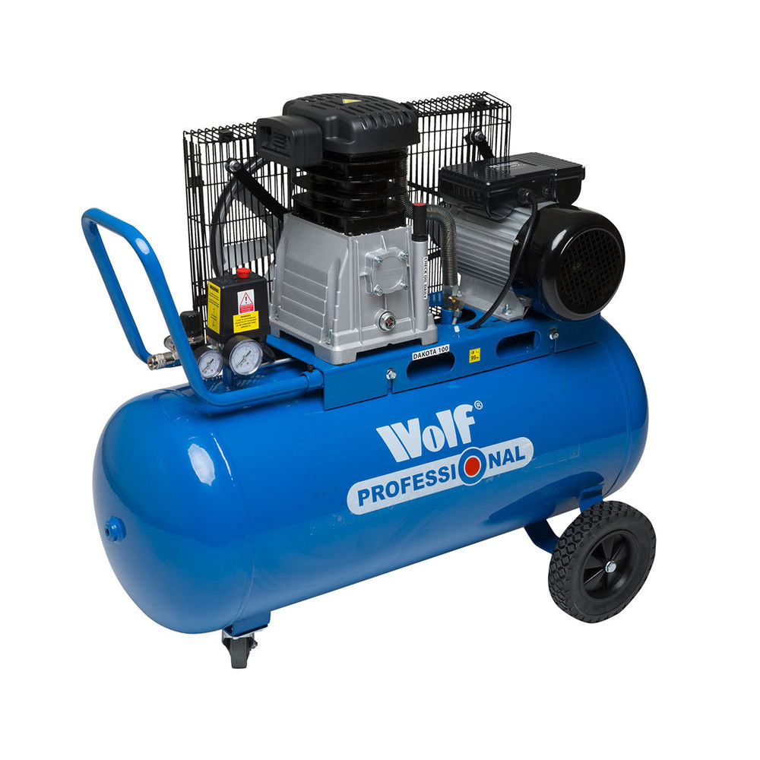
Air compressor

Slide 2

CONTENTS
1
Introduction
Page 3
2
Working Principle
Page 5
3
Types of air compressor
Page 7
4
Uses of Compressed Air
Page 8
5
Maintenance Practices
Page 9
X
About PMG Engineering
#

Slide 3
Indroduction
Air Compressor
A machine that extracts air from the atmosphere and compresses it into a holding chamber.
A machine that converts power “using an electric motor, diesel or gasoline engine, etc.” into potential energy stored in pressurized air. The energy contained in the compressed air can be used for a variety of applications; e.g. Utilization of kinetic energy of the air to get higher velocities for various usage
Notes:
3

Slide 4
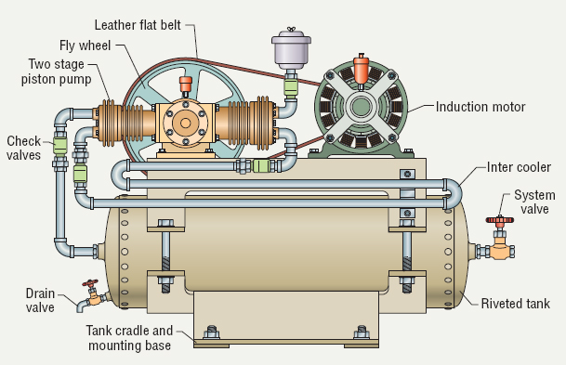
Indroduction
Air Compressor
Notes:
4

Slide 5
Working principle
Basic Components
The basic components of an air compressor
  Engine
  Storage Tank
In an air compressor, air is compressed by pulling in atmospheric air, reducing its volume and increasing its pressure.
Storage tank is used to hold the pressurized air & it releases the air as per requirement.
Notes:
5

Slide 6

Working principle
Basic Components
Pressure Gauge, Safety Valve are used for monitoring & assuring the safe operation.
The inlet valve is what allows air into the machine to be compressed as the piston pushes upward and keeps the inlet valve shut, which in turn opens the discharge valve which allows the air taken in through the inlet to be compressed.
Notes:
6

Slide 7
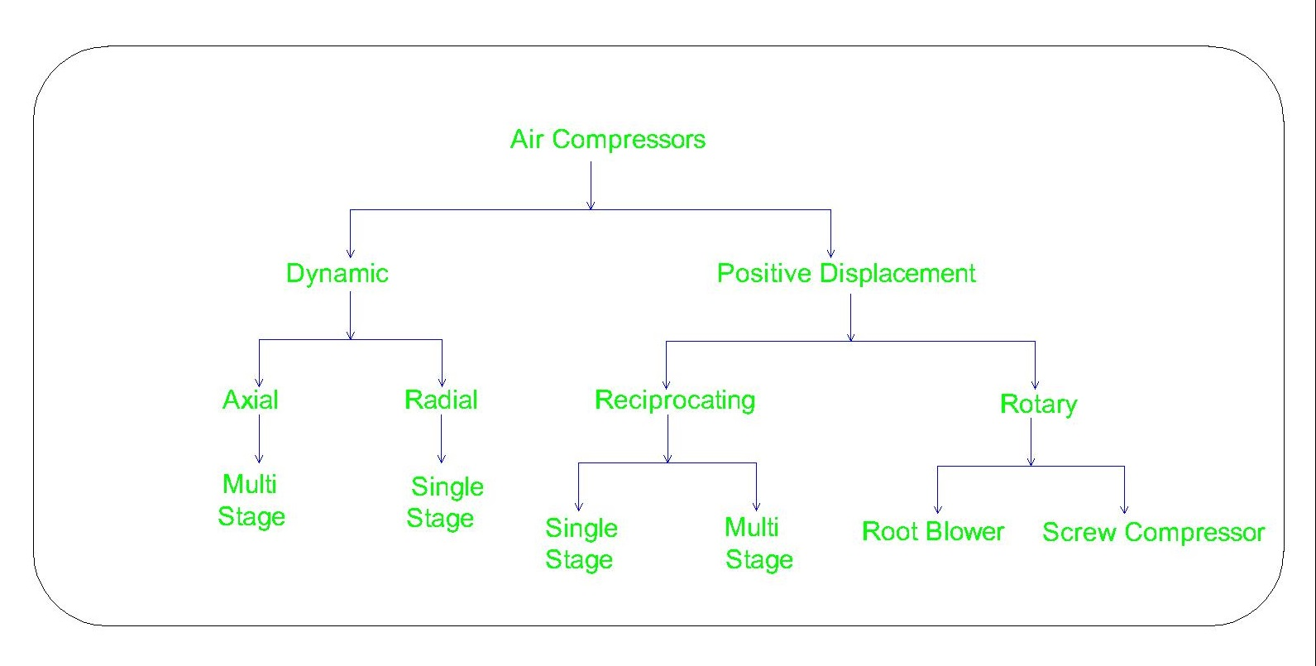
Types of air compressor
Classification
Notes:
7

Slide 8
Uses of compressed air
Compressed air is used in many industries for various purposes:
  Pneumatic Control -Actuators, Dosing Pumps
  Process: Pneumatic Conveying, Pumping, Dust Collection, Concrete lifting, Cleaning
  Power Tools: Hammers, Breakers
  Manufacturing - Abrasive jet machining
Notes:
8

Slide 9
Maintenance of air compressor
Need to focus on
  Cooling Oil
  Filters
  Dynamic Parts - Belt, Fans, Valves
  Regulatory - Pressure Gauges, Safety Valve’s
Notes:
9

