Slide 1
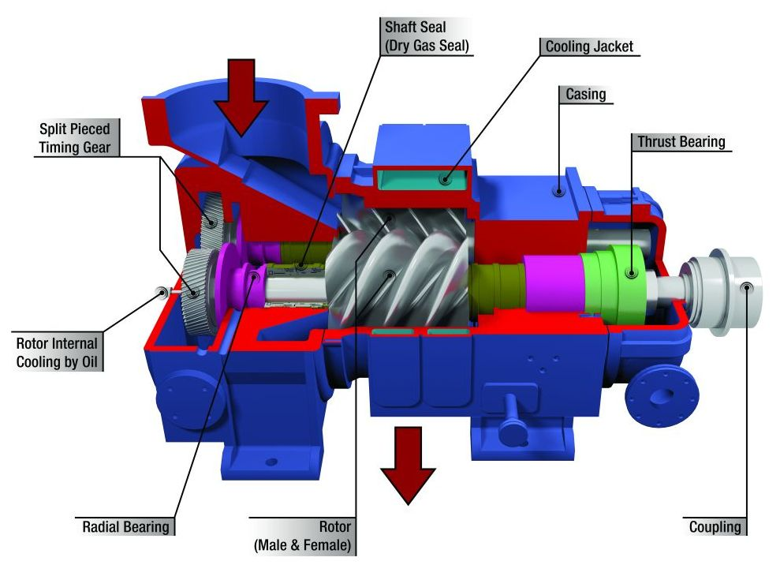
Types of air compressor

Slide 2

CONTENTS
1
Types of Air Compressors
Page 4
2
Positive displacement air compressor
Page 5
3
Dynamic air compressor
Page 12
X
About PMG Engineering
Page 8

Slide 3
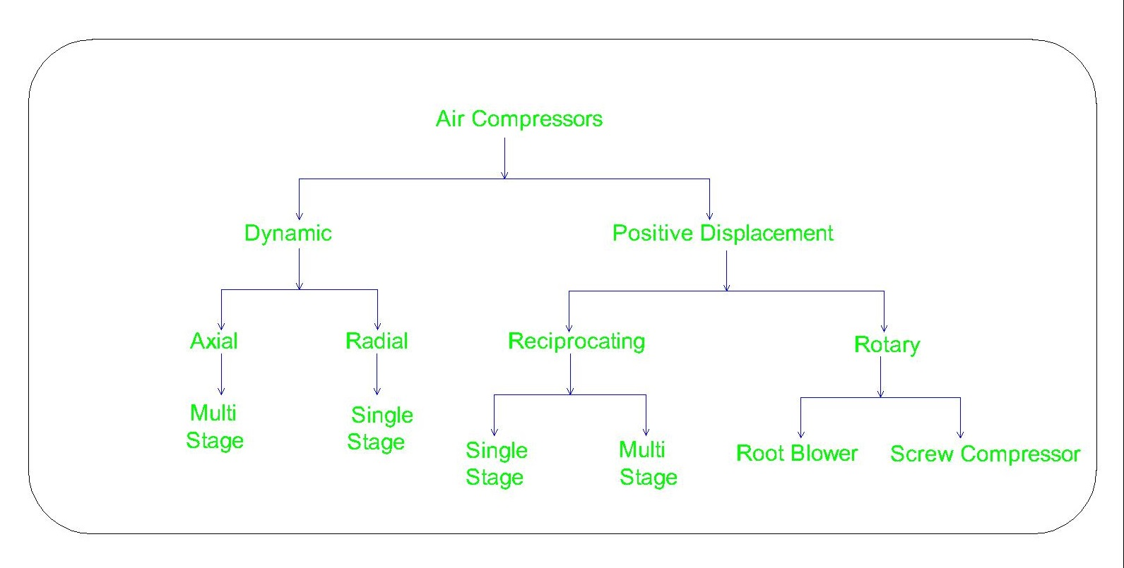
Types of air compressor
Classification
Notes:
3

Slide 4

Positive displacement air compressor
Positive displacement compressors draw in and capture a volume of air in a chamber, then reduce the volume of the chamber to compress the air.
  Compresses the fluid in continuous manner.
  The velocity of fluid must be high.
  Gives variable flow rate against variable output pressure.
  The fluid is provided kinetic energy which is converted into pressure energy.
List of Positive displacement type of Air Compressor
  Reciprocating Piston Compressors
  Rotary Screw Compressors
Notes:
4

Slide 5
Positive displacement air compressor
Reciprocating Piston Compressors
A reciprocating compressor or piston compressor is a positive-displacement compressor that uses pistons driven by a crankshaft to deliver gases at high pressure. There are two type of compressors as following:
  Single Acting
  Double Acting
Notes:
5

Slide 6
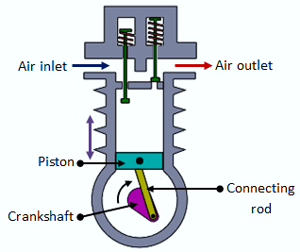
Positive displacement air compressor
Reciprocating Piston Compressors
Single acting- It means that air is drawn in and compressed on one side of the piston. The other side is exposed to the crankcase of the compressor. In this case, the downward stroke of the piston draws in the air, and the upward stroke compresses it.
Notes:
6

Slide 7
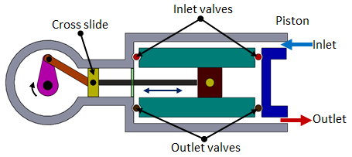
Positive displacement air compressor
Rotary Air Compressor
Double acting- Its type reciprocating compressors have compression chambers on both sides of the piston. On the down stroke, air is drawn in on the top of the piston while air is compressed on the bottom side. On the upstroke, air is drawn into the bottom side while air is compressed on the top side.
Notes:
7

Slide 8
Positive displacement air compressor
Rotary Air Compressor
A rotary compression pump works in cycles. Over each cycle a volume is created in contact with the chamber where pressure is to be lowered. By random motion, molecules from the vacuum chamber pass into the volume created by the pump.
Types of Rotary Air Compressor
  Root blower Compressor
  Screw Compressor
Notes:
8

Slide 9
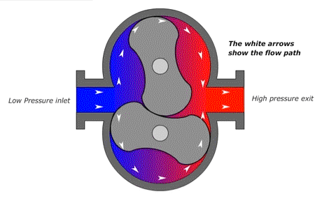
Positive displacement air compressor
Root Blower Compressor
The Roots type blower is a positive displacement lobe pump which operates by pumping a fluid with a pair of meshing lobes. A root Blower Consist of Two Rotors With Lobes Rotating in an airtight Casing. The Casing has inlet and outlet parts on opposite sides.
Notes:
9

Slide 10
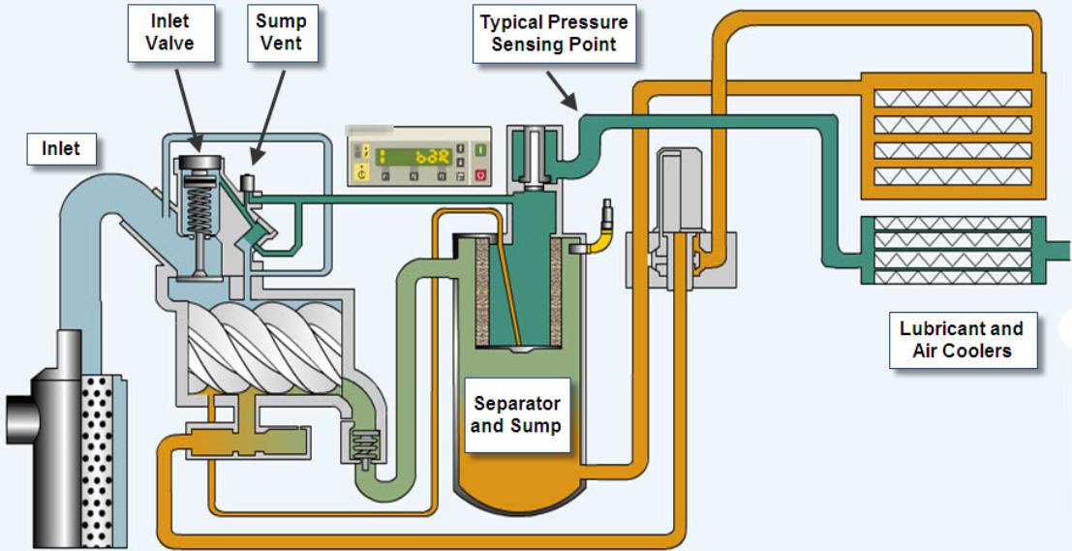
Positive displacement air compressor
Screw Air Compressor
A rotary-screw compressor is a type of gas compressor that uses a rotary-type positive-displacement mechanism.
Rotary-screw compressors use two meshing helical screws, known as rotors, to compress the gas.
The meshing rotors force the gas through the compressor, and the gas exits at the end of the screws.
Notes:
10

Slide 11
Dynamic air compressor
Dynamic compressors instead speed up the air to high velocity, and then restrict the air flow so that the reduction in velocity causes pressure to increase.
Dynamic compressors are capable of delivering large volumes of air but little pressure (0.5-3bar).
Dynamic compressors are two types these are following
  Axial Air Compressor
  Radial or centrifugal Air Compressor
Notes:
11

Slide 12
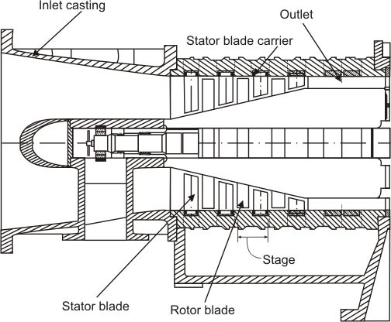
Dynamic air compressor
Axial Air Compressor
Axial type compressor use a set of fan blades in line to generate large air flow, pressures from this method aren’t expected to reach much over 0.5bar. The axial compressors are largely used for ventilation and as part of air processing.
Notes:
12

Slide 13
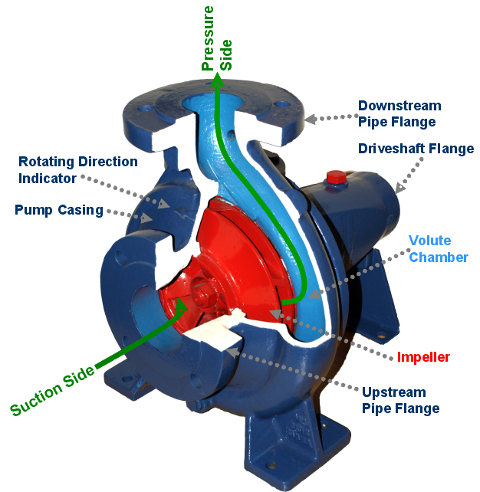
Dynamic air compressor
Centrifugal Air Compressor
Centrifugal compressors draw in air to the center of an impeller, and then accelerate it outward toward its perimeter. There it impinges upon a diffuser plate and outlet scroll, where velocity decreases and pressure increases
Notes:
13

