Slide 1
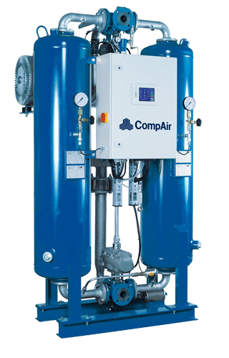
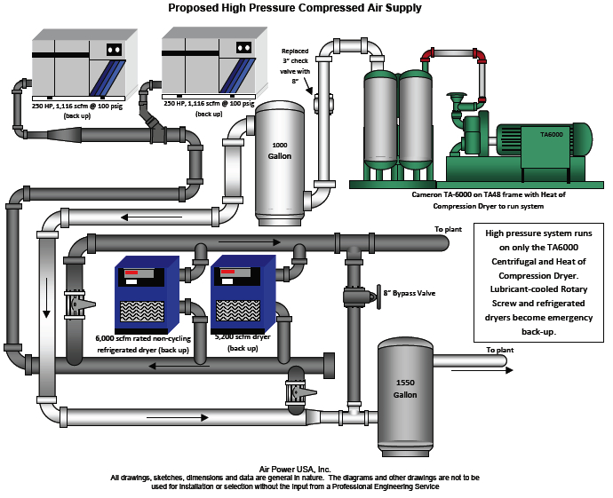
Centralized vs dedicated compressed air system

Slide 2

CONTENTS
1
Centralized System
Page 3
2
Advantage & Disadvantage of Centralized System
Page 3
3
Dedicated System
Page 4
4
Advantage & Disadvantage Dedicated System
Page 4
X
About PMG Engineering
#

Slide 3
Centralized air compressor
Centralized System
A central air system satisfies total air demand for total plant operations. Air provided by one or more compressors is distributed from a central supply point to areas requiring air service. Compressors in such a system are commonly installed in a power-house area with other utilities.
Advantages
  Lower capital cost per unit output
  Lower total installed compressor capacity.
  Heat recovery potential greater, if hot water is required.
Disadvantages
  Major Space Requirement.
  Leakage losses could be greater due to larger distribution network.
Notes:
3

Slide 4
Dedicated air compressor
Dedicated Air Compressor
In a dedicated air system, several air compressors are located at principal points of us through out the plant. This approach can be used instead of, or in combination with, the central type.
Advantages
  Low capital cost for step changes.
  Possibility of selecting lubricated/ unlubricated according to local requirement.
  Saving on distribution system.
Disadvantages
  Equipment tends to be less Robust.
  Smaller machines tend to be less efficient.
Notes:
4

