Slide 1
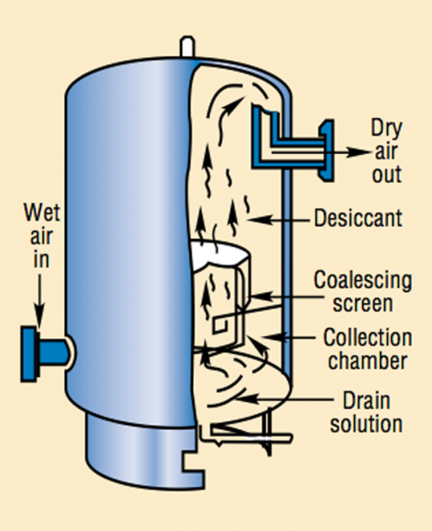
Types of air dryer

Slide 2

CONTENTS
1
Introduction
Page 3
2
Types of Air Dryer
Page 4
×
About PMG Engineering
#

Slide 3

Introduction
Air Dryer
Air dryer is used for removing water vapor from air. Air dryers are commonly found in a wide range of industrial and commercial facilities. The process of air compression concentrates atmospheric contaminants, including water vapor.
Notes:
3

Slide 4
Types of air dryer
Types of Air Dryer
There are various types of compressed air dryers. Their performance characteristics are typically defined by the dew point.
  Regenerative desiccant dryer
  Refrigerated dryer
  Deliquescent dryer
  Membrane dryer
Notes:
4

Slide 5
Types of air dryer
Regenerative Desiccant Dryer
The compressed air is passed through a pressure vessel with two towers filled with a media such as activated alumina, silica gel, molecular sieve or other desiccant material.
This desiccant material attracts the water from the compressed air via absorption. As the water clings to the desiccant, the desiccant bed becomes saturated.
The dryer is timed to switch towers based on a standard NEMA cycle, once this cycle completes some compressed air from the system is used to purge the saturated desiccant bed by simply blowing the water that has adhered to the desiccant off.
There tower name are following:
  Drying tower
  Regenerative tower
Notes:
5

Slide 6
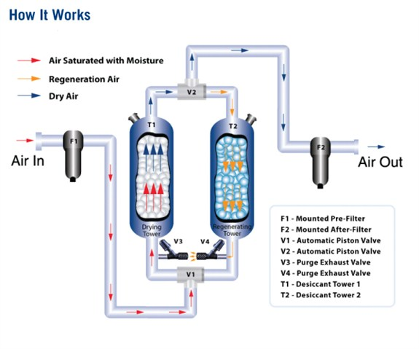
Types of air dryer
Regenerative Desiccant Dryer
Notes:
6

Slide 7
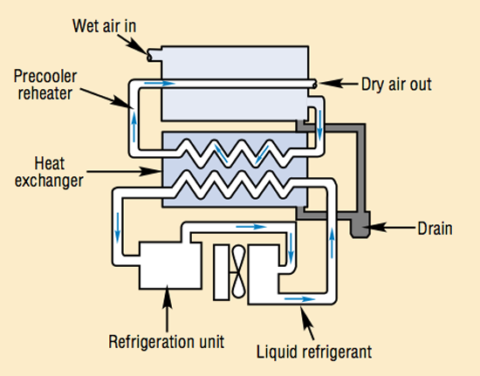
Types of air dryer
Refregerated Dryer
Refrigeration dryers employ two heat exchangers, one for air-to-air and one for air-to-refrigeration. There is also a single TRISAB heat exchanger that combines both functions.
The compressors used in this type of dryer are usually of the hermetic type and the most common gas used is R-134a and R-410a for smaller air dryers up to 100 CFM. Older and larger dryers still use R-22 and R-404a refrigerants.
  A refrigerated dryer delivers a dew point not lower than
  Approximately 35 °F (2 °C)
Notes:
7

Slide 8

Types of air dryer
Deliquescent Dryer
A deliquescent dryer typically consists of a pressure vessel filled with a hygroscopic medium that absorbs water vapor.
The medium gradually dissolves or deliquesces to form a solution at the base of the pressure vessel.
The liquid must be regularly drained from the vessel and new medium must be added. A deliquescent dryer delivers a dew point suppression that fluctuates with air temperature.
Typically, this suppression is 20 °F (11 °C) below the compressed air temperature.
Notes:
8

Slide 9
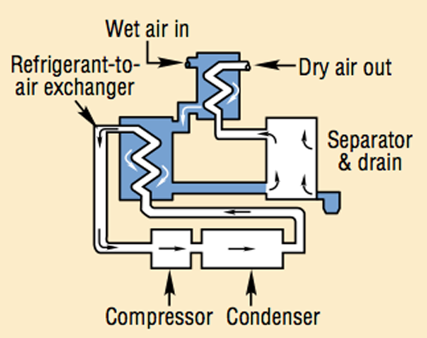
Types of air dryer
Membrane Dryer
In a Membrane dryer the compressed air is first filtered with a high-quality coalescing filter.
This filter removes liquid water, oil and particulate from the compressed air. In order to desorb the water Vapors the partial flow of dried air expanded to atmospheric and passed through outside of the hollow fiber bundle in counter flow direction which will flush out the moisture.
Notes:
9

