Slide 1
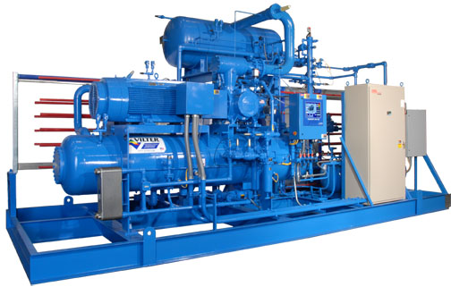
Refrigeration & It’s Scope In Industry

Slide 2

CONTENTS
1
Introduction
Page 3
2
Types of Refrigeration
Page 4
3
Vapour Compression Refrigeration
Page 5
4
Vapour Absorption Refrigeration
Page 10
5
Application of Refrigeration
Page 15
6
It’s Scope in Industry
Page 16
X
About PMG Engineering
#

Slide 3
Introduction
Refrigeration
It is a process of removing heat from a low-temperature reservoir and transferring to a high-temperature reservoir.
It also includes the process of reducing heat & maintaining the temperature of a body below the general temperature of its body.
In refrigeration system heat is being generally pumped low level to higher one & rejected at that temperature.
Notes:
3

Slide 4
Types of Refrigeration System
Vapour Compression Refrigeration (VCR)
  (Uses mechanical energy)
Vapour Absorption Refrigeration (VAR)
  (uses Thermal energy)
Notes:
4

Slide 5
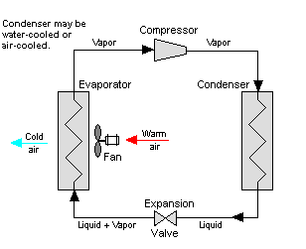
Vapour Compression Refrigeration
Vapour Compression Refrigeration
Vapour compression refrigeration system (VCRS) , in which the refrigerant undergoes phase changes, is one of the many refrigeration cycles and is the most widely used method for air-conditioning of buildings and automobiles.
Notes:
5

Slide 6
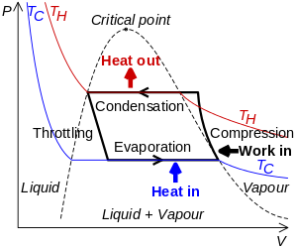
Vapour Compression Refrigeration
Pressure Volume Diagram
Notes:
6

Slide 7
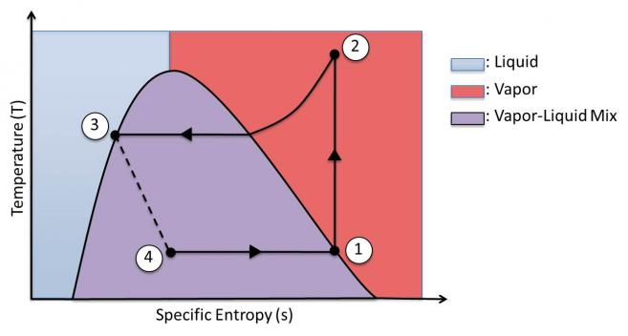
Vapour Compression Refrigeration
Temprature Entropy Diagram
Notes:
7

Slide 8
Vapour Compression Refrigeration
Working of Vapour Compression Refrigeration Cycle
Components & it’s working of Vapour compression Refrigeration system.
Condenser- The refrigerant enters the Condenser at high pressure high temperature & gets condensed . Condenser is water type cooled.
Expansion- It reduce refrigerants pressure. The cycle starts when refrigerant enters the compressor in a low-pressure, moderate-temperature, gaseous form In order for the higher temperature fluid to cool, the flow must be limited into the evaporator to keep the pressure low and allow expansion back into the gas phase.
Evaporator- In low pressure low temperature. To absorb outer air. It convert liquid refrigerants to vapour refrigerants .
Compressor- High pressure and high temperature. It is a process to raise the refrigerant pressure, as it flows from an evaporator .
Notes:
8

Slide 9
Vapour Compression Refrigeration
Vapour Absorption Refrigeration Cycle
Vapour Absorption Refrigeration - The vapor absorption refrigeration system comprises of all the processes in the vapor compression refrigeration system like compression, condensation, expansion and evaporation.
In vapor absorption system, the refrigerant used is ammonia, water or lithium bromide. The refrigerant gets condensed in the condenser and evaporated in the evaporator.
The refrigerant produces cooling effect in the evaporator and releases the heat to the atmosphere via the condenser.
Notes:
9

Slide 10
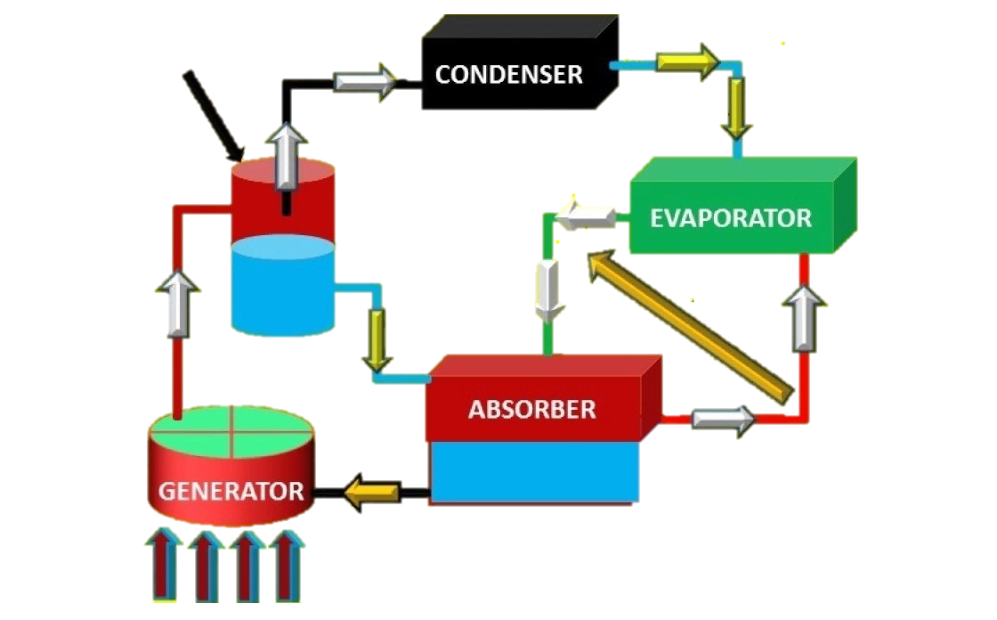
Vapour Absorption Refrigeration Cycle
Vapour Absorption Refrigeration Cycle
Ammonia in water
Ammonia separator
Ammonia vapour
Ammonia vapour + hydrogen mixture
Ammonia vapour
+
water
Heat transfer
weak
solution
Hydrogen gas
Strong solution
Notes:
10

Slide 11
Vapour Absorption Refrigeration Cycle
Vapour Absorption Refrigeration Cycle
Pressure Volume Diagram
Notes:
11

Slide 12
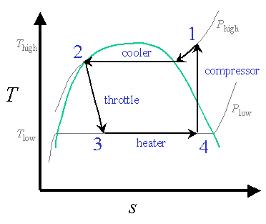
Vapour Absorption Refrigeration
Vapour Absorption Refrigeration
Temperature Entropy Diagram
Notes:
12

Slide 13
Vapour Absorption Refrigeration
Vopour Absorption Refrigeration
Components & working of Vapour Absorption Refrigeration Cycle
  Condenser- The refrigerant enters the Condenser at high pressure high temperature & gets condensed . Condenser is water type cooled.
  Expansion Valve- When the refrigerant passes through the expansion valve, its pressure and temperature reduces suddenly. This refrigerant (ammonia in this case) then enters the evaporator.
  Evaporator- The refrigerant at very low pressure and temperature enters the evaporator and produces the cooling effect. In the vapor compression cycle this refrigerant is sucked by the compressor, but in the vapor absorption cycle, this refrigerant flows to the absorber that acts as the suction part of the refrigeration cycle.
Notes:
13

Slide 14
Vapour Absorption Refrigeration
Components of Absorption Refrigerationn Cycle
Components & working of Vapour Absorption Refrigaration Cycle
  Pump -When the absorbent absorbs the refrigerant strong solution of refrigerant-absorbent (ammonia-water) is formed. This solution is pumped by the pump at high pressure to the generator. Thus, pump increases the pressure of the solution to about 10bar.
  Generator - The refrigerant-ammonia solution in the generator is heated by the external source of heat. This is can be steam, hot water or any other suitable source. Due to heating the temperature of the solution increases. The refrigerant in the solution gets vaporized and it leaves the solution at high pressure
  Absorber - The absorber is a sort of vessel consisting of water that acts as the absorbent, and the previous absorbed refrigerant. Thus, the absorber consists of the weak solution of the refrigerant (ammonia in this case) and absorbent (water in this case).
Notes:
14

Slide 15
Applications Of Refrigeration System
Applications of Refrigeration System
Applications of Refrigaration system
  Air conditioning homes and public buildings, and refrigerating foodstuffs in homes, restaurants and large storage warehouses. The use of refrigerator in kitchens for storing fruits and vegetables has allowed adding fresh salads to the modern diet year around and, storing fish and meats safely for long periods. Optimum temperature range for perishable food storage is 3 to 5 °C (37 to 41 °F).
Notes:
15

Slide 16
Refrigeration Future Scope In Industry
Future Scope
Refrigeration futute scope in industry- In tropical country like india with varying climate condition and seasons of gluts and scarcity .
Refrigeration has very important role to play in the preservation of perishables e.g. Meat, Poultry ,Fish ,Crustaceans ,Frog legs ,Fruits ,Vegitables,Bakery and Dairy Products etc.
Freezing of Foods is well recognized all the world over the best method of preservation of foods ,yielding of products in quality very close to that of the fresh ones .
Rapid Strides have accordingly been made in the refrigeration and freezing of foods in in industry . In refrigeration system product are good and fresh keep more days.
Notes:
16

