Slide 1
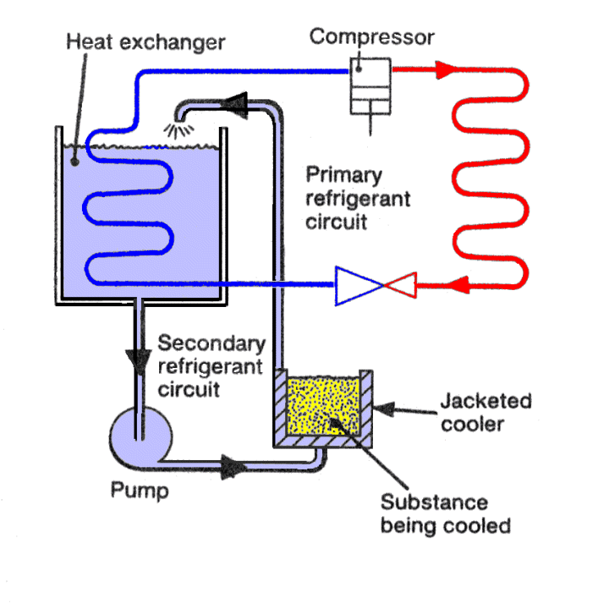
Refrigeration Process

Slide 2

CONTENTS
1
Refrigeration Cycle
Page 3
2
Refrigeration System
Page 12
3
Refrigerant
Page 25
X
About PMG Engineering
#

Slide 3

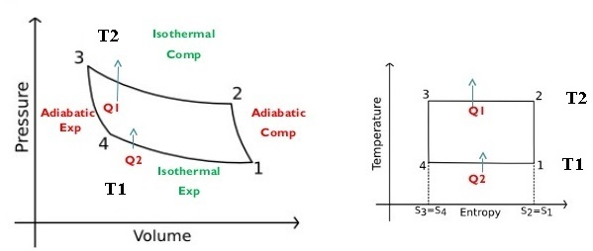
Refrigeration Cycle
Reverse Carnot Cycle
If refrigeration system working on reversed Carnot cycle it will gives maximum possible coefficient of performance.
It uses air as working medium.
At Point 1 , P1, V1, T1, be the pressure, volume and temperature of air respectively.
Notes:
3

Slide 4
Refrigeration Cycle
Reverse Carnot Cycle
Isentropic Compression Process (1-2):-
  In that process air is compressed isentropically, during this process pressure of air increases from p1 to p2 . Specific volume decreases from v1 to v2. Temperature increases from T1 to T2.
  Isothermal Compression Process (2-3):-
  In that process air is compressed isothermally, during this process pressure of air increases from p2 to p3 . Specific volume decreases from v2 to v3.
  Heat rejected by air during isothermal compression ,
  Q2-3=T3(S2-S3)=T2(S2-S3)
Notes:
4

Slide 5
Refrigeration Cycle
Reverse Carnot Cycle
Isentropic Expansion Process (3-4):-
  In that process air is expanded isentropically, during this process pressure of air decreases from p3 to p4 . Specific volume increases from v3 to v4. Temperature increases from T3 to T4.
Isothermal Expansion Process (4-1):-
  In that process air is expanded isothermally, during this process pressure of air decreases from p4 to p1 . Specific volume increases from v4 to v1.
  Heat absorbed by air during isothermal Expansion ,
  Q4-1=T4(S1-S4)=T4(S2-S3)=T4(S2-S3)
Notes:
5

Slide 6
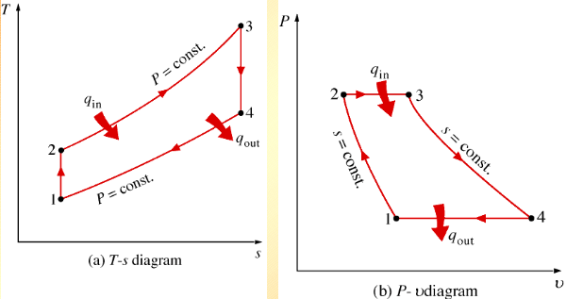
Refrigeration Cycle
Reverse Brayton Cycle
It consist of a compressor, cooler, expander and refrigerator.
It uses air as working medium.
At Point 1 , p1, v1, T1, be the pressure, volume and temperature of air respectively.
Notes:
6

Slide 7
Refrigeration Cycle
Reverse Brayton Cycle
Isentropic Compression Process (1-2):-
  Cold air from the refrigerator is drawn into the compressor cylinder where it is compressed isentropically in the compressor .
  During the compression stroke both pressure and temperature increases and the specific volume of air at delivery from compressor reduces v1 to v2.
  In that process no heat is absorbed or rejected.
  Constant Pressure Cooling Process (2-3):-
  The warm air from the compressor is now passed into the cooler, where it is cooled at constant pressure P3=P2, reducing the temperature T2 to T3.
  Specific Volume also reduces V2 to V3 .Heat rejected by the air during constant pressure per kg of air,
  Q2-3= Cp(T2-T3)
Notes:
7

Slide 8
Refrigeration Cycle
Reverse Brayton Cycle
  Isentropic Expansion Process(3-4):-
  The air from the cooler is now drawn into the expander cylinder where it is expanded isentropically from pressure p3 to the refrigerator pressure p4 which is equal to the atmospheric pressure.
  The temperature of air during expansion falls from T3 to T4. Specific volume of air at entry to the refrigerator increases from v3 to V4 . In that no heat is absorbed .
Notes:
8

Slide 9
Refrigeration Cycle
Reverse Brayton Cycle
  Constant Pressure Expansion Process(4-1):-
  Cold air from the expander is now passed to the refrigerator where it is expanded at constant pressure p4=p1. Temperature of air increases from T4 to T1. Due to heat from refrigerator specific volume of the air changes from V4 to V1.
  Heat absorbed by the air during constant pressure expansion per kg of air
  Q4-1= Cp(T1-T4)
Notes:
9

Slide 10
Refrigeration Cycle
Coefficient of Performance of Refrigerator
It is the ratio of heat extracted in the refrigerator to the work done on the refrigerant.
Also known as theoretical coefficient of performance.
Theoretical COP = Q / W .
Where;
  Q = Amount of heat extracted in the refrigerator.
  W = Amount of Work Done.
Notes:
10

Slide 11
Refrigeration Cycle
Coefficient of Performance of Refrigerator
It is the process of removing heat from a substance under controlled conditions.
Also, the process of reducing and maintaining the temperature of a body below the general temperature of its surrounding.
It means continued extraction of heat from a body.
Unit Of Refrigeration
Practical Unit of Refrigeration is expressed in terms of Tonne OF Refrigeration.
  It is defined as the amount of refrigeration effect produced by the uniform melting of one tone (1000 kg) of ice from and at 00C in 24 hours.
  Since the latent heat of ice 335kg/kg, therefore one tone of refrigeration,
  1TR=1000X335 KJ in 24 Hours = 232.6 kJ/min.
Notes:
11

Slide 12
Refrigeration System
Methods of Refrigeration System
Simple Air-Cooling System
Simple Air Evaporative Cooling System
Boot Strap Air-Cooling System
Boot Strap Air Evaporative Cooling System
Reduced Ambient Air-Cooling System
Regenerative Air-Cooling System
Notes:
12

Slide 13
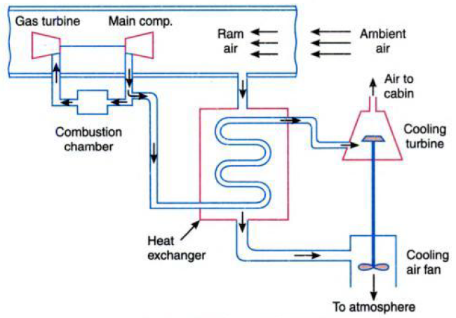
Refrigeration System
Simple Air-Cooling System
Notes:
13

Slide 14
Refrigeration System
Simple Air-Cooling System
Main Components of this system compressor which is driven by gas turbine, heat exchanger, cooling turbine and cooling air fan.
Air required for refrigeration system is bled off from the main compressor.
This high pressure and temperature air is cooled initially in the heat exchanger, where ram air is cooled easily.
It Is further cool in the cooling turbine by the process of expansion.
Work of this turbine is used to drive the cooling fan which draws cooling air through the heat exchanger.
This system is good for ground surface cooling and for low flight speed.
Notes:
14

Slide 15
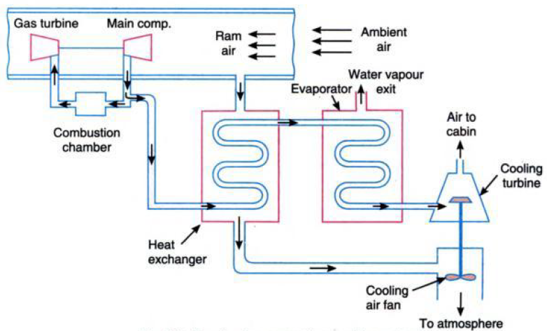
Refrigeration System
Simple Air Evaporative Cooling System
Notes:
15

Slide 16
Refrigeration System
Simple Air Evaporative Cooling System
It is similar to the simple cooling system except that the addition of an evaporator between the heat exchanger and cooling turbine.
The evaporator provides an additional cooling effect through evaporation of refrigerant such as water.
At high altitude the evaporative cooling may be obtained by using alcohol or ammonia
Water, ammonia and alcohol have different refrigerating effect at different altitude.
At 20,000 meters height water boils at 40⁰C, alcohol at 9⁰C and ammonia at -70⁰C.
Notes:
16

Slide 17
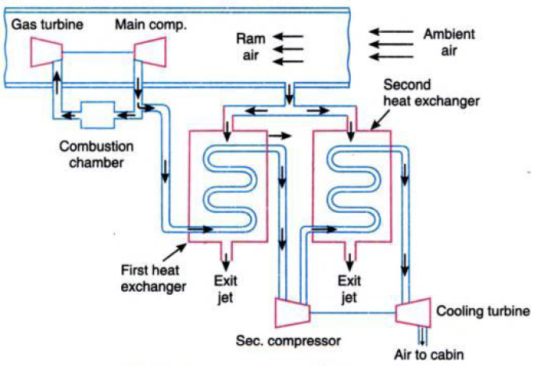
Refrigeration System
Boot Strap Air Cooling System
Notes:
17

Slide 18
Refrigeration System
Boot Strap Air Cooling System
It consist of two heat exchanger instead of one and cooling turbine drives a secondary compressor instead of cooling fan.
The air bled from the main compressor is first cooled by the ram air in the first heat exchanger.
These cooled air after compression in the secondary compressor is led to the second heat exchanger , where it is again cooled by the ram air before passing to the cooling turbine.
This type of cooling system is mostly used in transport type aircraft.
Notes:
18

Slide 19
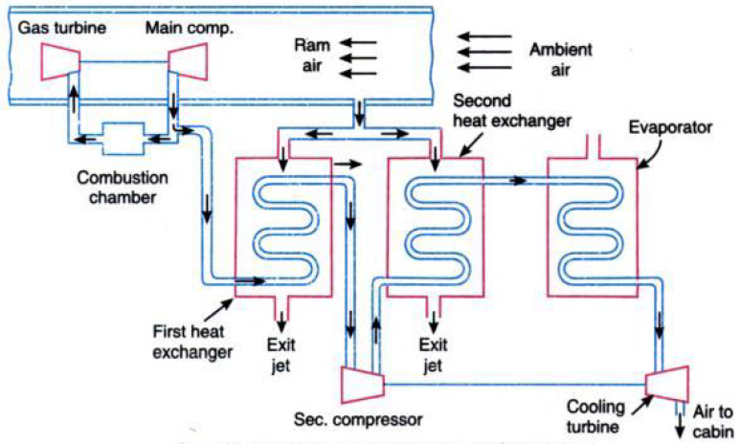
Refrigeration System
Boot Strap Air Evaporative Cooling System
Notes:
19

Slide 20
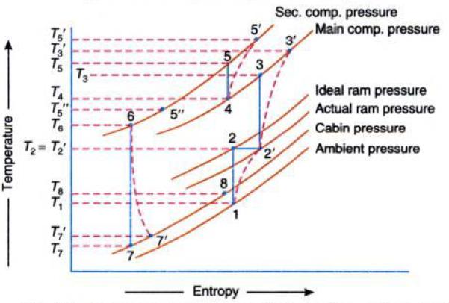
Refrigeration System
Boot Strap Air Evaporative Cooling System
It is similar, to the boot strap air cooling system except that the addition of an evaporator between the second heat exchanger and the cooling turbine.
If Q tones of refrigeration is the cooling load in the cabin, then the quantity of air required for the refrigeration purpose will be
Ma=210Q/Cp(T8-T7) kg/min.
Notes:
20

Slide 21
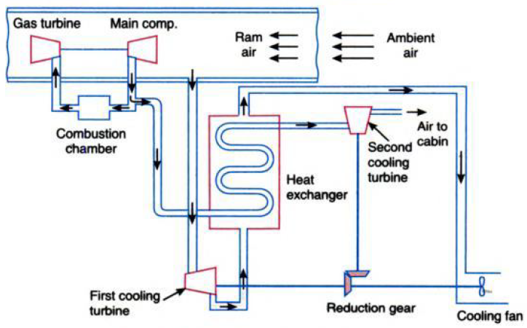
Refrigeration System
Reduced Ambient Air-Cooling System
Notes:
21

Slide 22
Refrigeration System
Reduced Ambient Air-Cooling System
It consist of two cooling turbines and one heat exchanger.
Air reduced for the refrigeration system is bled off from the main Compressor.
This high pressure and temperature air is cooled initially in the heat exchanger.
Air for cooling is taken from the cooling turbine which lowers the high temperature of rammed air.
Cooled air from the heat exchanger is passed through the second cooling turbine from where the air supplied to the cabin.
The work of the cooling turbine is used to drive the cooling fan which draws cooling air from the heat exchanger. It used for very high-speed aircraft.
Notes:
22

Slide 23
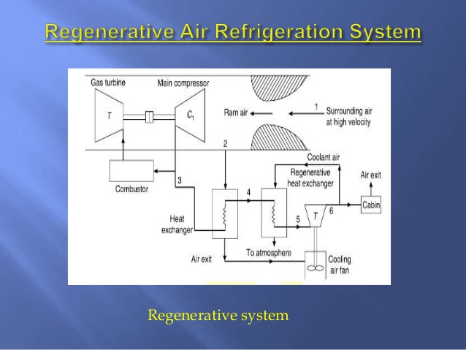
Refrigeration System
Regenerative Air-Cooling System
Notes:
23

Slide 24
Refrigeration System
Regenerative Air-Cooling System
It is a modification of simple air-cooling system with the addition of regenerative heat exchanger.
The high pressure and high temperature air from the main compressor is first cooled by the ram air in the heat exchanger .
This air is further cooled in the regenerative heat exchanger with the portion of air bled after expansion in the cooling turbine.
This type of cooling system is used for supersonic aircraft and rockets.
Notes:
24

Slide 25
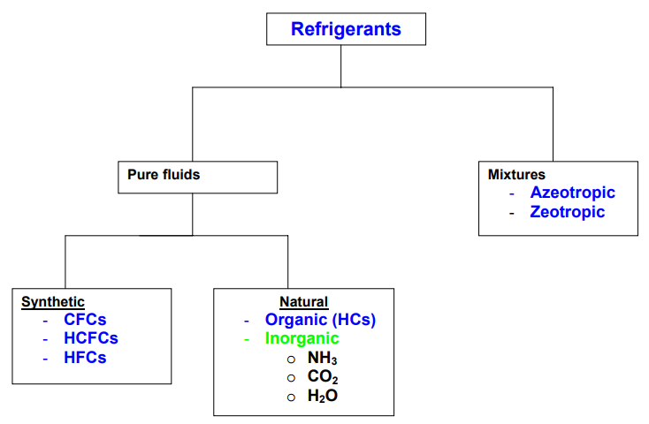
Refrigerants
Definition
It is fluid whose boiling and condensation moves heat from one heat exchanger to another.
Notes:
25

Slide 26
Refrigerants
Selection Criteria
Selection of refrigerant for particularly application is based on the following requirements;
  Thermodynamic and Thermo Physical Properties
  Environmental and safety Properties
  Economics
  Thermodynamic and Thermo Physical Properties
  Requirements are, Suction Pressure, Discharge Pressure , Pressure ratio, Latent heat of vaporization, Isentropic index of compression, Liquid specific heat, Thermal specific heat, Thermal conductivity and viscosity .
Notes:
26

Slide 27
Refrigerants
Thermodynamic and Thermo Physical Properties
Pressure ratio
  It should be as small as possible for high volumetric efficiency and low power consumption.
  Latent Heat of Vaporization
  Should be as large as possible so that the required mass flow rate per unit cooling capacity will be small.
  Isentropic Index of Compression
  It should be as small as possible so that the temperature rise during compression will be small.
Notes:
27

Slide 28
Refrigerants
Thermodynamic and Thermo Physical Properties
Liquid Specific Heat
  It should be as small so that degree of sub cooling will be large leading to smaller amount of flash gas at evaporator inlet.
  Thermal Conductivity
  It is high in both phase liquid and vapor phase for high heat transfer coefficient.
  Viscosity
  It is very small in liquid and vapor phase for smaller frictional pressure drop.
Notes:
28

Slide 29
Refrigerants
Environmental and Safety Properties
Ozone Depletion Potential
  According to the Montreal protocol, it should be zero.
  ODP depends mainly on the presence of bromine in the molecules .
  Global warming Potential
  It should be as low as possible .
  Ease of leak detection
  It should be easy to detect the leaks .
  Flammability
  It should be non-flammable or explosive.
Notes:
29

Slide 30
Refrigerants
Economic Properties
It should be inexpensive and easily available.
Notes:
30

