Slide 1
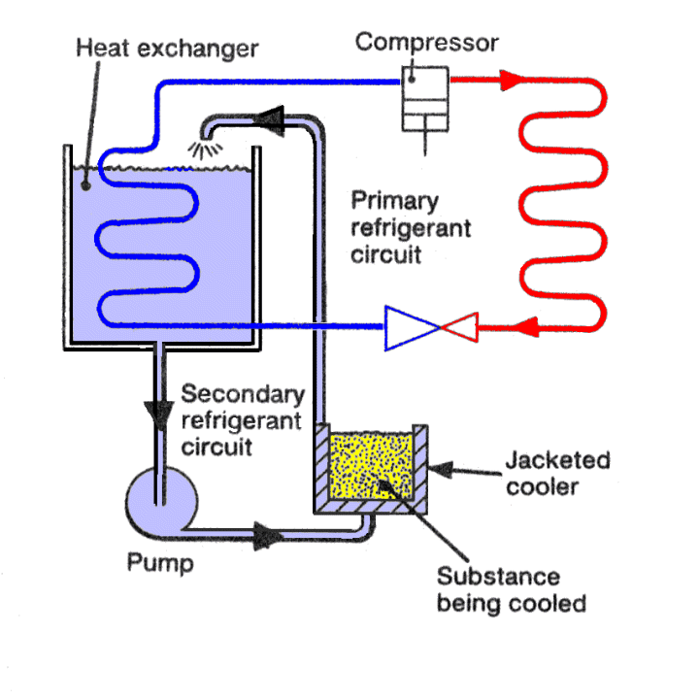
Refrigeration Design

Slide 2

CONTENTS
1
Introduction
Page 3
2
Selection of Compressor and Chiller
Page 9
3
Hydronic Distribution System
Page 18
4
Controls and Instrumentation
Page 29
X
About PMG Engineering
#

Slide 3

Introduction
Definition
While designing a refrigeration plant, following are the basic parameters should play very important role in design. They are respectively;
  Capacity
  Primary Refrigerant
  Saturated Condensing Temperature
  Evaporative type ammonia condenser unit capacity
  Cooling Tower Capacity
  Condensing Temperature
  Chilled Water Outlet Temperature
Notes:
3

Slide 4
Introduction
Capacity
While calculating the capacity of refrigeration plant, we required some parameters.
They are respectively
  Flow Rate
  Inlet Temperature of chilled water
  Outlet temperature of chilled water
  Let's Consider an example ,
    Flow rate =6 m³/hr =100LPM = 6 KLPH
    Inlet Temperature to chiller = 30 ⁰C
    Outlet Temperature to chiller = 9 ⁰C
Notes:
4

Slide 5
Introduction
Capacity
Total Kcal = Flow x Specific Heat x Weight x Difference Temperature
= 6000 x 1 x 1 x 21
= 126000 Kcal/Hr
Add 10 % Transfer loss and compressor efficiency
Total =138600 Kcal/hr
1Tr=3025 Kcal/hr at an evaporation temperature of +15 ⁰C
= 138600/3025
= 45.82 Tr
Notes:
5

Slide 6
Introduction
Evaporative Condenser Unit Capacity
In this both air and water used to extract heat from the condensing refrigerant.
They combine the features of a cooling tower and water-cooled condenser in a single unit. Required air flow rate is 350-500 m3/hr per TR of refrigeration capacity.
In these condenser the water is sprayed from top part on a bank of tubes carrying the refrigerant and air is induced upwards. There is a thin water film around the condenser tube from which evaporative cooling take place.
Heat transfer coefficient evaporative cooling is very large. Therefore, refrigeration system can be operated at low condensing temperature.
Water spray countercurrent to the airflow acts as cooling tower. The role of air is primarily to increase the rate of evaporation of water.
Notes:
6

Slide 7
Introduction
Cooling Tower Capacity
Cooling capacity is the measure of cooling system ability to remove heat.
Unit of cooling tower capacity is Ton. Which describes the amount of water at a given temperature that can be frozen in given amount of time.
Q = m x Cp x Δt
Where,
  Q is the cooling capacity in KW
  M = mass rate kg/s
  Cp = Specific heat capacity KJ / KG sec
  Δt= temperature change
Notes:
7

Slide 8
Introduction
Condensing Temprature
Condensing temperature is the temperature at which a cooling medium changes phases from a gas to liquid.
When these phase change occur, cooling medium condenses.
The temperature at which cooling medium condenses is dependent on the type of coolant and the condensing pressure.
Notes:
8

Slide 9
Selection Of Compressor & Chiller
Compressor
There are four basic type of compressor used in chilled water plant. They are respectively
  Rotary Compressor
  Centrifugal Compressor
  Reciprocating Compressor
  Rotary Compressor
  They are basically divided into two types, single screw and Twin screw. The single screw consist of single cylindrical main rotors that work that works with a pair of gate rotors. While the twin screw is the common designation for double helical rotary screw compressor.
Notes:
9

Slide 10
Selection Of Compressor & Chiller
Compressor
Centrifugal Compressor
  It is dynamic compression device that on a continuous basis exchange angular momentum between a rotating mechanical element and steadily flowing fluid.
  It is a single stage or multistage.
  Reciprocating Compressor
  It is positive displacement machine. Cooling capacity of reciprocating compressor are controlled by;
  Cycling on/off with or without multiple compressor
  Using cylinder unloaders
  Using hot gas bypass
Notes:
10

Slide 11
Selection Of Compressor & Chiller
Compressor
Cycling the compressor on/off is a cost effective and energy efficient particularly when multiple compressor are used.
Unloaders are energy efficient and cost-efficient control strategy.
Hot gas bypass allows the machine to run at very low and no cooling loads without cycling the compressor.
Notes:
11

Slide 12
Selection Of Compressor & Chiller
Chiller
It is a machine that removes heat from a liquid via a vapor compression or absorption refrigeration cycle. Then it can be circulated through heat exchanger.
It is a mechanical device used to facilitate heat exchange from water to a refrigerant in closed loop system. The refrigerant is then pumped to a location where the waste heat is transferred to the atmosphere.
In air conditioning chilled water is often used to cool a building air and equipment, especially in situation where many individual room must be control separately such as a hotel. A chillers lowers the water temperature to between 40⁰F to 45⁰F before the water is pumped to the location to be cooled.
Notes:
12

Slide 13
Selection Of Compressor & Chiller
Chiller
Compressor are the driving force in a vapor compression chiller and act as a pump for the refrigerant. Compressed refrigerant gas is sent from the compressor to a condenser unit that rejects the heat energy from the refrigerant to cooling water or air outside the system.
There are three different type of chillers. They are respectively;
  Air
  Water
  Evaporative condensed chiller
There are four subcategories in each of the above categories for industrial chillers. They are respectively,
Notes:
13

Slide 14
Selection Of Compressor & Chiller
Chiller
Reciprocating chiller
Centrifugal chiller
Screw driven chiller
Absorption chiller
Reciprocating Chiller
  Gas is compressed inside these types of chillers with pistons. There are multiple pistons that continue to compress the gas to heat it.
  The difference is that the hot gas is used inside the system, not simply exhausted out of a tailpipe. The demand is matched by the adjustable intake and exhaust valves that can be opened to allow the piston to simply idle.
  Idling the piston when demand for chilled water helps manage capacity.
  This system is very flexible and can cope with the specific demands from load on the system.
Notes:
14

Slide 15
Selection Of Compressor & Chiller
Reciprocating Chiller
  Centrifugal Chiller
    It has very high cooling capacity in compact design.
    They operate via an impeller, much like a water pump. The impeller compresses the refrigerant.
    These chillers can be outfitted with both variable speed drives and inlet vanes which are used to regulate the control of the chilled water capacity.
    These are high capacity and can handle 150 tons and up.
Notes:
15

Slide 16
Selection Of Compressor & Chiller
Chiller
  Absorption Chiller
  These chillers typically use two liquids, one to cool and one to absorb.
  The absorbent liquid is usually ammonia or lithium bromide, and the coolant is usually water.
  The two liquids are separated and recombined during the absorption cycle.
  Due to the low-pressure conditions in the chiller water can change phase easily.
  Water and the absorption liquid also perform well in chillers because of their natural properties of affinity.
  The refrigeration cycle starts with the heating of the combined liquids.
  This boils the water out of the absorption liquid at a high pressure.
Notes:
16

Slide 17
Selection of Compressor & Chiller
Absorption Chiller
The next step is sending the refrigerant water vapor past a condenser coil where the heat is rejected, and the water vapor is phased into a high-pressure liquid.
Then the high-pressure liquid is passed along to the lower pressure evaporator where adiabatic flash evaporation returns the water to a gas.
This absorbs the heat from the water that needs to be chilled.
The last step is the concentrated absorption liquid is sent back to be recombined with the lower pressure water vapors coming from the evaporator.
Notes:
17

Slide 18
Hydronic Distribution System
Hydronic Distribution System
  There are two types of hydronic distribution system. They are respectively;
  Constant flow chilled water system
  Variable flow chilled water system
  Constant flow system
  These system can be used as per application
  Single chiller serving a single cooling load
  Single chiller with multiple cooling loads
  Multiple parallel chillers with multiple cooling loads
  Multiple series chillers with multiple loads
Notes:
18

Slide 19
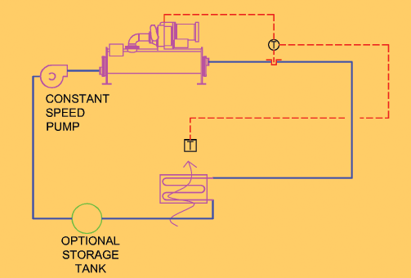
Hydronic Distribution System
Single Chiller serving single cooling load
Notes:
19

Slide 20
Hydronic Distribution System
Single Chiller serving single cooling load
  The simplest design strategy is to eliminate the traditional three-way control valve at the coil and to use a constant-volume pump to circulate water between the evaporator and the coil.
  Control is provided by resetting the temperature of the chilled water leaving the chiller.
  Constant water flow provides reliable heat transfer at both the evaporator and the cooling coil.
  When dehumidification is required at low loads, the temperature of the air leaving the coil can be set to achieve the necessary dew point temperature.
Notes:
20

Slide 21
Hydronic Distribution System
Single Chiller serving single cooling load
  Chillers must have a sufficient volume of water in the piping system to prevent unstable temperature swings and this may be an issue with single-chiller, single-coil systems.
  Often a small storage tank is required if the chiller is closely coupled to the coil.
Notes:
21

Slide 22
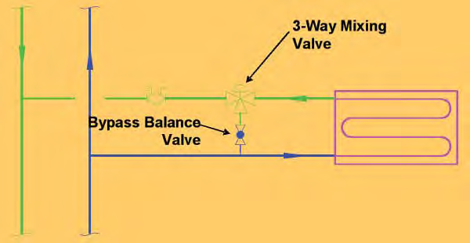
Hydronic Distribution System
Single Chiller with Multiple Cooling Load
Notes:
22

Slide 23
Hydronic Distribution System
Single Chiller with multiple cooling load
  Such kind of system is used when pumping head is less.
  In these system three-way valves are used at the cooling coils to modulate the load at each air handler.
  An energy-saving control strategy is to reset the chiller’s leaving water temperature to satisfy the coil requiring the coldest temperature.
Notes:
23

Slide 24
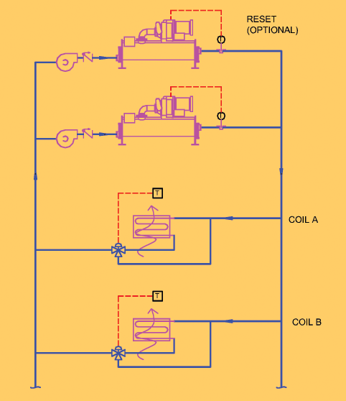
Hydronic Distribution System
Multiple Parrallel Chillers With Multiple Cooling Load
Notes:
24

Slide 25
Hydronic Distribution System
Multiple Parrallel Chillers With Multiple Cooling Load
  Constant-flow systems can be piped with multiple chillers in a parallel configuration. Since, staging with constant-flow systems can be dictated by flow rather than load, these systems should be limited to coils that are serving loads with the similar part-load characteristics.
  When the system operates near full load performance is satisfactory as all chillers and pumps are operating.
Notes:
25

Slide 26
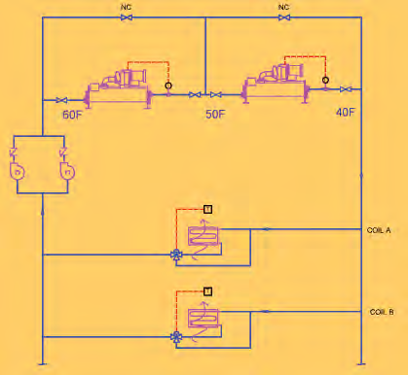
Hydronic Distribution System
Multiple Series Chillers With Multiple Cooling Load
Notes:
26

Slide 27
Hydronic Distribution System
Multiple Series Chillers With Multiple Cooling Load
  In this configuration, the entire flow passes through each machine. This method is effective for systems designed with a high delta-T (15 to 20°F).
  During off-peak periods, the lag machine (second in series) is turned off and the lead machine (first in series) continues to deliver chilled water at the correct temperature.
  Although this system works well, chilled water pump energy savings are not realized during periods of low load.
  This is partially offset by the lower flows required with high delta-T designs. Series chillers also become very cumbersome when the plant has more than two chillers
Notes:
27

Slide 28
Hydronic Distribution System
Variable Flow
  Variable flow has many advantages in large chilled water systems with multiple chillers and multiple loads or coils.
  Significant pumping energy can be saved because the plant can effectively modulate during periods of low load.
Notes:
28

Slide 29
Control And Intrumentation
Variable Flow
  For the smooth operation of chilled water plant there are some controls and instrumentation required to perform various operation. They are respectively;
  Sensor
  Control Valve
  Controllers
  Sensor
  Sensor are used in chilled water plant for a variety of measurements,
  Temperature
  Humidity
  Liquid Flow
  Electric Current
  Electric Power
  Gas Flow
Notes:
29

Slide 30
Control And Intrumentation
  Control Valve
  Valve selection is based on , operation and process requirement. Mostly respective of valve are used
  Ball Valve
  Butterfly Valve
  Globe Valve
  Two and Three-way valve
Notes:
30

