Slide 1
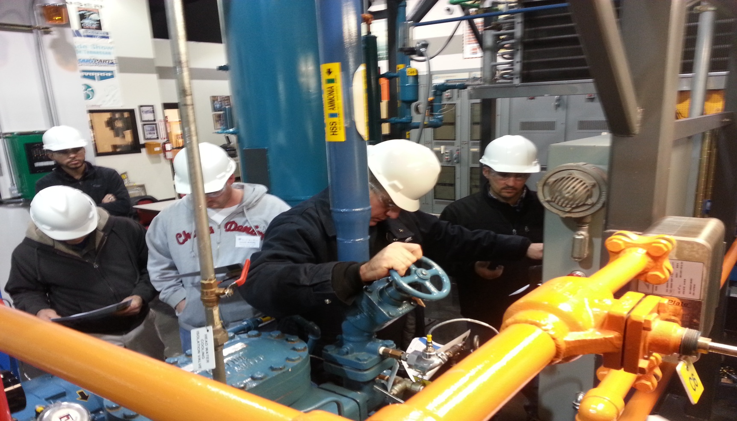
Plant Safety

Slide 2

CONTENTS
1
Typical Incidents
Page 3
2
Accident Prevention and Safe Operation
Page 7
3
Emergency Instruction
Page 13
4
Checklist For Safety
Page 17
X
About PMG Engineering
#

Slide 3

Typical Incidents
Incidents During Operation
  The most common cause for an ammonia release during the operation of a refrigerating system is the opening of pressure relief valve due to some failure.
  The Set Pressure of pressure relief valve had decreased below that of compressor stop. The relief valve opened releasing ammonia into the atmosphere through the relief line. The gas entered the compressor room through the air intake.
  The Overheating protection of condensate pump tripped. The reduction of condensation power increased condenser pressure. Because the pressure switch did not operate, Compressor pressure rose & Pressure relief valve opened.
Notes:
3

Slide 4
Typical Incidents
Typical Incidents
Incidents During Repair And Maintenance
  A cold room evaporator was defrosted with hot water. Due to the temperature rise the pressure in the isolated part of the refrigeration system exceeded relief valve set pressure. Ammonia was release into the machinery room through a hole in the relief line.
  A refrigerating system was defrosted with hot gas circulation and partially melted ice was removed by tapping it with fork spanner.
  A coolant pipe ruptured when heat by the spanner and an ammonia leak resulted. Due to panicking the compressor were not stopped immediately and an ammonia released.
Notes:
4

Slide 5
Typical Incidents
Incidents Due to the installation errors and external Factors
  Ammonia was leaking from the gasket of a feed valve. The aluminum gasket had been damaged due to over tightening.
  Ammonia was leaking from the slit between a pump flange and gasket. The flange had been just installed but its tightening had not been checked operation temperature.
  A compressor gasket had been installed erroneously and had broken.
  An ammonia pipe was leaking due to external corrosion at the lead through between cold room and upper room piping.
Notes:
5

Slide 6
Typical Incidents
Fire And Explosion Incidents
  A valve at the evaporator in cold storage was leaking. Although the evaporator had been isolated, ammonia concentration in the insufficiently ventilated room kept rising.
  Ammonia leaked either from the pipe section next to the leaking valve or the isolation was not properly done. The employees tried to reduce the ammonia concentration by spraying carbon dioxide from 23 kg cylinder. These method had been used for small leaks.
  An engineer heard a noise and saw a vapor cloud in the machinery room. He shut the main liquid valve and notified the fire department.
  At fired incidents where refrigerating system had been involved ammonia did not ignite but the fire often damaged ammonia piping causing release.
Notes:
6

Slide 7
Accident Prevention & Safe Operation
Accident Prevention & Safe Operation
Operator Guidance And Instruction
  According to the standard SFS-EN 378 the supplier or installer of new refrigerating system or unit system must give the necessary training to the operating staff .
  The training must cover all the equipment of the refrigerating system or unit system as well as their functioning.
  Training must emphasis the compliance with the operation instruction. The operating staff should be present when the equipment is assembled, evacuated, filled with the refrigerant and tested.
  Operating instruction should be properly display.
Notes:
7

Slide 8
Accident Prevention & Safe Operation
Operating Instruction
The Name, addressed & phone number of supplier or installer.
The Name, addressed & phone number of maintenance company.
The refrigerant name and fill amount for normal operation.
The used of the system.
The description of equipment.
The Part list , Process and Instrumentation diagram and electrical diagram.
Short instruction for the starting and stopping of the system .
The highest operating pressure .
Instruction for the filling and draining of the refrigerant.
Instruction on the handling and related risk of the refrigerant.
Notes:
8

Slide 9
Accident Prevention & Safe Operation
Isolation Valve
Isolation Valve
  The standard SFS-EN 378 contains direction for the proper realization of isolation valve. To reduce hazard situation and refrigerant leaks it must be possible to isolate the equipment individually or in groups with manual or automatic isolation valve.
  Isolation valve that are used continuously must have fixed hand wheel.
  Branches of the ammonia mains should have an isolation valve which can be used to isolate part of the system from the main.
  Location of ammonia pipes and isolation valve must be marked clearly so that even a person unfamiliar with the system can find them.
Notes:
9

Slide 10
Accident Prevention & Safe Operation
Gas Sensor
When ammonia is used as refrigerant gas sensor must be installed in the machinery room and every cold room. The working of the sensor must be monitored at the control panel of machinery room.
Room geometry, air flow and most probable leak position must be considered when placing the gas sensor. No unmonitored packets should remain.
Gas sensor should also be installed next to the end of any relief line. In this way the message that relief valve has opened will be available immediately.
Gas sensor can be integrated in the control system of the refrigeration plant to limit consequences of an ammonia leak.
Notes:
10

Slide 11
Accident Prevention & Safe Operation
Pressure Relief Valve
Pressure Relief Valve
  Pressurized part of refrigeration system must be protected with pressure relief valve to prevent the system pressure from exceeding the maximum operating pressure.
  It is sufficient to place the end of a relief pipe high enough above the roof and as far as possible, away from the air intake.
  The opening of a relief valve should stop compressor and pump and close isolation valve. Then the amount of ammonia released into the atmosphere is as small as possible.
Notes:
11

Slide 12
Accident Prevention & Safe Operation
Ventilation Installation
Ventilation Installation
  An appropriate ventilation of the rooms of the refrigeration system can be used to prevent an ammonia release from spreading to the other room. It can also prevent the formation of flammable ammonia air mixtures in the room where the release occur. The machinery room and other room with ammonia piping must be designed in such way that the gas spread to the other rooms can be prevented .
  The formation of flammable mixture is prevented with emergency ventilation.
  The latter is accomplished by an independent fan or by increasing the air exchange rate of the ventilation installation.
Notes:
12

Slide 13
Emergency Instruction
One of the most important factors in the accident prevention of refrigeration system is the training of operating and maintenance personnel. An essential part of the implementation of an internal emergency plan is the training of the entire personnel for emergencies.
Depending on the duties of the person the training may consist of the following items,
  Behavior and impact of leaking ammonia.
  Positioning and action of gas sensor.
  Fire hazards and the function of fire alarm system.
  Detection of leak making an emergency call and raising the alarm system.
Notes:
13

Slide 14
Emergency Instruction
Internal Emergency Plan
The finish on the decree on the supervision of the handling and storing of hazardous chemicals provides the enterprises carrying on an extensive activity must draw up an internal emergency plan. It must contain following objective ;
  Containing and controlling incidents so as to minimize the effect and to limit damaged to man the environment and property.
  Implementing the measures necessary to protect man and the environment from the effect of major accidents.
  Providing for the restoration and clean up of the environment following major accidents.
Notes:
14

Slide 15
Emergency Instruction
Internal Emergency Plan
The internal emergency plan must present among others the following items associated with refrigeration system and ammonia release;
  Assembly areas incase of an ammonia release.
  The emergency access roads of the fire brigade.
  Internal emergency organization.
  Gas detectors and action to be taken when they alarm.
  Instruction on how to detect gas releases and to make an emergency call.
  Instruction on how to raise the alarm.
  Informing of an emergency.
  Personal training and exercises for the action in incidents and emergency.
Notes:
15

Slide 16
Emergency Instruction
Ammonia Leaks
Liquid ammonia is transported and stored at ambient temperature in tanks under pressure. In very large storage tanks ammonia is stored as refrigerated liquid at the boiling point of - 33 ⁰c.
Different types of ammonia leaks in refrigerating system;
  Minor leaks from valves and flanges.
  Pipe connecting to the compressor with the evaporator.
  Liquid leak from the pipe connecting the condenser with the medium pressure tank.
  Liquid leak from the from the pipe connecting the evaporator with the low-pressure compressor.
Notes:
16

Slide 17
Checklist For Safety
Checklist for Safety
Are all employees properly trained?
Are all personnel assigned to work with anhydrous ammonia capable of working in a hazardous area?
Are goggles used by all persons handling anhydrous ammonia?
Is a safety water tank or an approved deluge shower available?
Is a first aid water decal on the safety tank or shower?
Are rain suits or slickers available?
Are boots available?
Are to full-face mask available?
Are canisters current?
Notes:
17

Slide 18
CHECKLIST FOR SAFETY
Checklist for Safety
Are two self contained air mask available for emergencies?
Are Safety belts and life lines are available?
Are storage tanks approved for anhydrous ammonia?
Are Fire extinguisher in good condition?
Are the liquid and vapor valves properly identified?
Are excess flow checks in all opening where required?
Are excess flow checks in all opening where required?
Are relief valve checked and replace regularly?
Are all relief valve capped?
Is all piping done with schedule 80?
Notes:
18

