Slide 1
Steam

Slide 2

CONTENTS
1
Introduction
Page 3
2
Formation of Steam
Page 4
3
Types of Steam
Page 7
4
Uses of Steam
Page 11
X
About PMG Engineering
#

Slide 3
Introduction
Steam
Steam is the gaseous phase of water.
Steam is generated in boiler at required pressure.
Steam is created by heating a boiler via burning coal and other fuels, but it is also possible to create steam with solar energy.
Steam may be obtained starting form ice or straight away from the water by adding the heat to it.
It requires 100 calories of heat to raise one gram of water from the freezing point (0°C) to the boiling point.
Notes:
3

Slide 4
Formation Of Steam
Steam
During the first stage of heating, the temperature of water will begin to rise until the water boils at a temperature known as saturation temperature which depends upon the pressure in the cylinder.
After the boiling temperature is reached, steam begins to be formed during which time the temperature remains constant. Until the point is reached at which all water is converted into steam, Formation of steam at constant pressure, the contents of mixture will be steam and water known as wet steam.
When all the water including those particles of water held in suspension will be evaporated, the steam is said to be dry and is known as dry saturated steam.
As heating continues further, the temperature of steam begin to rise again, and steam is now known as superheated steam and behaves more or less as a perfect gas.
Notes:
4

Slide 5
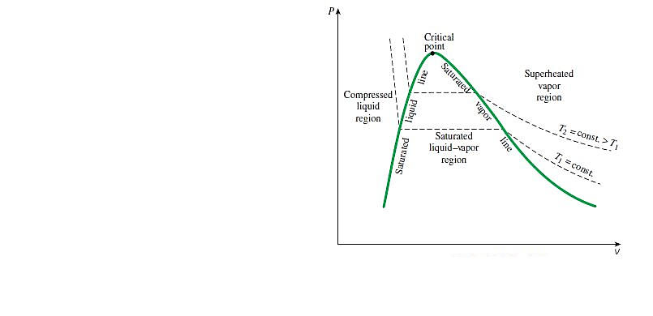
Formation Of Steam
Steam
Pressure – Volume Diagram
Notes:
5

Slide 6
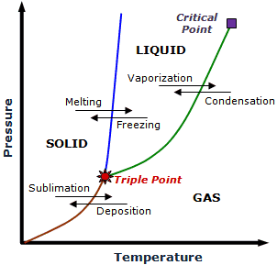
Formation of Steam
Steam
Pressure – Temperature Diagram
Notes:
6

Slide 7
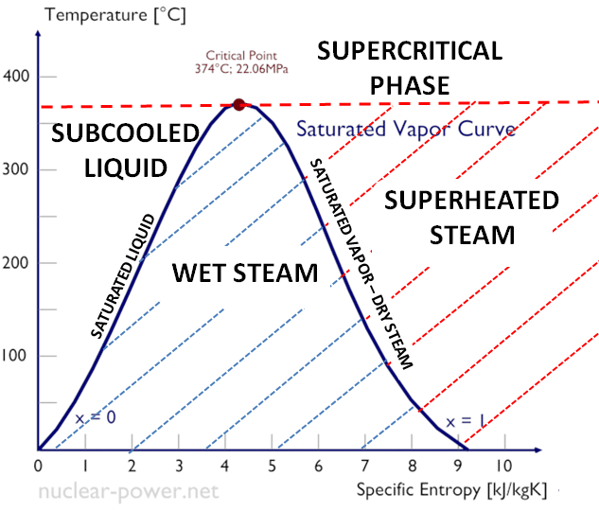
Types of Steam
  Classification
Steam types are following here
  Wet or Unsaturated Steam
  Dry or Saturated Steam
  Super Heated Steam
Notes:
7

Slide 8
Types of Steam
  Wet Steam
Wet steam is a mixture of steam and liquid water. It exists at a saturation temperature containing more than 5% water. It is said to be a two-phase mix: steam contains droplets of water that have not changed phase.
Wet steam lowers the heat transfer efficiency of steam, which results in an inefficient sterilization procedure.
Wet steam is also known as Unsaturated steam.
Notes:
8

Slide 9
Types of Steam
  Dry or Saturated Steam
Dry steam applies to steam when all its water molecules remain in the gaseous state. It's a transparent gas.
Dry steam contains not more than one half of one percent moisture.
In heating applications, dry steam is preferable, because it has a better energy exchange capacity and does not cause corrosion.
Dry steam occurs at temperatures and pressures where steam (gas) and water (liquid) can coexist. In other words, it occurs when the rate of water vaporization is equal to the rate of condensation.
Saturated steam has many properties that make it an excellent heat source, particularly at temperatures of 100 °C and higher
Notes:
9

Slide 10
Types of Steam
  Superheated Steam
Superheated steam is created by further heating wet or saturated steam beyond the saturated steam point.
That has a higher temperature and lower density than saturated steam at the same pressure.
Superheated steam is mainly used in propulsion/drive applications such as turbines, and is not typically used for heat transfer applications.
Notes:
10

Slide 11
Uses of Steam
Uses of Steam
Steam is used in a wide range of industries. Common applications for steam are for example, steam heated processes in plants and factories and steam driven turbines in electric power plants, but the uses of steam in industry extend far beyond this.
Steam application are following here-
  Humidification & Dehumidification
  Process Heating
  Refrigeration
  Power
  Powder plants
  Sanitization
Notes:
11

