Slide 1
STEAM DISTRIBUTION

Slide 2
AGENDA
1
Introduction
2
Process of Steam Generation
3
Condensate Recovery Unit
4
Equipment List in Steam Distribution
5
PRS
Notes:
2

Slide 3
CONDENSATE RECOVERY UNIT
Steam Distribution
The steam distribution system is the essential link between the steam generator and the steam user.
This Module will look at methods of carrying steam from a central source to the point of use. The central source might be a boiler house or the discharge from a co-generation plant.
Notes:
3

Slide 4
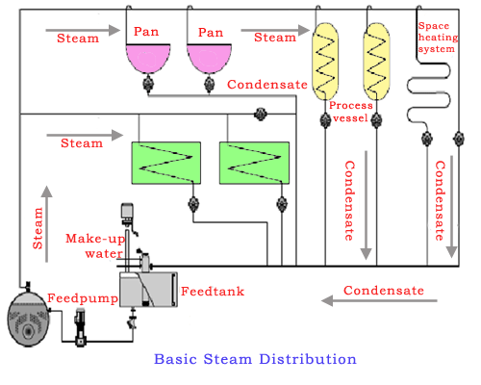
CONDENSATE RECOVERY UNIT
Steam Distribution
Notes:
4

Slide 5
STEAM DISTRIBUTION
Steam
During the first stage of heating, the temperature of water will begin to rise until the water boils at a temperature known as saturation temperature which depends upon the pressure in the cylinder. After the boiling temperature is reached, steam begins to be formed during which time the temperature remains constant. Until the point is reached at which all water is converted into steam, Formation of steam at constant pressure, the contents of mixture will be steam and water known as wet steam. When all the water including those particles of water held in suspension will be evaporated, the steam is said to be dry and is known as dry saturated steam. As heating continues further, the temperature of steam begins to rise again and steam is now known as superheated steam and behaves more or less as a perfect gas.
Notes:
5

Slide 6
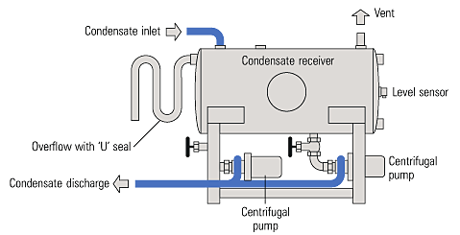
CONDENSATE RECOVERY UNIT
Condensate Recovery Unit
Condensate recovery is a process to reuse the water and sensible heat contained in the discharged condensate. Recovering condensate instead of throwing it away can lead to significant savings of energy, chemical treatment and make-up water.
Notes:
6

Slide 7
EQUIPMENT LIST
Equipment List
Equipment list of steam distribution are following-
  Control valve- A control valve is a valve used to control fluid flow by varying the size of the flow passage as directed by a signal from a controller.
  PRS- This is use to convert high pressure in to low pressure steam.
  Pressure gauge- This is used to check the pressure in steam line.
  Tempreature gauge- This is used to check the temperature in steam line.
  Flow meter- This is used to indicate the flow in steam line.
  Air vent- To release unwanted air.
Notes:
7

Slide 8
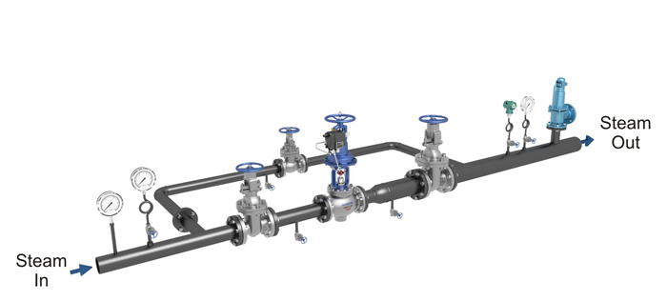
PRS
PRS
PRS is stand on pressure relief station. Which convert a high pressure steam to required low pressure of steam. It is combination of various equipment and each equipment have different function for redusing pressure. These part are following here -
Notes:
8

Slide 9
PRS
PRS
Moisture Seprator- It removes essential from gases and Steam.
Pressure gauge- It measures steam intensity.
Inlet stop valve- For isolation.
Strainer- To separate soild particals.
Outlet stop valve- For isolation.
By pass line stop valve- For By Pass.
Safety valve- To maintain maximum set pressure
Pressure redusing valve- To reduce the pressure.
Drain assembly- For drain & isolation.
Notes:
9

