Slide 1
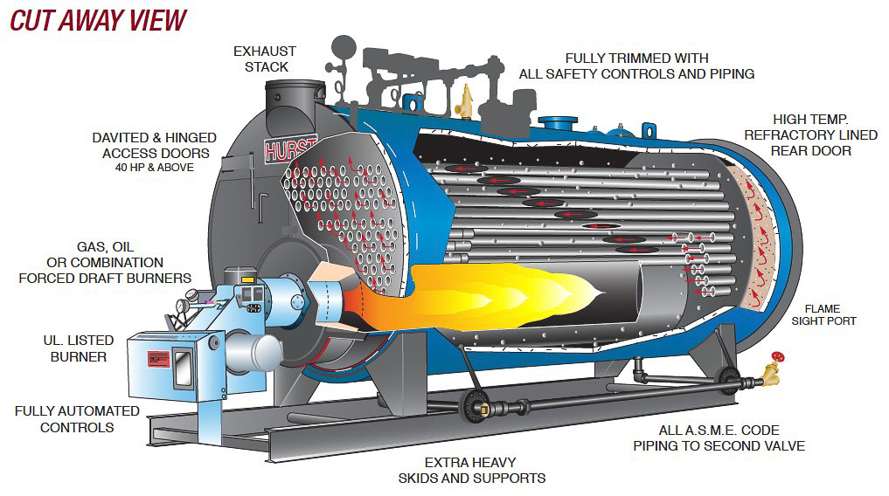
TYPES OF BOILER

Slide 2
AGENDA
1
Introduction to Boiler
2
Working Principle of Boiler
3
Types of Boiler
4
Difference Between Fire Tube Boiler & Water Tube Boiler
5
Basic Components of Boiler
Notes:
2

Slide 3
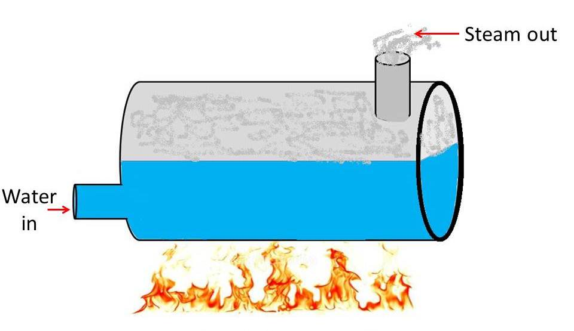
TYPES OF BOILER
Boiler
A boiler is defined as a closed vessel in which water or other liquid is heated, steam or vapor is generated.
In boiler water is converted into steam at required pressure.
The boiler has a very a wide application such as power sector, textiles, plywood, FMCG etc.
Notes:
3

Slide 4
TYPES OF BOILER
Boiler
The boiler is essentially a closed vessel inside which water is stored. Fuel (generally coal) burns in a furnace and hot gasses are produced. These hot gasses comes in contact with water vessel where the heat of these hot gases transfer to the water and consequently steam is produced in the boiler.
This steam is going to the turbine of thermal power plant. There are many different types of boiler utilized for different purposes like running a production unit, sanitizing some area, sterilizing equipment, to warm up the surroundings etc.
Notes:
4

Slide 5
TYPES OF BOILER
Classification
There are mainly two types of boiler
  Water tube boiler
  Fire tube boiler
In fire tube boiler, there are numbers of tubes through which hot gases are passed and water surrounds these tubes.
Water tube boiler is reverse of the fire tube boiler. In water tube boiler the water is heated inside tubes and hot gasses surround these tubes.
Notes:
5

Slide 6
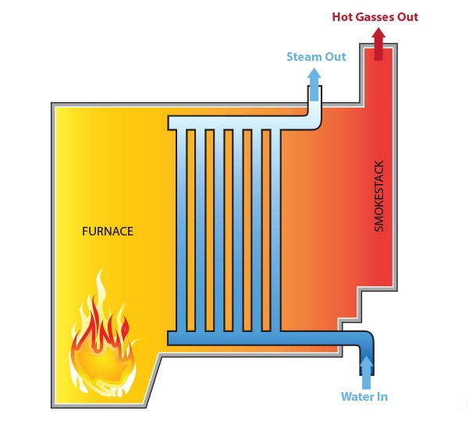
TYPES OF BOILER
Water Tube Boiler
A water tube boiler is such kind of boiler where the water is heated inside tubes and the hot gasses surround them. Actually this boiler is just opposite of fire tube boiler where hot gasses are passed through tubes which are surrounded by water.
Type of Water Tube boiler
  Horizontal Straight Tube Boiler.
  Bent Tube Boiler.
  Cyclone Fired Boiler.
  Lamont Boiler.
  Benson Boiler
Notes:
6

Slide 7
TYPES OF BOILER
Water Tube Boiler
Advantage of Water Tube boiler
  Larger heating surface can be achieved by using more numbers of water tubes.
  Due to convectional flow, movement of water is much faster than that of fire tube boiler, hence rate of heat transfer is high which results into higher efficiency.
  Very high pressure in order of 140 kg/cm² can be obtained smoothly.
Disadvantage of Water Tube boiler
  The main disadvantage of water tube boiler is that it is not compact in construction.
  Its cost is not cheap.
  Size is a difficulty for transportation and construction.
Notes:
7

Slide 8
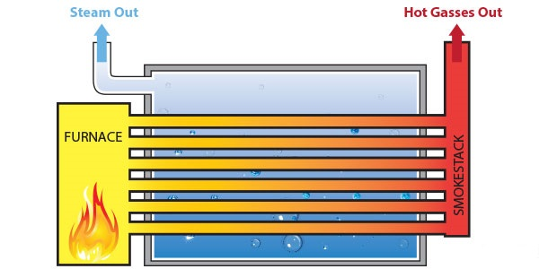
TYPES OF BOILER
Fire Tube Boiler
The fire tube boiler consists of numbers of tubes through which hot gasses are passed. These hot gas tubes are immersed into water, in a closed vessel. Actually in fire tube boiler one closed vessel or shell contains water, through which hot tubes are passed. These fire tubes or hot gas tubes heated up the water and convert the water into steam and the steam remains in same vessel. As the water and steam both are in same vessel a fire tube boiler cannot produce steam at very high pressure. Generally it can produce maximum 17.5 kg/cm² and with a capacity of 9 Metric Ton of steam per hour
Notes:
8

Slide 9
TYPES OF BOILER
Fire Tube Boiler
Types of water tube boiler
  Horizontal Return Tubular Boiler.
  Short Fire Box Boiler.
  Compact Boiler.
  Lancashire Boiler.
  Cochran.
  Locomotive boilers
Notes:
9

Slide 10
TYPES OF BOILER
Fire Tube Boiler
Advantage of Fire tube boiler
  It is quite compact in construction.
  Fluctuation of steam demand can be met easily.
  It is also quite cheap.
Disadvantage of Fire tube boiler
  As the water required for operation of the boiler is quite large, it requires long time for rising steam at desired pressure.
  Fire tube boiler not give a high pressure of Steam.
  Fire tube boiler steam was not dry steam.
Notes:
10

Slide 11
DIFFERENCE
Fire tube boiler
Water tube boiler
These are oprated at low pressure up to 20 bar.
The rate of steam generation and quality of steam are very low.
This type of boiler’s steam not use in power generation.
Overoll efficiency is up to 75%
Simple in design, easy to erect and low maintenance cost .
It is used to process industry
The working pressure is high up to 250 bar.
The rate of steam generation and quality of steam is high
This type of boiler’s steam used for power generation.
Overoll efficiency with an economizer is up to 90%
Complex design, difficult to erect and high maintenance cost.
It is used to large power plant.

Slide 12
BASIC COMPONENTS OF BOILER
Components
Basically Boiler component are divided into two types of Categories
  Boiler Mountings
  Boiler Accessories
Boiler Mountings- Its type of component generally mounted on the surface of boiler to have safety during operation. These are essential component of the boiler without these component we can not operate the boiler.
Boiler Accessories- These are component which increase a efficiency of the boiler. These component are installed near to the boiler Area. Without these component we operate a boiler.
Notes:
12

Slide 13
BASIC COMPONENTS OF BOILER
Boiler Mountings
Boiler Mountings:
  Water Level Indicator- this device is indicates the exact level of water in the boiler tube.
  Safety Valve- It is mechanical device used to safeguard the boiler ,in case the pressure inside the boiler rises above its normal working atmosphere.
  Pressure Gauge-The pressure gauge component use to the check the pressure inside the boiler
  Steam Stop Valve- steam stop valve are use stop and open the steam from the boiler to supply point
  Feed Check Valve- A valve placed at the boiler in to regulate the flow of water.
Notes:
13

Slide 14
BASIC COMPONENTS OF BOILER
Boiler Accessories
Boiler accessories;
  Air Preheater-The function of preheater is heated a air to before enter the furnace chamber By the exhaust gases of boiler.
  Economizer- The function of economizer it that it heat a water before going boiler by the waste flue gases .
  Super heater- The function of super heater is to increase the temperature of the steam above its saturation point.
  Feed pump - The function of the feed pump is feed a water in boiler.
Notes:
14

