Slide 1
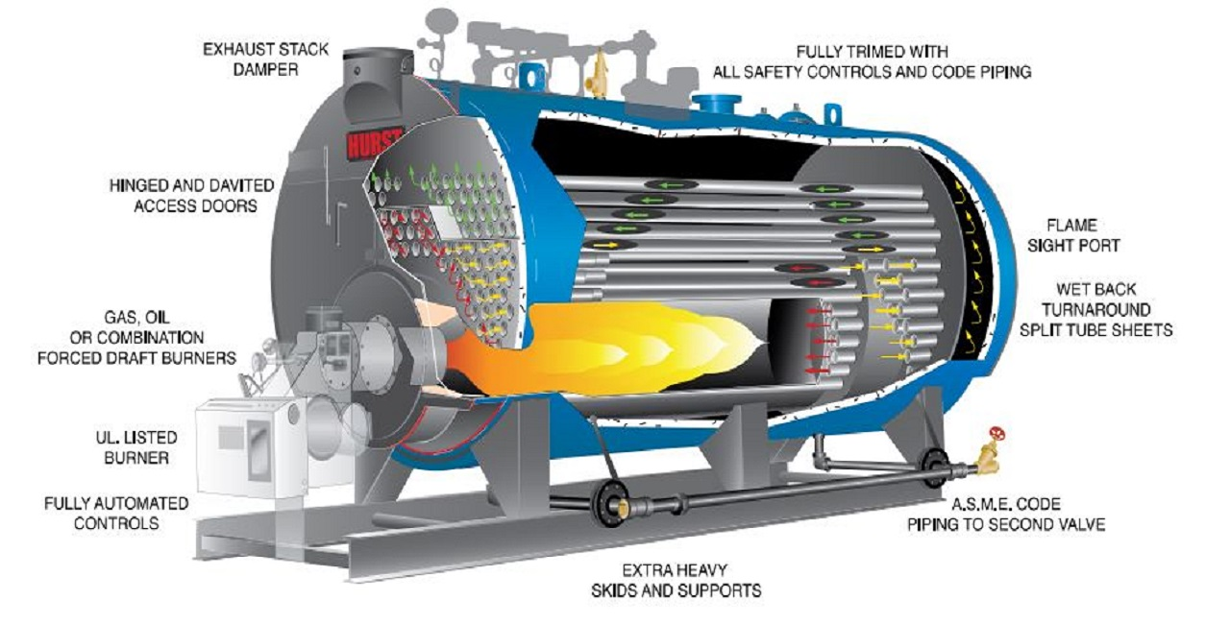
SELECTION OF BOILER

Slide 2
ABOUT PMG
“BUILDING FOOD FACTORIES WITH TOP QUALITY STANDARDS OF NESTLE, MONDELEZ,ABBOTT, DANONE USING 3D DESIGN AND HYGIENIC ENGINEERING.”
At PMG, we deliver Engineering Design and Project Management scopes in Food and Beverage industry. Our team of design engineers and engineering executives has rich experience in Project Planning, Design, Execution and Commissioning with key competencies in areas like 3D Plant Design, Hygienic Engineering, and Project Management. Our safe-by-choice, result-oriented, and pro-active work-ethics allow us deliver work scopes meeting objectives, complete stakeholder alignment and first-time quality.
PMG Knowledge Repository: Targeted Knowledge Sharing & Skill Development
Precise and focused training modules for the exhaustive set of people working in manufacturing industry, instilling qualities of self-belief, creative thinking & widened perspective.
Clear Learning Objectives
Focused approach to skill development and knowledge sharing
Progressive Evaluation
Gauging improvement on every step and keeping audience connected.
After-training follow-ups
We systematically track differential progress of recipients after the training.
Audience Specific Approach
Programs are fine-tuned to the ability and interests of the recipients.
Multiple Awe-moments
Awe-moments are refreshing and increase receptivity many-fold.
Seasoned Trainers
PMG trainers are subject matter experts with substantial work experience.

Slide 3
AGENDA
1
Introduction
2
Selection of Boiler on Basis of Plant Requirement
3
Selection of Boiler on Basis of Plant Pressure Requirement
4
Seletion of Boiler on Basis Of Fuel
5
Selection of Boiler on The Basis Of Costing
Notes:
3

Slide 4
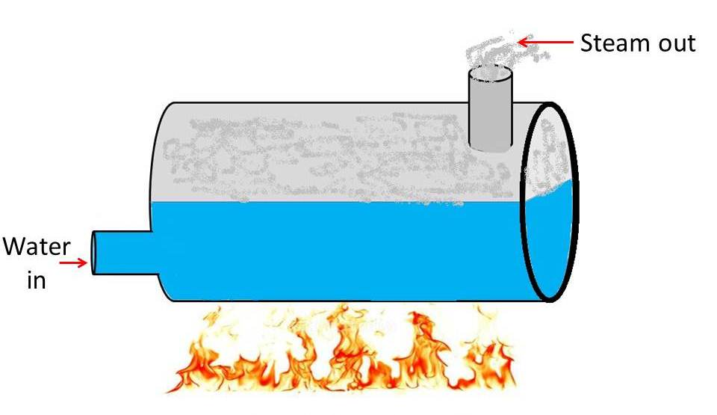
INTRODUCTION
Boiler
A boiler is defined as a closed vessel in which water or other liquid is heated, steam or vapor is generated.
In boiler water is converted into steam at required pressure.
The boiler has a very a wide application such as power sector, textiles, plywood, FMCG etc.
Notes:
4

Slide 5
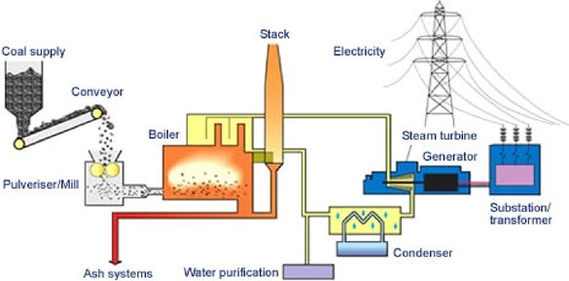
SELECTION
Selection of Boiler on Basis of Plant Requirement
Power generation plant- In this type of plant we need a high pressure & super heated steam which is generated by a water tube type boiler.
Notes:
5

Slide 6
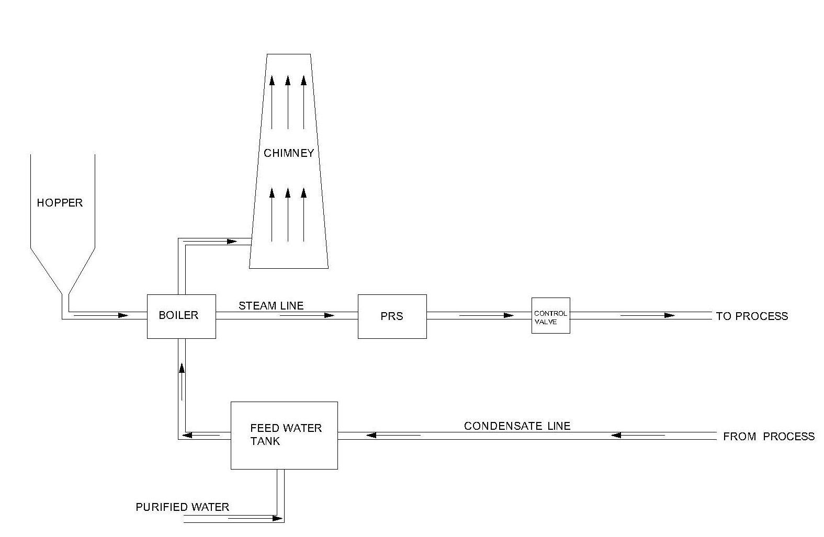
SELECTION
Section of Boiler on Basis of Plant Requirement
Non-Power generation plant- In this type of plant we need a low pressure & saturated steam which is generated by a fire tube type boiler.
Notes:
6

Slide 7
SELECTION
Selection of Boiler on Basis of Pressure
High pressure boiler:
  The boiler which produce steam at pressures of 80 bar and above are called high pressure boiler. This type of boiler are mostly used in power generation plant.
  Examples: Babcock and Wilcox, Velox, Lamont , Benson Boiler etc.
Low pressure Boiler:
  The boiler which produce steam at pressure below 80 bars are called low pressure boiler. this type of boiler are basically used in process & heat exchange process.
  Examples: Cochran, Cornish, Lancashire and Locomotive boiler etc.
Notes:
7

Slide 8
SELECTION
Selection of Boiler on Basis of Fuel
We use various types of fuel in a boiler;
  Coal –In industry mostly four type of coal used : Anthracite, Bituminous, peat and Lignite. In India mostly bituminous coals are used which it contains less Sulphur content and high ash content
Type of Coal | Peat | Lignite | Bituminous | Anthracite
Carbon % | 40% | 40-55% | 55-80% | 80-95%
Moisture% | More than other | 35% | 15-40% | Negligible
GCV | Lower then other | < 5kw/kg | 6.8-9kw/kg | 9kw/kg
Notes:
8

Slide 9
SELECTION
Selection of Boiler on Basis of Fuel
Wood- In a industry Wood, wood residue, bark, are used. And in any form wood like sawdust, sander dust, wood chips, scraps, slabs, millings, shavings, and processed pellets made from wood or other forest products are also used in furnace.
Diesel- In a industry HSD(high speed diesel) are used. Which has low viscosity and higher volatility as compare to low diesel oil. Its Chetan number 56-60.
Furnace oil- It is a dark, viscous liquid at room temperature. It is a complex mix of hydrocarbons with carbon atoms ranging mainly from 20 to 55.
Notes:
9

Slide 10
SELECTION
Selection of Boiler on Basis of Cost
Water tube boiler
  Its design cost, erection cost, and maintenance cost is too high. But for a power generation & super heated steam we used this type of boiler.
Fire tube boiler
  Its design cost, erection cost and maintenance cost is less compare to water tube boiler. For process work in industry we used this type of boiler.
Notes:
10

Slide 11
SELECTION
Other Factors For Selection
Apart from type of steam requirement, there are various other factors those plays major role in the selection of boiler;
  Fuel Feeding System- Manual/Automatic
  Liquid/Solid Fuel- Availability of fuel for specific height
  Steam-Fuel Ratio
  Steam Quality
  Flue Gas Parameters- To comply with Pollution Norms
  Operation- Manual/Automated
Notes:
11

