Slide 1
ENERGY CONSERVATION

Slide 2
AGENDA
1
Introduction
2
Why We Need Nergy Conservation
3
Area of Energy Conservation
4
How to Energy Conservation
5
Benefit of Energy Conservation
Notes:
2

Slide 3
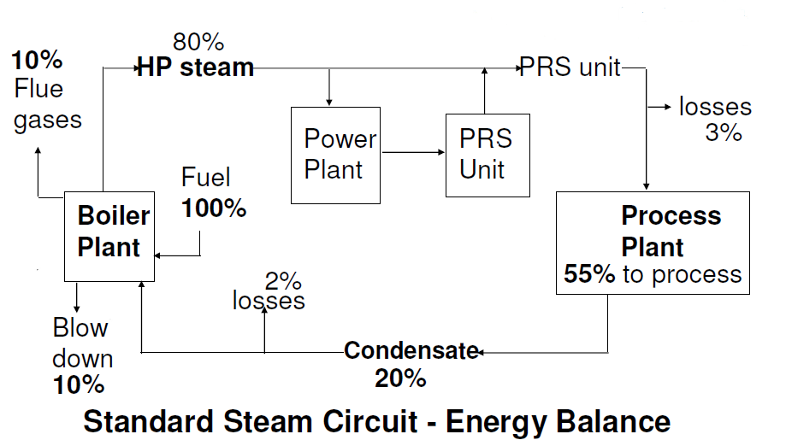
INTRODUCTION
Energy Conservation
Energy conservation is not about making limited resources last as long as they can, that would mean that you are doing nothing more than prolong a crisis until you finally run out of energy resources all together. Conservation is the process of reducing demand on a limited supply and enabling that supply to begin to rebuild itself. Many times the best way of doing this is to replace the energy used with an alternate.
Notes:
3

Slide 4
NEED
Why We Need Energy Conservation
We have limited fuel on the earth and our demand is increasing day by day, that’s why we need to conserve that.
You should know that there are two kinds of energy sources we depend on are renewable and nonrenewable.
Renewable energy sources are those that are continuously replenished, such as water, wind, and solar. Nonrenewable energy sources, on the other hand, like gas, coal, and oil cannot be replaced.
We depend on energy for virtually everything in our lives.
Notes:
4

Slide 5
AREA
Area
In industry have many area for energy conservation these are following?
  Fans & Blowers
  Exhaust & ventilation Sustem
  Pumps and pumping System
  Compressed air System
  Cooling Tower System
  Heat exchanger
  Insulation of pipe
Notes:
5

Slide 6
ENERGY CONSERVATION
Energy Conservation
In a fan and blower choose a right fan and maintenance regularly.
In industry replace old pump by energy efficient pumps.
Provide booster pump for few areas of higher speed.
Use efficient compressor for industry
Ensure the cooling tower meets ASHRAE 90.1 standards with regard to HP per cooling ton at a minimum.
Optimize cooling tower fan blade angle on a seasonal and/or load basis.
Notes:
6

Slide 7
BENEFITS
Benefits of Energy Conservation
There is a lot of potential for energy savings from energy conservation .Technical solutions proposed in the energy audits show massive potential for energy savings in energy subsector with and average of almost 10% of the energy usage .However , this can only materialize through replication at other factories within the respective subsector.
In a industry a energy conservation have many benefits:
  Energy savings
  Quality improvements
  Productivity improvements
  Reduced maintenance
  Fewer breakdowns
  Better Safety and protection
  A Process for repeatable improvements
Notes:
7

