Slide 1
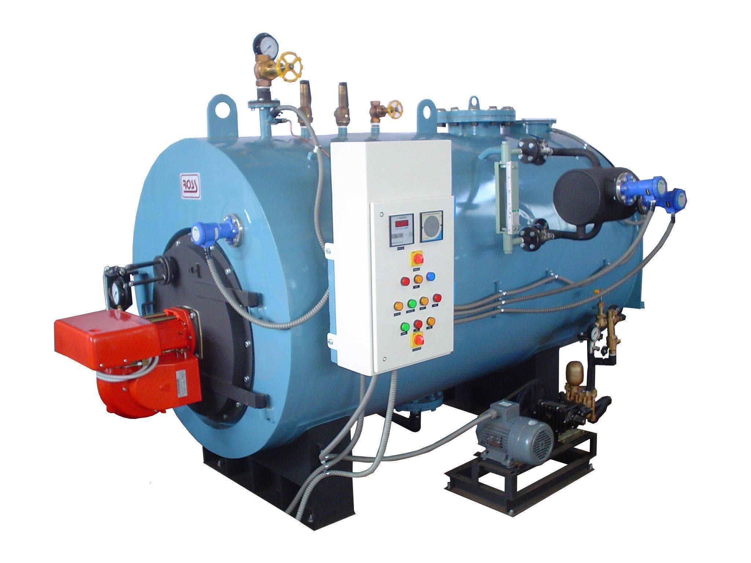
Boiler Operations

Slide 2

CONTENTS
1
Introduction to Boiler
Page 3
2
List of Opreation
Page 4
3
Safety Valve
Page 5
4
Fuel System
Page 6
5
Temperature & Level Gauge
Page 8
X
About PMG Engineering
Page 10

Slide 3
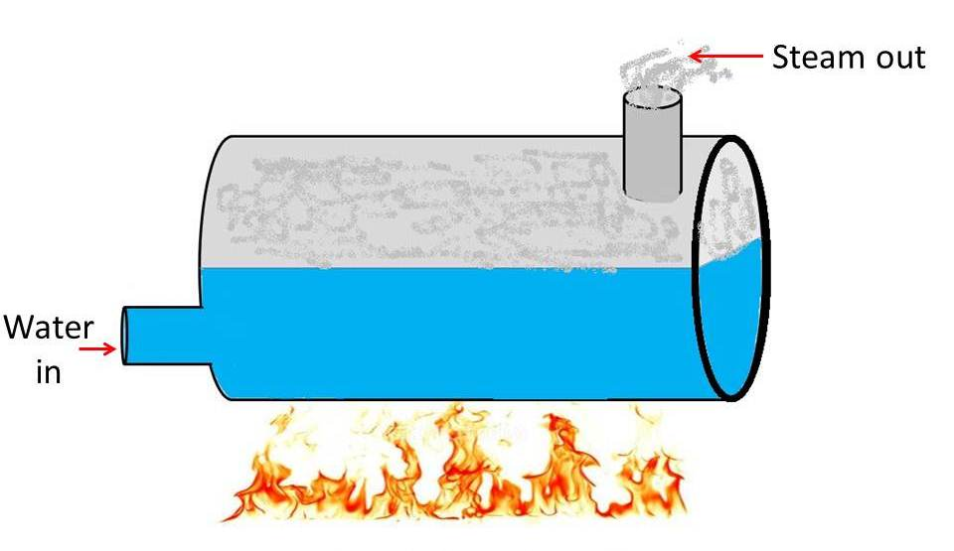
Introduction
Introduction
A boiler is defined as a closed vessel in which water or other liquid is heated, steam or vapor is generated.
In boiler water is converted into steam at required pressure.
The boiler has a very a wide application such as power sector, textiles, plywood, FMCG etc
Notes:
3

Slide 4
List Of Operations
Operations
Boilers’s Operations:
  Safety valve
  Water level control and low water fuel
  Fuel system
  Water gauge glass
  Temperature gauge
Notes:
4

Slide 5
Operations
Safety Valve
Often considered the primary safety feature on a boiler, the safety valve should really be thought of as the last line of defense. If something goes wrong, the safety valve is designed to relieve all the pressure that can be generated within the boiler.
Internal corrosion is probably the most common cause of "freezing" or binding of safety/relief valves. This condition is generally caused by slight leaking or "simmering" due to improper seating of the valve disk and is a condition that should be corrected without delay.
To assure that a valve's mechanism will operate properly, the try-lever should be lifted once a month and the valve set pressure tested annually.
Notes:
5

Slide 6
Operations
Fuel System
If a valve will not operate or does not reseat properly when tested, the boiler must be shut down immediately and the valve repaired or replaced.
It is not good practice to operate a boiler too close to the valve setting.
Operating too close to the set pressure will cause these valves to leak slightly, resulting in an internal corrosion buildup that will eventually prevent the valve from operating.
Notes:
6

Slide 7
Operations
Fuel System
The fuel system, particularly the burner, requires periodic cleaning and routine maintenance. Failure to maintain the equipment in good working order could result in higher fuel costs, the loss of heat transfer or even a furnace explosion.
Modern fuel systems are very complex assemblies, consisting of both electronic and mechanical components.
Over a period of time many things may go wrong ignition transformers deteriorate ignition electrodes burn and become coated, fuel strainers and burner equipment become clogged, fuel valves become dirty and leak, air/fuel ratios drift out of adjustment, flame scanners become dirty.
Many users wisely contract with their gas company or oil service company to periodically check and maintain their burner equipment.
Notes:
7

Slide 8
Operations
Temperature & Level Gauge
The safety feature most often adjusted is the burner purge cycle, designed to prevent furnace explosions caused by a buildup of unburned fuel in the furnace chamber.
The cycle length is determined by the equipment manufacturer to purge fuel from an unsuccessful ignition sequence. It is annoying to have a boiler fail to ignite and then wait for the burner to go through another complete purge cycle.
Notes:
8

Slide 9
Operations
Temperature & Level Gauge
The gauge display on a steam boiler on in any tanks enables the operator to visually observe and verify the actual water level in the boiler or other tanks.
If not properly cleaned and maintained, however, a gauge glass can seem to show there is sufficient water, temperature when the boiler is actually operating in a low water condition or high temperature.
A boiler is operated with the isolation valves to the gauge glass closed because the glass has been broken or is leaking. Take the time to replace the glass, even if the boiler must be shut down.
The piping connecting the gauge glass to the boiler should be cleaned and inspected regularly to assure it remains clear.
The importance of proper cleaning and maintenance of the gauges in industry.
Notes:
9

