Slide 1
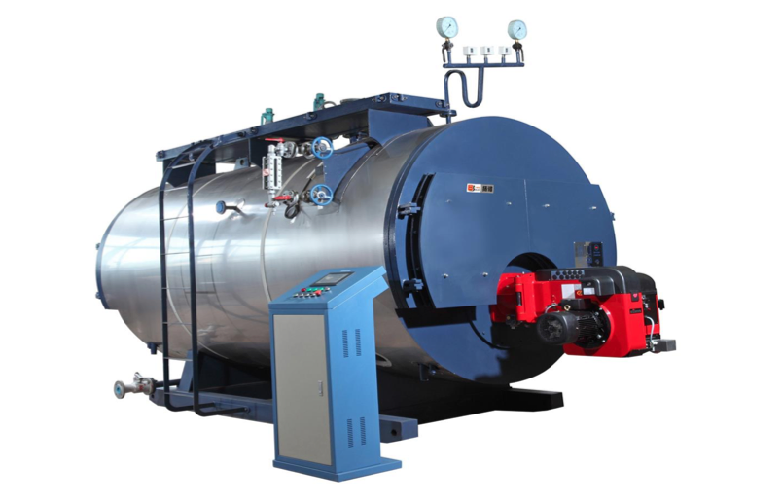
Boiler Regulations

Slide 2

CONTENTS
1
Introduction
Page 3
2
Document Requirement
Page 4
3
IBR Material Certification
Page 5
4
Inspection Process
Page 6
5
Welding Regulation
Page 8
X
About PMG Engineering
Page 10

Slide 3
Introduction
Basic Introduction
The IBR covers the design, fabrication, inspection, testing and certification of Boilers or any boiler part including feed piping and fittings or vessels.
The Indian Boiler Authorities strictly enforce the requirements of IBR, refusing site installation or assembly of any materials that are not correctly certified to the Indian Boiler Regulations.
Compliance with IBR is confirmed via certification on relevant IBR forms issued and/or endorsed by Competent Persons of an Inspecting Authority recognized by the Central Boilers Board - India.
Notes:
3

Slide 4
Introduction
Basic Introduction
Manufacturing drawings and particulars of the material, design and construction need to be submitted to the Inspecting Authority or examination and approval.
After approval by the Inspecting Authority, the manufacturing drawings are sent to Center boiler board , New Delhi and Chief Inspector Boiler of the state by the owners/users where the boiler will be installed.
The Chief Inspector Boiler will examine them and give final approval.
No manufacturing should begin before the Chief Inspector Boiler gives final approval.
Notes:
4

Slide 5
Documents
  Required Documents
To register a completed boiler, the owner must provide the following to the state’s CIB:
  An approved plan showing the general arrangement of the boiler. It should also contain details of the principal components and methods of manufacture, inspection and testing.
  A certificate issued by the Inspecting Authority certifying that the materials were tested, and the boiler built under their supervision. In the case of a boiler on site, either representatives of the Chief Inspector of Boilers or LR Asia Competent Persons in six Indian states can undertake the site inspection, testing and certification.
Individual components manufactured outside of India require certification of construction and hydraulic test witnessed by the Inspecting Authority.
Notes:
5

Slide 6
Documents
.
  IBR Material Certificate
Boiler components that need certification include:
  Steam piping
  Feed piping
  Economizers
  Super heaters
  Any mounting or fitting
  Any other external or internal part of a boiler which is subject to a pressure exceeding one kilogram per centimeter square gauge.
The material for your boiler does not need to be sourced from India to meet IBR requirements. International material manufacturers can meet the certification requirements with correct guidance and compliance to IBR rules and regulations. Materials need to be produced under the inspection of the Inspecting Authority and relevant IBR forms to be endorsed by material manufacturer and Inspecting Authority
Notes:
6

Slide 7
Inspection
Steps
IBR certification process are complete in 3 step:
  Design Review
  Material Inspection
  Pressure part inspection
Notes:
7

Slide 8
Inspection
Design Review
Manufacturer contacts Inspecting Authority for approval of boiler or boiler component design.
Inspecting Authority provides feedback and guidance on the design, calculations and drawings to ensure they meet the IBR Regulations.
After both manufacturer and the Inspecting Authority are satisfied, the documents are to be sent by the manufacturer to the Center Boiler Board New Delhi and Chief inspector boiler of the Indian state in which the boiler or components will be installed.
Material Specification
  Inspecting Authority inspects pressure part materials (plates, pipes, tubes, castings, forgings fittings, standard parts, etc.) and signs the relevant certificate forms.
Notes:
8

Slide 9
Inspection
  Pressure Part Inspection
The Inspecting Authority carries out stage inspections during the manufacture of a boiler or boiler components per Appendix J of the IBR Regulations.
Typical stages are:
  Design review
  Material identification
  Review of material certification
  Witness/review NDE
  Review heat treatment records
  Witness production test coupons testing
  Witness pressure test
  Carry out visual and dimensional examination
  Endorse manufacturer’s certification and issue inspection authority certification
Notes:
9

Slide 10
Welding Regulation
Welding Guidelines
All welders working on boiler or their components for IBR must be certified to the IBR Regulations.
The Center boiler board does not accept the work of welders qualified to any other code or standard.
The Competent Authority can witness the welder qualification tests and qualify the welder.
Welder Written and practical examinations are required, as well as mechanical testing.
Welder theoretical examination points
  weld preparation
  elementary knowledge of welding equipment
  an understanding of properties of material to be welded
  welding techniques
Notes:
10

