Slide 1
Introduction To Water Usage In Industry

Slide 2

CONTENTS
1
Introduction
Page 3
2
Formation of Water
Page 4
3
Types of Water Used In Industry
Page 5
4
Types of Water Treatment
Page 8
5
Uses of Water In Industry
Page 16
X
About PMG Engineering
#

Slide 3
Introduction
Water
Water is a transparent and nearly colorless chemical substance that is the main constituent of Earth's streams, lakes, and oceans, and the fluids of most living organisms. Its density is 1 g/cm3. its boiling temperature is 100 deg centigrade & freezing point is 0 deg centigrade.
Water plays an important role in the world economy.
Large quantities of water, are used to formation of steam for heating, in industry.
Notes:
3

Slide 4
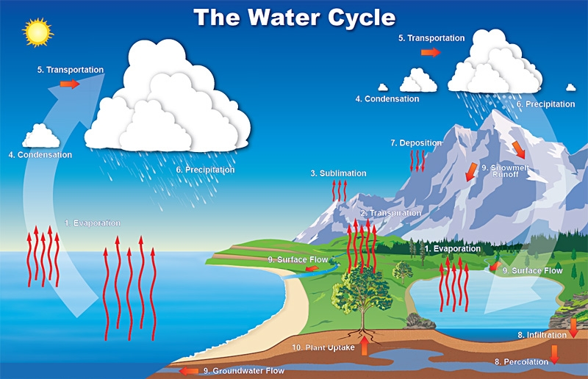
Formation of Water
Water Cycle
Notes:
4

Slide 5
Types of Water Used In Industry
In an industry various types of water used
  Raw water
  RO water
  Soft water
  Cooling tower water
  Chilled water
  Hot water
Notes:
5

Slide 6
Types of Water
Raw water
  Raw water is natural water found in the environment and has not been treated, nor have any minerals, ions, particles or living organisms removed. Raw water includes rainwater, ground water, water from infiltration wells, and water from bodies like lakes and rivers. This is used for only washing in industry.
RO water
  Reverse osmosis (RO) water is purified water which have removed ions molecules and larger particles from drinking water. This water is used in process and drinking.
Soft water
  Soft water is removed a ions molecules in a raw water. This types of water used in boiler and cooling towers.
Notes:
6

Slide 7
Types of Water
Cooling tower water
  It is a type of soft-water, but temperature of this water is low as compared to Raw water. It is cooled by natural treatment with cooling tower. Cooling towers may either use the evaporation of water to remove process heat and cool the working fluid.
Chilled water
  Its temperature is near by to 0 deg centrigrate. This water is used to process for chiling the product and air by heat exchanger.
Hot water
  Hot water heat water above its initial temperature. Typical industrial uses of hot water include in process ,cooking, cleaning, and space heating.
Notes:
7

Slide 8
Types of Water Treatment
In an industry, various types of water treatment uses;
  WTP (Water treatment plant)
  ETP (Effulent treatment plant)
Notes:
8

Slide 9
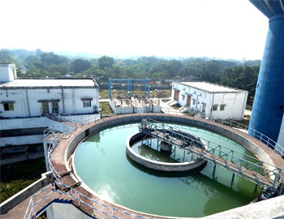
Treatment Of Water
WTP
Raw water from all sources can be treated for suspended solids, turbidity & colloidal particles using clarification systems. In a WTP we treat a water and remove the impurities.
In WTP we remove impurities in 2 step. First only remove a ions this types of water called soft water and second remove the both hardness and ions. This types of water called a RO water or process water.
Notes:
9

Slide 10
Treatment Of Water
Water Treatment in WTP
The feed water treatment methods are as following;
  Lime and Soda softening.
  Ion exchange:-
    Base exchange.
    De alkalization.
    De mineralization.
  Reverse osmosis.
Notes:
10

Slide 11
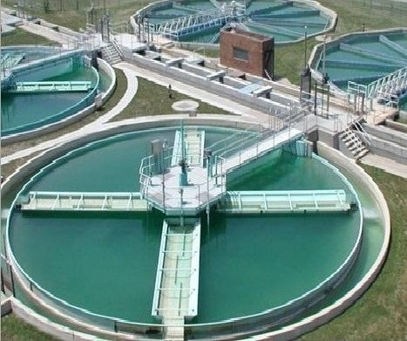
Treatment Of Water
Water Treatment in ETP
Effluent Treatment Plant (ETP) is essential to purify the waste-water which is come from different types of manufacturing industry like FMCG, textile, ternary, dyes and chemical manufacturing industry, pharmaceuticals etc. Different environment saving organizations are trying to protect the environment from the harmful effect of the effluent. Different waste-water has different characteristics which pollute the water.
Notes:
11

Slide 12
Treatment Of Water
Water Treatment in ETP
Effluent from industry
↓
Primary Filtration
↓
Cooling and Mixing
↓
Neutralization (by acid or alkali)
↓
Chemical Coagulation
↓
Settling and Separation of Sludge
↓
Pressure Filtration
↓
Discharge
Notes:
12

Slide 13
Treatment Of Water
Water Treatment in ETP
Primary Filtration:
  It is the first stage of effluent treatment plant, where effluent is come from weaving, dyeing, printing or finishing unit. Here primary filtration is performed to remove solid waste particles.
Cooling and Mixing:
  In this stage, different types of effluent are mixed and cool down by the help of motor which run a fan.
Neutralization Tank:
  After cooling and mixing; effluent is transferred to neutralization tank by the help of pump. Here, acid or alkali is mixed to neutralize the effluent. A pH meter is placed in the neutralization tank.
Coagulant Bath:
  After neutralization of effluent; effluent is transferred to a coagulant bath. Here, coagulant is added with the effluent.
Notes:
13

Slide 14
Treatment Of Water
Water Treatment in ETP
Settling Tank:
  Effluent separates from the water and it found in the lower level of the tank. Effluent is like as sludge.
Pressure Filter:
  Filtration is done under pressure. A certain amount of pressure is created here.
Discharge to Drain:
  After completion of all the process, the effluent becomes purify and it becomes safe to drain to the environment. When treated water is drain to the environment it is checked by the different testing lab. Different standard is maintained during discharge of the treated effluent.
Notes:
14

Slide 15
Treatment Of Water
Water Treatment in ETP
pH Control:
  To adjust the pH in the treatment process to make wastewater pH neutral.
    For acidic wastes
    (low pH): NaOH, Na₂CO₃, CaCO₃ or Ca(OH)₂.
    For alkali wastes
    (high pH): H₂SO₄, HCl
Notes:
15

Slide 16
Uses
Uses of Water in Industry
Uses of water in industry ;
  Raw water are only used in floor cleaning of industry.
  Soft water is used in cooling tower.
  Soft water are used in boiler to formation of steam.
  RO water are used in process equipment cleaning in duration of process and drinking water.
  Chilled water are used for pasteurized a product by heat transfer.
  Hot water are also used in pasteurized process.
Notes:
16

