Slide 1
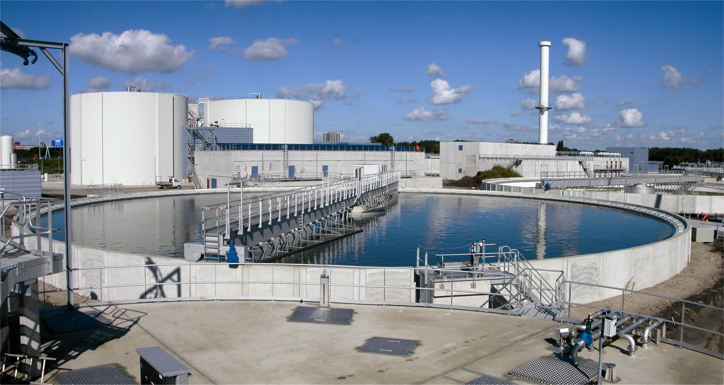
Selection Of Water Treatment Plant

Slide 2

CONTENTS
1
Introduction
Page 3
2
Types of Water Treatment
Page 4
3
Water Treatment Plants
Page 5
4
Effulent Treatment Plant
Page 12
5
Sewage Treatment Plant
Page 16
X
About PMG Engineering
#

Slide 3
Introduction
Water Treatment
We consider wastewater treatment as a water use because it is so interconnected with the other uses of water. Much of the water used by homes, industries, and businesses must be treated before it is released back to the environment.
It's a matter of caring for our environment and for our own health. There are a lot of good reasons why keeping our water clean is an important priority.
Raw water entering an industrial plant often needs treatment to meet tight quality specifications to be of use in specific industrial processes. Industrial water treatment encompasses all these aspects which include industrial wastewater treatment, boiler water treatment and cooling water treatment.
Notes:
3

Slide 4
Selection
Selection of Water Treatment Plant
When choosing a water treatment system there are a number of factors to be considered: size of treatment system, type of contaminants you want to treat, knowledge of how the proposed treatment system works including its strengths and weaknesses, purchase price and maintenance costs, and whether or not the water treatment device is safe and effective.
Selection of Water treatment plant some take in your mind:-
  Deside how much treated water you want
  Indentify the contaminates you want to treat
  Do your homework when you selecting a water treatment plant
  Recognize water treatment device have limitation
  Consider the long-term cost
  Looks for certification
Notes:
4

Slide 5
Water Treatment Plant
Feed Water
The feed water treatment methods are as following:
  Lime and Soda softening.
  Ion exchange:-
    Base exchange.
    De alkalization.
    De mineralization.
Reverse osmosis.
Notes:
5

Slide 6
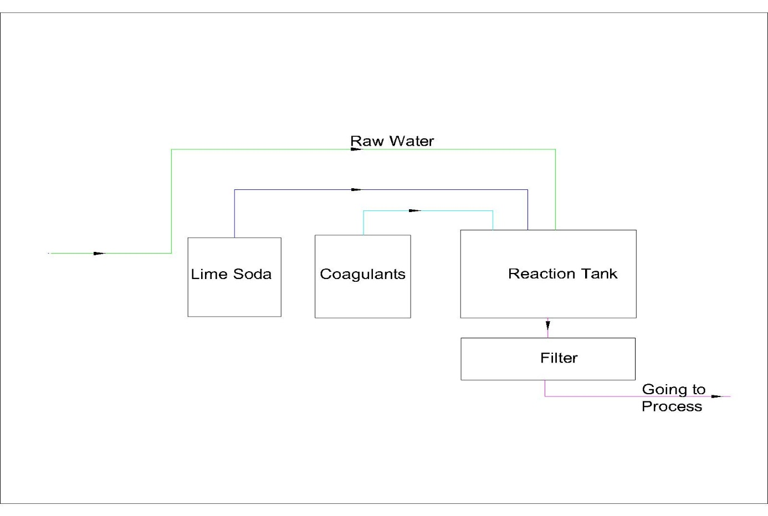
Water Treatment Plant
  Base Exchange
Soda lime is a process used in water treatment to remove Hardness from water. This process is now obsolete but was very useful for the treatment of large volumes of hard water. Addition of lime (Cao) and soda (Na2CO3) to the hard water precipitates calcium as the carbonate, and magnesium as its hydroxide. The amounts of the two chemicals required are easily calculated from the analysis of the water and Stoichiometry of the reactions. The lime‐soda uses lime, Ca (OH)2 and soda ash, Na2CO3, to precipitate hardness from solution.
Notes:
6

Slide 7
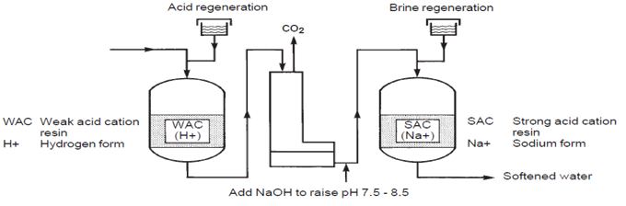
Water Treatment Plant
  De Alkalization Exchange
The de alkalization of water refers to the removal of alkalinity ions from water. Chloride cycle anion ion exchange de alkalizes remove alkalinity from water. Chloride cycle de-alkalizes & operate similarly as sodium cycle cation water softeners. Like water softeners, de alkalizes contain ion exchange resins that are regenerated with a concentrated salt solution - NaCl. In the case of a water softener, the cation exchange resin is exchanging sodium for hardness minerals such as calcium and magnesium. A de alkalizes contains strong base anion exchange resin that exchanges chloride for carbonate, bicarbonate and sulfate. As water passes through the anion resin the carbonate, bicarbonate and sulfate ions are exchanged for chloride ions.
Notes:
7

Slide 8
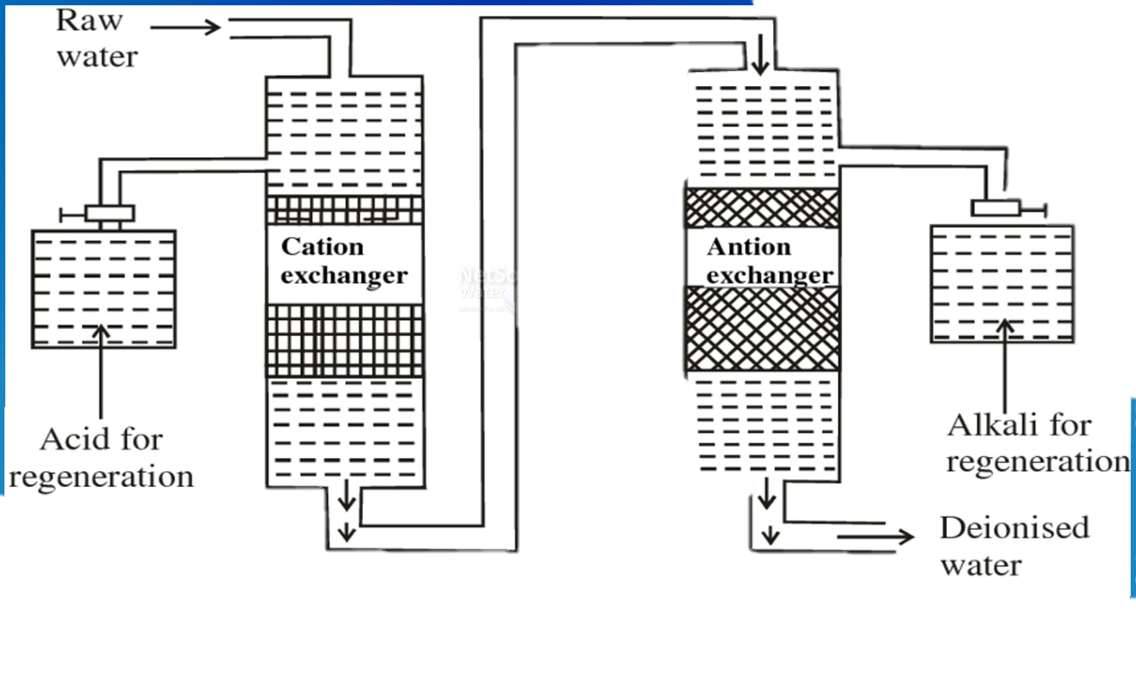
Water Treatment Plant
  De Mineralization Exchange
This process will remove virtually all the salts. It involves passing the raw water through both cation and anion exchange resins. Sometimes the resins may be contained in one vessel and this is termed 'Mixed Bed' demineralization. The process removes virtually all the minerals and produces very high-quality water containing almost no dissolved solids. It is used for very high-pressure boilers such as those in power stations.
Notes:
8

Slide 9
Water Treatment Plant
  Reverse Osmosis
Major Parts of RO Plant;
  Pre-Filter(s): Water from the cold-water supply line enters the Reverse Osmosis Pre Filter first. There may be more than one pre-filter used in a Reverse Osmosis system, the most common being sediment and carbon filters. These pre-filters are used to project the RO membranes by removing sand silt, dirt, and other sediment that could clog the system. Additionally, carbon filters may be used to remove chlorine, which can damage the RO membranes.
  Reverse Osmosis Membrane: The Reverse Osmosis Membrane is the heart of the system. The semipermeable RO membrane is designed to remove a wide variety of both aesthetic and health-related contaminants. After passing through the membrane, the water goes into a pressurized storage tank where treated water is stored.
  Storage Tank: The standard RO storage tank holds of water. A bladder inside the tank keeps water pressurized in the tank when it is full.
Notes:
9

Slide 10
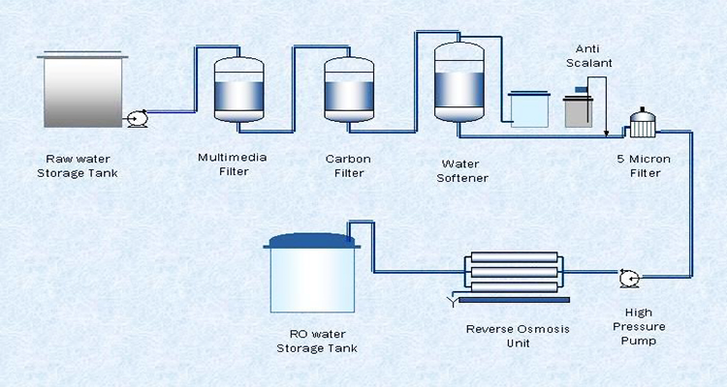
Water Treatment Plant
  Reverse Osmosis
Notes:
10

Slide 11
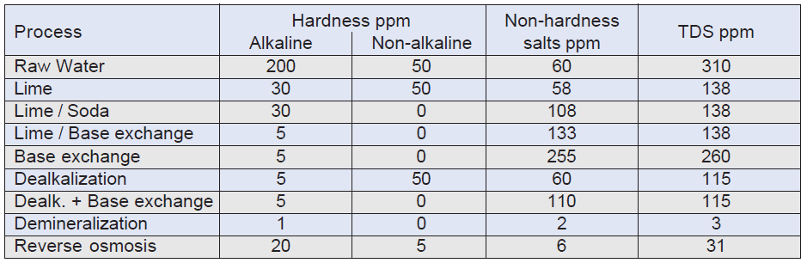
Water Treatment Plant
  Water Treatment Plant
Notes:
11

Slide 12
Effluent Treatment Plant
Water Treatment in ETP
Effluent from industry
↓
Primary Filtration
↓
Cooling and Mixing
↓
Neutralization (by acid or alkali)
↓
Chemical Coagulation
↓
Settling and Separation of Sludge
↓
Pressure Filtration
↓
Discharge
Notes:
12

Slide 13
Effluent Treatment Plant
Water Treatment in ETP
Primary Filtration:
  It is the first stage of effluent treatment plant, where effluent is come from weaving, dyeing, printing or finishing unit. Here primary filtration is performed to remove solid waste particles.
Cooling and Mixing:
  In this stage, different types of effluent are mixed and cool down by the help of motor which run a fan.
Neutralization Tank:
  After cooling and mixing; effluent is transferred to neutralization tank by the help of pump. Here, acid or alkali is mixed to neutralize the effluent. A pH meter is placed in the neutralization tank.
Coagulant Bath:
  After neutralization of effluent; effluent is transferred to a coagulant bath. Here, coagulant is added with the effluent.
Notes:
13

Slide 14
Effluent Treatment Plant
Water Treatment in ETP
Settling Tank:
  Effluent separates from the water and it found in the lower level of the tank. Effluent is like as sludge.
Pressure Filter:
  Filtration is done under pressure. A certain amount of pressure is created here.
Discharge to Drain:
  After completion of all the process, the effluent becomes purify and it becomes safe to drain to the environment.
  When treated water is drain to the environment it is checked by the different testing lab. Different standard is maintained during discharge of the treated effluent.
Notes:
14

Slide 15
Effluent Treatment Plant
Water Treatment In ETP
pH Control:
  To adjust the pH in the treatment process to make wastewater pH neutral:
    For acidic wastes
      (low pH): NaOH, Na2CO3, CaCO3 or Ca(OH)2.
    For alkali wastes
      (high pH): H2SO4, HCl
Notes:
15

Slide 16
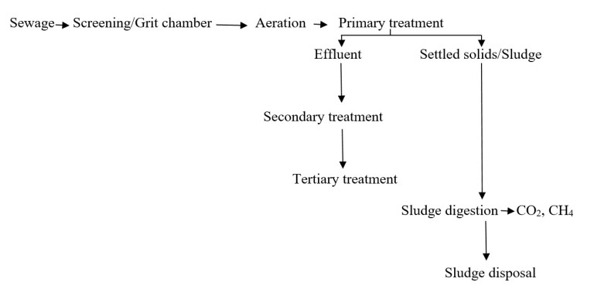
Sewage Treatment Plant
STP
Sewage sludge treatment describes the processes used to manage and dispose of sewage sludge produced during sewage treatment. Sludge is mostly water with lesser amounts of solid material removed from liquid sewage.
Waste-water or raw sewage is water that drains from toilet sinks, showers, baths, dishwasher, washing machine and liquid industrial waste.it is treated in a multi-stage process by the water companies that make it safe to return to the environment.
Notes:
16

Slide 17
Sewage Treatment Plant
STP
In a STP treatment process are complete in four step-
  Preliminary treatment
  Primary treatment
  Secondary treatment
  Tertiary treatment
Notes:
17

Slide 18
Sewage Treatment Plant
STP
Preliminary treatment:
  Preliminary treatment consists solely in separating the floating materials like tree branches pieces of rags, wood etc. and heavy settable inorganic solids. Preliminary treatment have some process to remove a contaminate-
    Screening – to remove floating, papers.
    Grief chamber – to remove grief and sand.
    Skimming tanks – to remove oil and gases.
Primary treatment
  Primary treatment consist of removing large suspended organic solids. It is usually accomplished by sedimentation in settling basin. The liquid effluent from the primary treatment often contains a large amount of suspended organic material and has a high BOD
Notes:
18

Slide 19
Sewage Treatment Plant
Secondary Treatment
Here the effluent from primary treatment is treated through biological decomposition of organic matter carried out either aerobic or anaerobic conditions.
  Aerobic biological units
    Filter
    Activated sludge plant
    Oxidation ponds and aerated lagoons
  Anaerobic biological unit
    Anaerobic lagoons
    Septic tanks
    Inhofe tanks
The effluent from the secondary treatment contains a little BOD (5% to 10% of original) and may contain milligram
Notes:
19

Slide 20
Sewage Treatment Plant
Tertiary Treatment
The purpose of tertiary is to provide a final treatment stage to raise the effluent quality before it is discharge to receiving environment. More than one tertiary treatment process may be used at any treatment plant, if disinfection is practiced , it is always the final process. It is also known as effluent polishing.
Notes:
20

