Slide 1
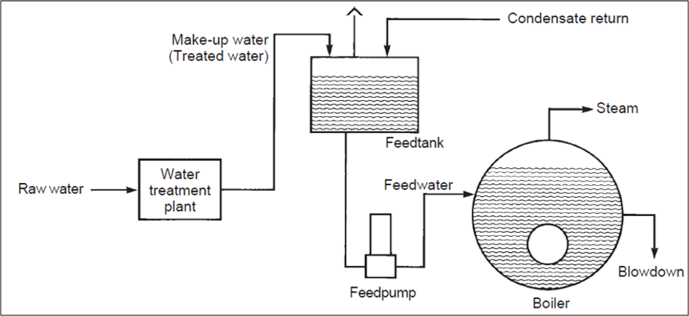
Feed Water Quality

Slide 2

CONTENTS
1
Introduction
Page 3
2
Impurities in Water
Page 4
3
Impurities Effect on Boiler
Page 5
4
Feed Water Treatment
Page 8
5
Compare of treatment process
Page 16
X
About PMG Engineering
#

Slide 3
Feed Water
Feed Water
In a boiler we need ultra pure water for the steam generaion.
Natural/Raw water contains suspended and dissolved gases.
For all boilers, feed water must be pretreated to remove impurities.
Feed water is mix up of condensate & make up water.
Notes:
3

Slide 4
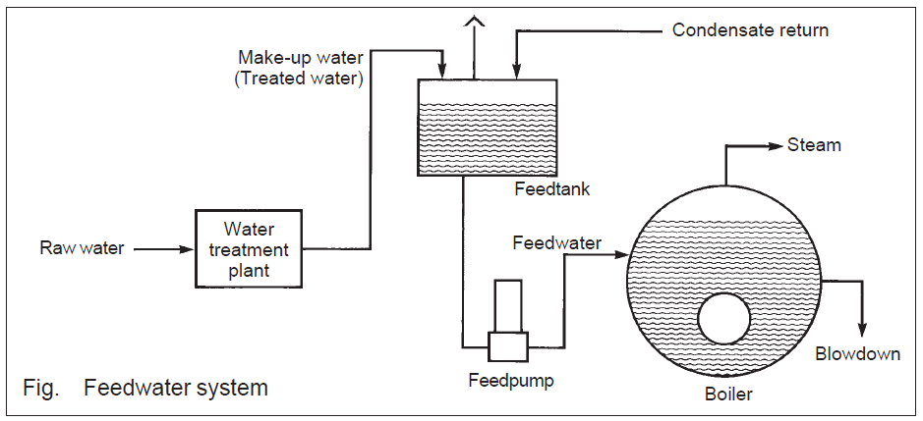
Feed Water
Notes:
4

Slide 5
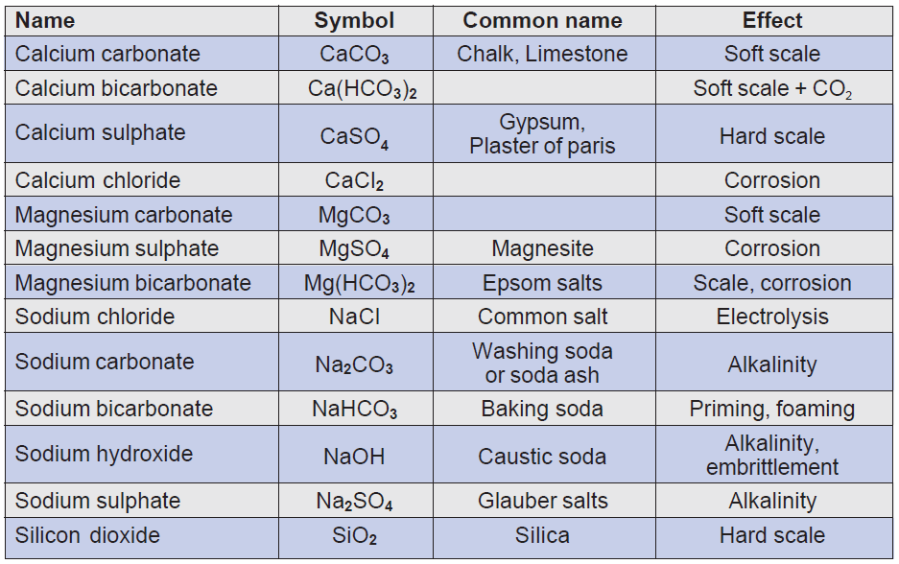
Feed Water
Notes:
5

Slide 6
Problem Causes By Impurites
Feed Water
If we feed water inside a boiler without treatment, it leads to following problems;
  Scaling: Scale forming substances the principal ones are the carbonates and sulfate of calcium and magnesium. Not all dissolved solids will form scale.
  Sludge: Sludge forming substances usually solid mineral or organic particles carried in suspension. These substances are not generally a problem with most waters.
  Corrosion: Corrosion is natural process which is converts a refined metal to more chemically stable form ,such as its oxide,hydroxide or sulfide.
  Fouling: Fouling is the accumulation of unwanted material on solid surface to detriment of function .The fouling material can consist of either living organism or non organism substance.
Notes:
6

Slide 7
Treatment Of Water
Feed Water
The feed water treatment methods are as following;
  Lime and Soda softening.
  Ion exchange:-
    Base exchange.
    De alkalization.
    De mineralization.
  Reverse osmosis.
Notes:
7

Slide 8
Treatment Of Water
Lime and Soda Softening
Soda lime is a process used in water treatment to remove Hardness from water. This process is now obsolete but was very useful for the treatment of large volumes of hard water.
Addition of lime (CaO) and soda (Na₂CO₃) to the hard water precipitates calcium as the carbonate, and magnesium as its hydroxide. The amounts of the two chemicals required are easily calculated from the analysis of the water and stoichiometry of the reactions.
The lime‐soda uses lime, Ca(OH)₂ and soda ash, Na₂CO₃, to precipitate hardness from solution.
Notes:
8

Slide 9
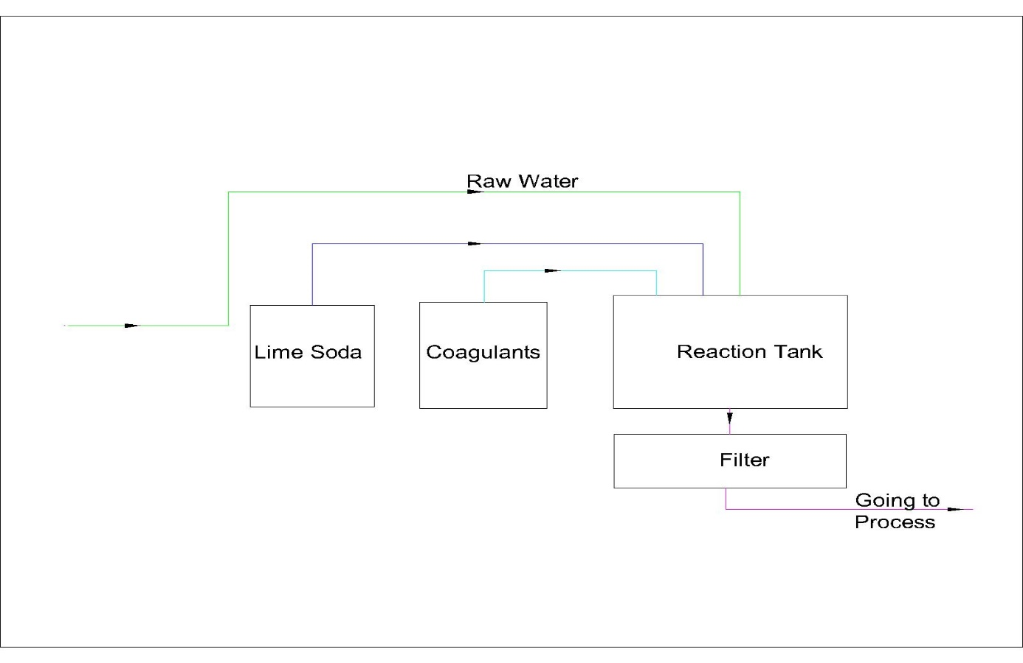
Treatment Of Water
Lime and Soda Softening
Notes:
9

Slide 10
Treatment Of Water
  Base Exchange
This is the simplest form of ion exchange and also the most widely used. The resin bed is initially activated or charged bypassing a 7 - 12 % solution of brine (sodium chloride or common salt) through it, which leaves the resin rich in sodium ions.
Thereafter, the water which is to be softened is pumped through the resin bed and ion exchange occurs.
Calcium and magnesium ions displace sodium ions from the resin, leaving the flowing water rich in sodium salts.
Remember sodium salts stay in solution at very high concentrations and temperatures and do not form harmful scale in the boiler.
Notes:
10

Slide 11
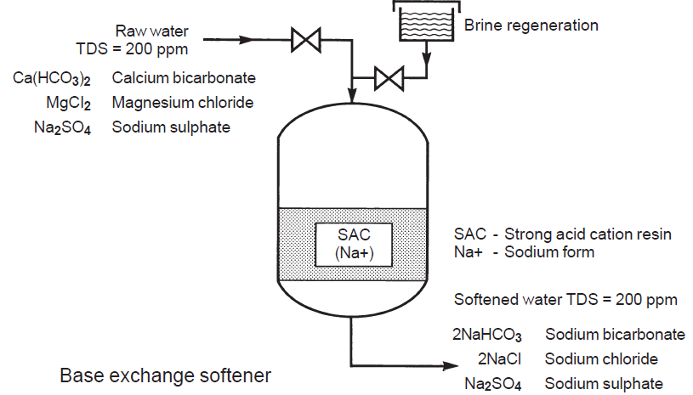
Treatment Of Water
  Base Exchange
Notes:
11

Slide 12
Treatment Of Water
  De Alkalization Exchange
The de alkalization of water refers to the removal of alkalinity ions from water. Chloride cycle anion ion exchange de alkalizes remove alkalinity from water. Chloride cycle de alkalizes operate similar to sodium cycle cation water softeners.
Like water softeners, de alkalizes contain ion exchange resins that are regenerated with a concentrated salt solution - NaCl.
In the case of a water softener, the cation exchange resin is exchanging sodium for hardness minerals such as calcium and magnesium.
A de alkalizes contains strong base anion exchange resin that exchanges chloride for carbonate, bicarbonate and sulfate.
As water passes through the anion resin the carbonate, bicarbonate and sulfate ions are exchanged for chloride ions.
Notes:
12

Slide 13
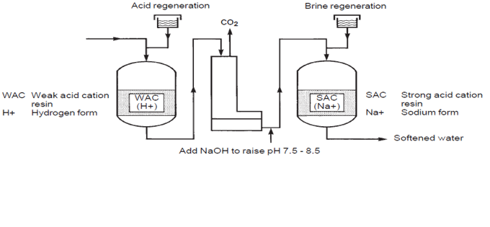
Treatment Of Water
  De Alkalization Exchange
Notes:
13

Slide 14
Treatment Of Water
  De Mineralization Exchange
This process will remove virtually all the salts. It involves passing the raw water through both cation and anion exchange resins.
Sometimes the resins may be contained in one vessel and this is termed 'Mixed Bed' demineralization.
The process removes virtually all the minerals and produces very high quality water containing almost no dissolved solids.
It is used for very high-pressure boilers such as those in power stations.
Notes:
14

Slide 15
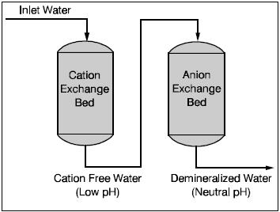
Treatment Of Water
  De Mineralization Exchange
Notes:
15

Slide 16
Treatment Of Water
  Reverse Osmosis
Major Parts of RO Plant:
  Pre-Filter(s): Water from the cold-water supply line enters the Reverse Osmosis Pre Filter first. There may be more than one pre-filter used in a Reverse Osmosis system, the most common being sediment and carbon filters. These pre-filters are used to PROTECT the RO membranes by removing sand silt, dirt, and other sediment that could clog the system. Additionally, carbon filters may be used to remove chlorine, which can damage the RO membranes.
Notes:
16

Slide 17
Treatment of Water
  Reverse Osmosis
Major Parts of RO Plant:
  Reverse Osmosis Membrane: The Reverse Osmosis Membrane is the heart of the system. The semipermeable RO membrane is designed to remove a wide variety of both aesthetic and health-related contaminants. After passing through the membrane, the water goes into a pressurized storage tank where treated water is stored.
  Storage Tank: The standard RO storage tank holds of water. A bladder inside the tank keeps water pressurized in the tank when it is full. The typical under counter Reverse osmosis tank.
Notes:
17

Slide 18
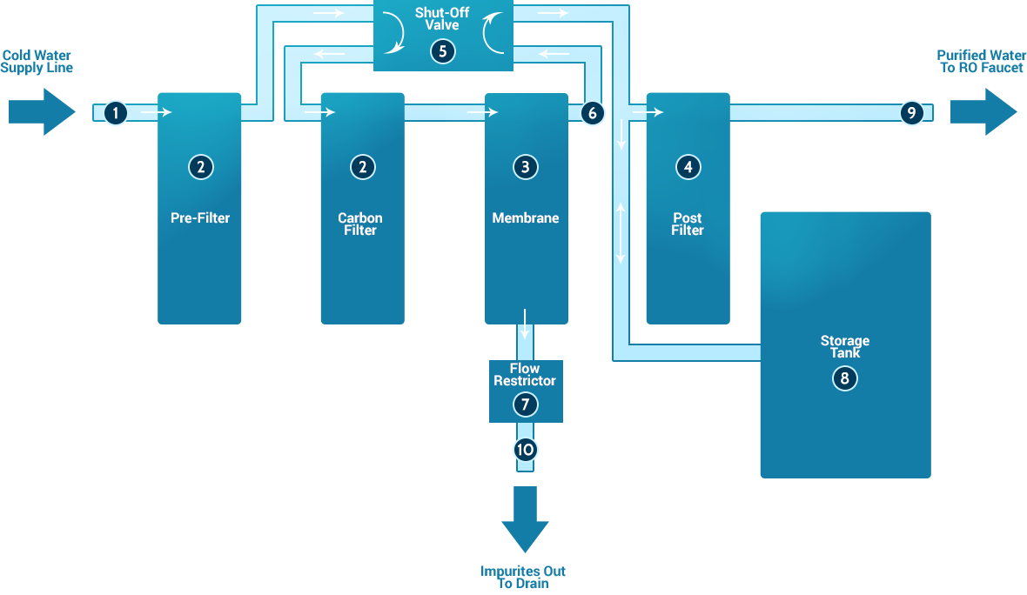
Treatment Of Water
  Reverse Osmosis
Notes:
18

Slide 19
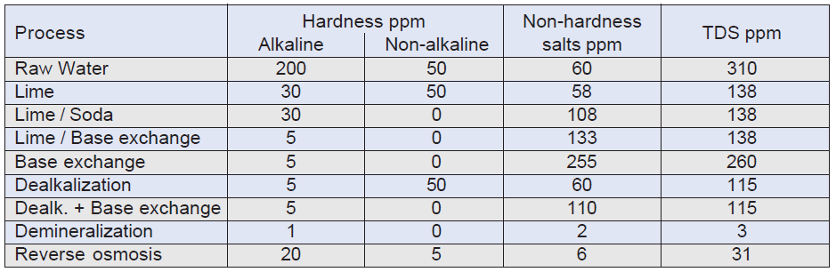
Treatment of Water Compare Sheet
Feed Water
Notes:
19

