Slide 1
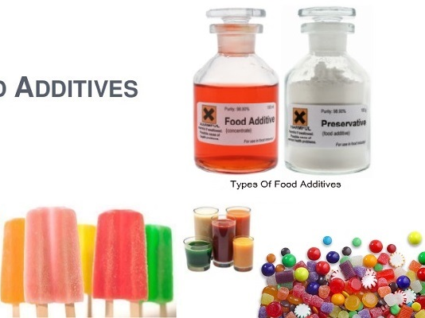
FOOD ADDITIVES

Slide 2
AGENDA
1
What are food additives?
2
Why use additives?
3
Functions of food additives
4
Types of food additives
5
Classes of food additives
6
E-Codes
Notes:
2

Slide 3
WHAT ARE FOOD ADDITIVES?
Food Additives
Food additives are substances added to food to preserve flavor or enhance its taste, appearance, or other qualities.
These are chemicals or ingredients added to food to increase the stability of food
They are natural or artificial chemicals added to food for microbiological and chemical atability, also to stop food rancidity.
Some additives have been used for centuries; for example, preserving food by pickling (with vinegar), salting, as with bacon, preserving sweets or using sulfur dioxide as with wines
Notes:
3

Slide 4
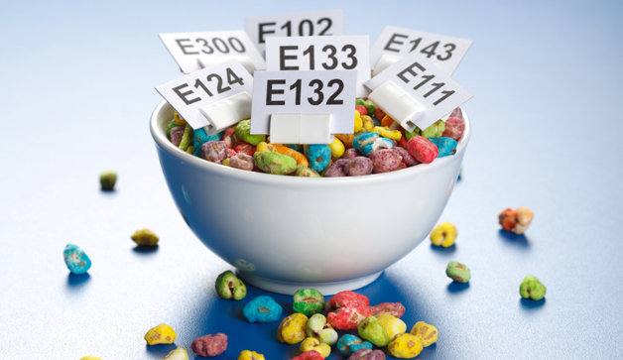
WHY USE FOOD ADDITIVES?
Food Additives- The Need
Food produced on a large scale that is needed to supply super markets and various other food stores has to be transported and stored before it can be consumed.
Food has to stay in top conditionover a much longer period of time than home cooked food
Additives are used so that these foods have consistently high quality uptill the time they are consumed
Notes:
4

Slide 5
FUNCTIONS OF FOOD ADDITIVES
Functions
Improves the taste or appearance of processed food. E.g. Beeswax- glazing agent used to coat apples
Improves the keeping quality/ stability of food. E.g. Sorbitol- added to mixed dry fruit to maintain moisture level and softness of the fruit
Improves shelf life/ storage time. E.g. Sulphur dioxide added to sausage meat to avoid microbial growth
Ensures nutritional value
Maintains uniform quality parameters like flavor, color etc in large scale production
Notes:
5

Slide 6
TYPES OF FOOD ADDITIVES
Based on origin
Mode of Addition
Natural: found naturally, such as extracts from beetroot juice (E162), used as a colouring agent
Manmade: synthetic identical copies of substances found naturally, such as benzoic acid (E210), used as a preservative
Artificial: Produced synthetically and not found naturally, such as nisin (E234), used as a preservative in some dairy products and in semolina and tapioca puddings.
Direct/ intentional food additives: Added deliberately to improve sensory quality, stability,ease in processing and quality retention.
Indirect/ unintentional food additives: They get into foods incidently during handling, processing and packaging
Notes:
6

Slide 7
CLASSES OF FOOD ADDITIVES
Preservatives
Antioxidants
Food colors
Flavor enhancers
Sweetners
Acids, bases & buffer
Anticaking agents
Anti foaming agents
Glazing agents
Emulsifiers& stabalizers
Notes:
7

Slide 8
CLASSES OF FOOD ADDITIVES
Preservatives
Antioxidants
Prevent the growth of micro-organisms which could cause food spoilage and lead to food poisoning
Extend the shelf-life of products, so that they can be distributed and sold to the consumer with a longer shelf-life
Prevent food containing fat or oil from going rancid due to oxidation, i.e. developing an unpleasant odour or flavour
Prevent the browning of cut fruit, vegetables and fruit juices (and so increase shelf life and appearance).
Notes:
8

Slide 9
CLASSES OF FOOD ADDITIVES
Food Colors
Flavor Enhancers
Restore colour lost during processing or storage, e.g. marrowfat peas
Ensure that each batch produced is identical in appearance or does not appear ‘off’
Reinforces colour already in foods, e.g. enhance the yellowness of a custard
Give colour to foods which otherwise would be colourless (e.g. soft drinks) and so make them more attractive
Bring out the flavor in foods without imparting a flavor of their own, e.g. monosodium glutamate (E612) is added to processed foods. For example some soups, sauces and sausages.
Flavourings are added to a wide range of foods, usually in small amounts to give a particular taste
Notes:
9

Slide 10
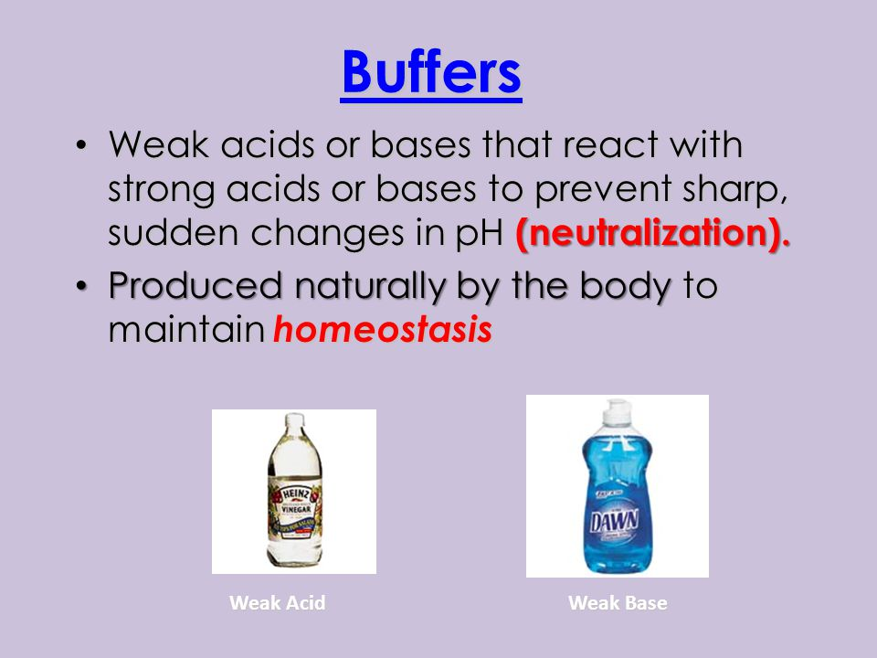
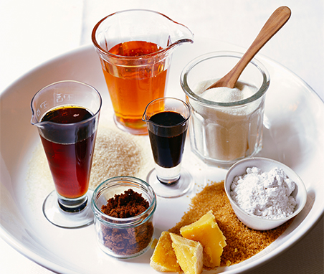
CLASSES OF FOOD ADDITIVES
Sweetners
Acids, bases & buffers
Intense sweeteners: e.g. saccharin, have a sweetness many times that of sugar and therefore are used in small amounts, e.g. in diet foods, soft drinks, sweetening tablets
Bulk sweeteners: e.g. sorbitol, have a similar sweetness to sugar and are used at similar levels
Acids, bases and buffers control the acidity or alkalinity of food, for safety and stability of flavour.
Notes:
10

Slide 11
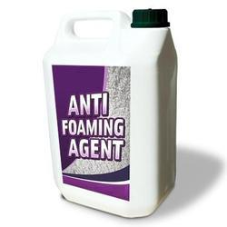
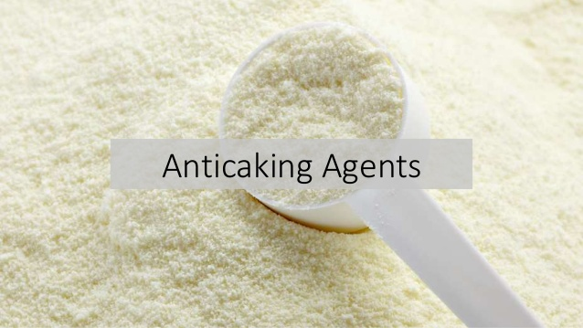
CLASSES OF FOOD ADDITIVES
Anti-caking agents
Anti-foaming agents
Anti-caking agents ensure free movement or flow of particles, e.g. in dried milk or table salt.
Anti-foaming agents prevent or disperse frothing, e.g. in the production of fruit juices.
Notes:
11

Slide 12
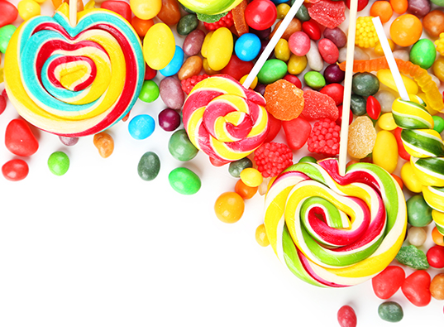
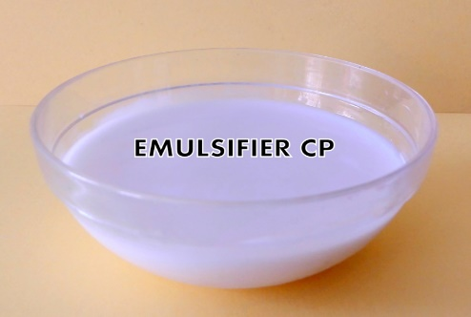
CLASSES OF FOOD ADDITIVES
Glazing agents
Emulsifiers
Glazing agents provide a protective coating or sheen on the surface of foods, e.g. confectionary (for appearance and shelf-life).
Emulsifiers help mix ingredients together that would normally separate, e.g. Lecithins
Stabilisers prevent ingredients from separating again, e.g. locust bean gum
Emulsifers and stabilisers give food a consistent texture, e.g. they can be found in low-fat spreads.
Notes:
12

Slide 13
E-CODES
What are they?
E- code Numbers
E-codes are codes found on food labels
These codes indicate an ingredient with some type of food additive
The “E” indicates that the food additive is approved by the European Union
E-100: Coloring Agents
E-200: Preservatives
E-300:Anti oxidants
E-400: Thickeners, stabalizers, gelling agents, emulsifiers
E-500: agents for physical characteristics
E-600: Flavor Enhancers
Notes:
13

