Slide 1
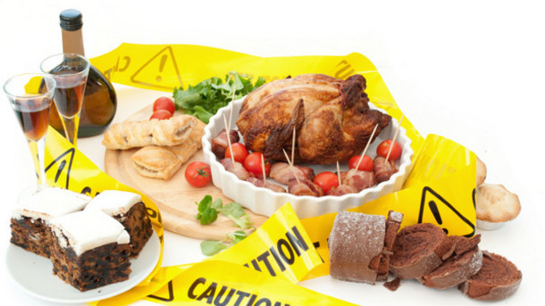
FOOD CONTAMINANTS

Slide 2
AGENDA
1
What is food Contamination?
2
Major contaminants in food
3
Biological Contaminants
4
Chemical Contaminants
5
Physical contaminants

Slide 3
WHAT IS FOOD CONTAMINATION?
Food Contamination
Food Recalls
Anything in food that reduces the safety or quality and is not supposed to be there.
Food may be contaminated intentionally or accidentally.
As a consumer, we never want to see our food to be contaminated but often the contamination we can see doesn't actually harm us, it is more often the unseen contamination that is most harmful.
A food recall is when food is returned to the producers due to safety or legal concerns.
Food recalls may not be anything actually wrong with the product, but often it is something wrong with the labeling.
Allergens are considered a food contamination if it is not properly stated on the label. If something is not stated on the label then it is considered a food contaminant.

Slide 4
MAJOR CONTAMINANTS IN FOOD
Contaminant
Types of contaminants
Any substance added intentionally or unintentionaqlly that
  Makes food unfit for human consumoption e.g. Insects
  Is added only to increase the bulk or weight of food e.g. water in milk
  Is food but is in the wrong place e.g. beans in a can of peas.
There are three major types of food contaminations in a food facility.
  Biological contaminants. E.g. Microorganisms
  Chemical contaminants. E.g. Pesticides
  Physical contaminants. E.g. glass
Some of these contaminants are safety concerns while others are quality concerns.

Slide 5
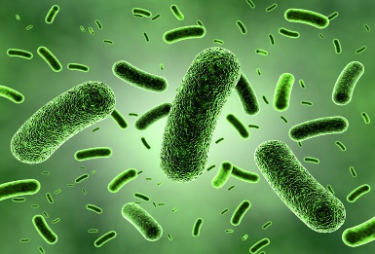
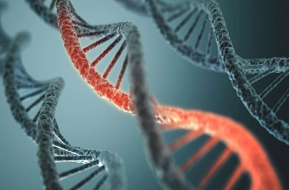
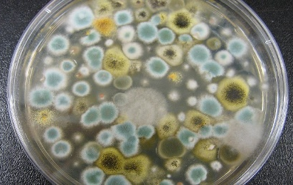
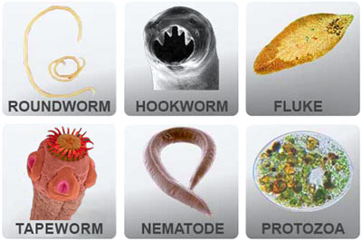
BIOLOGICAL CONTAMINANTS
A microbial contaminant that may cause a food borne illness (bacteria, viruses, fungi, parasites, biological toxins)
Bacterial
Viral
Fungal
Parasitic
Botulism
E.coli infection
Salmonellosis
Shigellosis
Listeriosis
Staphylococcal Illness
Hepatitis- A
Norwalk virus
Rota virus
Yeast
Mold
Giardiasis
Cyclosporiasis
Trichonosis

Slide 6
BIOLOGICAL CONTAMINANTS
The “FAT TOM” condition for growth of bacteria
FOOD (F)
ACIDITY (A)
TEMPERATURE (T)
Bacteria need energy to live.
Poultry, dairy products, meat, fish etc are ideal sources of energy for their growth
Nacteria grow best in food that is lightly acidic to neutral
Temperature danger zone is between 41°F-135°F.
It favours bacterial growth
Food to spend minimal time in this zone
TIME (T)
OXYGEN (O)
MOISTURE (M)
The more the time in danger zone, more is the number and chance of bacteria growing to make food unsafe.
Some bacteria need oxygen for their growth (aerobic) and some do not (anaerobic), and some can grow with or without oxygen (facultative)
Moisture favours the growth of bacteria.

Slide 7
BIOLOGICAL CONTAMINANTS
Bacteria in focus
Salmonella typhi
Lives only in humans. Ready to eat foods & beverages are linked to this bacteria
Preventive measures: Washing hands & cooking food to minimum internal temperatures
Shigella spp
Found in human waste, flies & unwashed hands.
Food linked to it are contaminated by hands
Preventive measures: Wash hands & prevent flies inside facility
Escherichia coli
Found in infected people & intestines of cattle
Linked with beef and contaminated produce
Preventive measures: Prevent cross contamination

Slide 8
BIOLOGICAL CONTAMINANTS
Viruses in focus
Hepatitis- A
The source is human feces & often is transferred by unwashed fingers to food and equipment
Also found in water & ready to eat food
Preventive measures: Washing hands,not touching RTE with bare hands, exclusion of staff with jaundice from facility
Norovirus
The source is human feces & often is transferred by unwashed fingers to food and equipment
Also found in water & ready to eat food
Preventive measures: Exclude staff with diarrhea & vomiting from facility, wash hands, do not touch products with bare hands

Slide 9
CHEMICAL CONTAMINANTS
Chemical Contaminants
Chemicals (Anribiotics/ pesticides)
Food that has been contaminated by some type of chemical substance.
This includes antibiotics, pesticides, and cleaning agents
Agricultral antibiotics are not safe for human consumotion.
E.g. Cow milk may contain antibiotic administered to cow against disease
Cleaning agents
Allergens
Necessary to clean up possible biological & physical contaminants
Yet, cleaning agents are harmful if ingested. Finalproduct to be free of cleaning agents
Allergens are also considered a chemical contaminant only if the allergen is not declared on the food label.

Slide 10
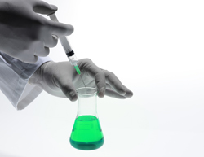
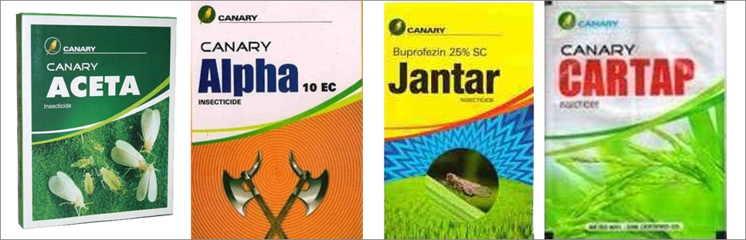
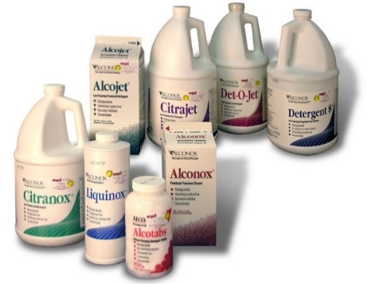
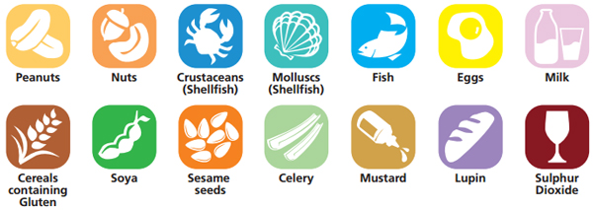
CHEMICAL CONTAMINANTS
Chemical Contaminants
Chemicals (Anribiotics/ pesticides)
Cleaning agents
Allergens

Slide 11
PHYSICAL CONTAMINANTS
Physical Contaminants
Hair, Nails etc.
Food that has been contaminated by a foreign object at some stage of the production process.
These contaminants are found due to improper implementation of
GMP’s, keeping facility clean and equipment in good shape.
Metal scraps/ glass
Dust/ insects
These contaminants are found due to defects in the equipments.
Can be prevented by use of metal detectors
These contaminants are found due to lack of cleanliness and air monitoring in the processing areas.
Can be prevented by stringent cleanliness and air monitoring.

