Slide 1
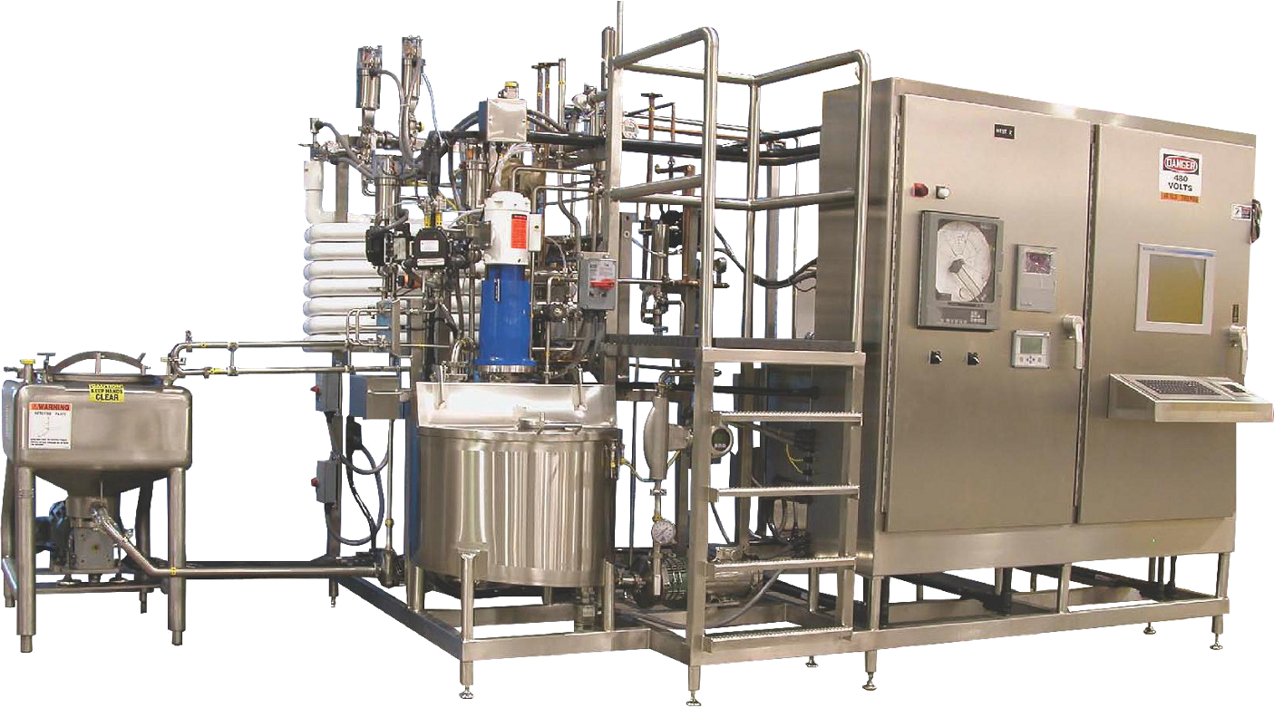
HTST PASTEURIZATION

Slide 2
AGENDA
1
Definition
2
HTST Pasteurization use
3
Overview of HTST Pasteurization
4
Thermal Exchange systems
5
CCP’s for HTST Pasteurization
Notes:
2

Slide 3
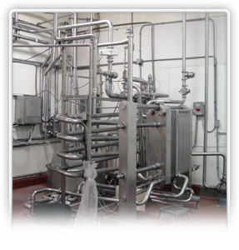
DEFINITION
High Temperature Short Time (HTST)
In high-temperature short-time (HTST) pasteurization, the product is heated to the minimum temperature and held continuously at or above that temperature for at least the minimum time required.
Compared to vat pasteurization, the required temperatures are much higher and the holding periods much shorter.
Notes:
3

Slide 4
HTST PASTEURIZATION USE
HTST Pasteurization Use
The below table shows the required time and temperature for HTST Pasteurization of various milk products
Product | Temperature | Time
Milk | 161 °F | 15 seconds
Viscous products, or products with more than 10% fat or added sweetener (e.g., cream, yogurt) | 166 °F | 15 seconds
Frozen dessert mixes | 175 °F | 25 seconds
Notes:
4

Slide 5
OVERVIEW OF HTST PASTEURIZATION
HTST pasteurization includes these main steps:
Product enters the constant level tank and is drawn under reduced pressure to the regenerator section.
In the regenerator section, the product is pre-warmed by hot product flowing through regenerator plates.
The product is then drawn through the timing pump to the heater section.
The now-hot product flows through the holding tube.
The product contacts the indicating thermometer and the recording thermometer.
If it has not reached the minimum required temperature, it is returned back to the constant level tank via the diversion port.
Notes:
5

Slide 6
OVERVIEW OF HTST PASTEURIZATION
HTST pasteurization includes these main steps:
If the product is at or above the minimum required temperature, it passes through the regenerator plates (on the pasteurized side) and then to the cooling section.
The product exits the cooling section and rises to an elevation of at least 12 inches above any raw product.
Finally, the product passes to a storage tank for packaging.
Notes:
6

Slide 7
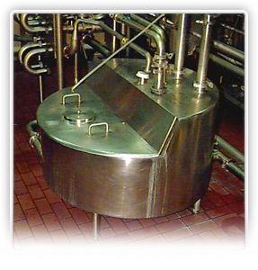
OVERVIEW OF HTST PASTEURIZATION
Constant Level Tank/ Balance Tank
The constant level tank (or balance tank) provides:
  A continuous supply of product to the HTST unit.
  Return storage for sub-legal milk from the flow diversion valve.
  A means for the recirculation of pasteurized milk.
The constant level tank must have a sanitary design, and the overflow level must be at least 1 inch below the lowest level of raw milk in the regenerator.
Notes:
7

Slide 8
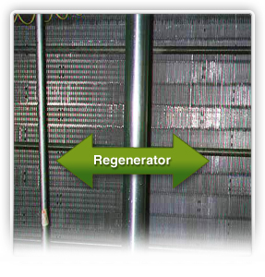
OVERVIEW OF HTST PASTEURIZATION
Regenrator
The regenerator section:
  Pre-warms cold raw milk by the heat given up by hot pasteurized milk flowing in a counter-current direction.
  Separates pasteurized and raw product with stainless steel plates.
Notes:
8

Slide 9
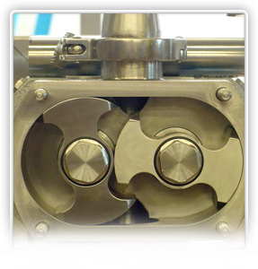
OVERVIEW OF HTST PASTEURIZATION
Timing Pump
The timing pump:
  Controls the flow rate within the HTST system.
  Is located after the raw regenerator and before the holding tube.
  Draws raw milk through the raw regenerator and pushes it forward. The pasteurized product is always under greater pressure than the raw.
The timing pump must be set so the maximum delivery rate is equal to or less than the calculated maximum flow rate. This ensures that the desired minimum holding time is obtained.
Notes:
9

Slide 10

OVERVIEW OF HTST PASTEURIZATION
Timing Pump
Common types of timing pumps include:
  Gear-driven positive displacement pump. In this type of pump, two rotors revolve within an oval case to carry the fluid around the periphery of the pump body. The temperature and type of liquid being pumped may greatly influence the efficiency of a gear-driven positive displacement pump.
  Piston-type pump, such as a homogenizer. This is a very efficient positive displacement pump and is commonly used as the timing pump in HTST pasteurizers. The homogenizer is equipped with a recirculation loop, so that product does not continue to the holding tube if the timing pump is not operating.
  Magnetic flow meter-based pump. This pump uses a centrifugal pump in conjunction with product flow-controlling methods.
Notes:
10

Slide 11
THERMAL EXCHANGE SYSTEMS
Heat exchange systems
While there are different types of thermal exchange systems used in HTST pasteurization, they all function to:
  Heat the product,
  Hold product at the required time and temperature, and
  Cool the product.
The two types of thermal exchange systems are:
  Plate heat exchanger (PHE).
  Tubular heat exchanger (THE).
Both types use indirect heating methods, which involve transferring heat from the heat medium through a partition into the product.
Notes:
11

Slide 12
THERMAL EXCHANGE SYSTEMS
Plate Heat Exchanger
The PHE uses metal plates to transfer heat from pasteurized product to raw product. These plates are pressed with surface patterns to create and increase turbulence in the product stream and enhance the heat transfer.
Molded gaskets around the plate edges and ports prevent leakage and intermixing of fluid. The raw side deflector plates are drilled with weep holes that will allow the regenerator to be free-draining during a shutdown.
Notes:
12

Slide 13
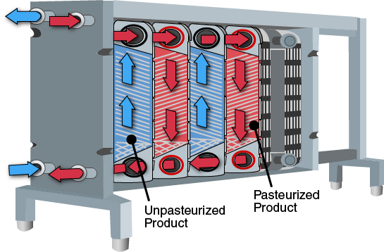

Slide 14
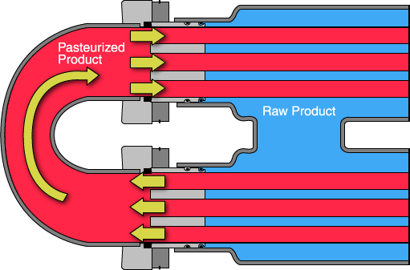
THERMAL EXCHANGE SYSTEMS
Tube Heat Exchanger
Unlike PHEs, THEs have no contact points in the product channel. THEs may have either a double-tube or triple-tube design. However, from the standpoint of heat transfer, the THE is less efficient than the PHE.
The tubes within a THE have spiral or corrugated surfaces to increase turbulence and heat exchange.
Notes:
14

Slide 15
THERMAL EXCHANGE SYSTEMS
Holding Tube
The holding tube ensures that the product is at sterilization temperature for the proper time, and that temperature variation does not exceed 1 °F.
The holding tube:
  Has a minimum upward slope of 0.25 inch per running foot to ensure uniform product flow and preclude air entrapment.
  Is less than 7 inches in diameter.
The length of time the product spends in the holding tube is determined by the pumping rate of the timing pump, the length of the holding tube, and the product surface friction. After flowing through the holding tube, the product contacts the indicating thermometer and the recording thermometer.
The holding tube must:
  Be of sanitary design and be installed on permanent supports.
  Be fabricated to eliminate short circuiting (i.e., no alterable sections).
  Not have any insulation, to allow inspection of the tube.
Notes:
15

Slide 16
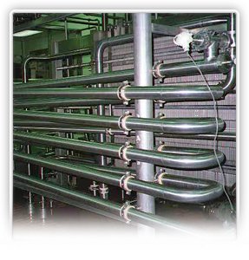
THERMAL EXCHANGE SYSTEMS
Holding Tube
The holding tube must:
  Be of sanitary design and be installed on permanent supports.
  Be fabricated to eliminate short circuiting (i.e., no alterable sections).
  Not have any insulation, to allow inspection of the tube.
Notes:
16

Slide 17
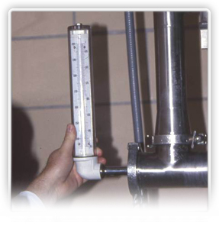
THERMAL EXCHANGE SYSTEMS
Indicating Thermometer
The indicating thermometer in a HTST pasteurizer shows the accurate, “official” temperature of the product.
The indicating thermometer should:
  Be located at the end of the holding tube and as near as practical to the recording thermometer.
  Span not less than 25 °F, and be graduated in 0.5 °F divisions.
  Be accurate to within plus or minus 0.5 °F.
Notes:
17

Slide 18
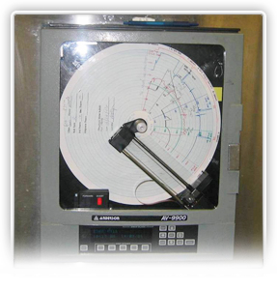
THERMAL EXCHANGE SYSTEMS
Recorder Controller
The recording controller/ safety thermal limit record (STLR) automatically
  Records pasteurization temperatures and times.
  Records the position of the flow diversion device.
  Controls the position of the flow diversion device.
The redording thermometer must be located within 18 inches of the upstream form the flow diverson devide.
Notes:
18

Slide 19
THERMAL EXCHANGE SYSTEMS
Types
STLRs may be one of the following two types:
  Capillary: In this older design, there is a tube filled with a volatile liquid that boils at fairly low temperatures, including in the pasteurization ranges. As it boils, it builds pressure in the sealed tube, which causes a flat coiled tube called the Bourdon coil to unwind and collapse. A significant disadvantage of this system is that as the distance from the sensor bulb to the coil increases, the speed of the response decreases.
  Electronic: Electronic designs may either have analog controls or microprocessor controls. In either case, these STLRs meet the same operational functions as the capillary design. A disadvantage for this design is that some of these units have shown susceptibility to outside radio interference.
Notes:
19

Slide 20
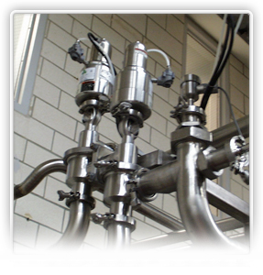
THERMAL EXCHANGE SYSTEMS
Flow Diversion Device (FDD)
The purpose of the flow diversion device is to safely and accurately control and separate raw and pasteurized product flow.
In order to do this, the flow diversion device:
  Controls pumps and other valves.
  Allows product flow forward only when minimum temperature is met.
  Has certain time-delay requirement
Notes:
20

Slide 21
THERMAL EXCHANGE SYSTEMS
Types
Flow diversion devices may be one of the following two types:
  Single stem: The single-stem flow diversion device consists of a three-way valve that automatically controls the direction of product flow. It is air activated for the open (forward) flow position, and spring activated for the closed (divert or fail-safe) position.
  Dual stem: The dual-stem flow diversion device is made up of two three-way valves operating in tandem and multiple controls. This device will switch to the fail-safe divert position in the event of loss of adequate temperature, electronic power, or air pressure.
Notes:
21

Slide 22
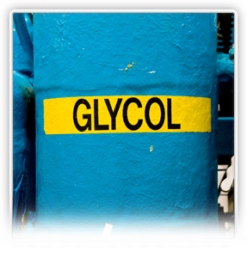
THERMAL EXCHANGE SYSTEMS
Cooler Section
In the cooler section, the product is chilled down to a present temperature (below 45°F) by glycol or ice water solutions
When the product exits the cooler section, it rises to an elevation at least 12 inches above any raw product. Finally, the product passes to a storage tank or vat to await packaging.
Notes:
22

Slide 23
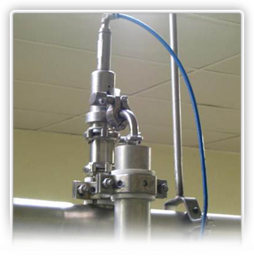
Thermal Exchange Systems
Vacuum breakers
Vacuum breakers:
  Are atmospheric devices that help maintain proper pressure relationships in milk-to-milk regenerator sections.
  Prevent a negative pressure between the flow diversion device and any downstream flow promoting device.
  Are installed after the pasteurized milk regenerator.
  Need to be accessible for inspection and cleaning.
Notes:
23

Slide 24
CCP’s for HTST Pasteurization
CCP’s for inspecting a HTST Pasteurizer
Component | Considerations
Regenerator | Is the pasteurized milk discharged from the regenerator properly? Will the raw milk drain freely back from the raw side of the milk-to-milk regenerator when all flow-promoting devices are stopped?
Timing Pump | If the system has a timing pump, is the homogenizer equipped with a recirculation loop?
Holding Tube | Is the holding tube less than 7 inches in diameter, with permanent supports and no alterable sections? Does the tube slope continuously uphill at not less than 0.25 inch per foot from start to finish?
Notes:
24

Slide 25
CCP’s for HTST Pasteurization
CCP’s for inspecting a HTST Pasteurizer
Component | Considerations
Thermometers | Is the indicator thermometer bulb as close as possible to the recorder bulb? Is the recording thermometer bulb within 18 inches of the flow diversion device? Are the recording thermometer charts properly maintained?
Vacuum Breakers | Are the required vacuum breakers located in the proper place? Are they functioning?
Notes:
25

