Slide 1
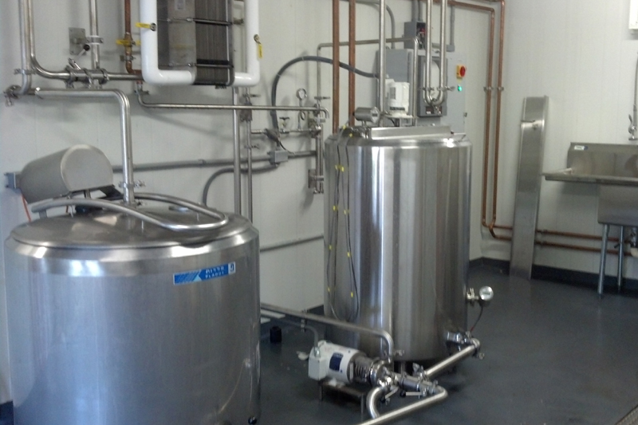
VAT PASTEURIZATION

Slide 2
AGENDA
1
Definition
2
Vat Pasteurization Use
3
Overview of vat pasteurization process
4
Equipment Construction
5
CCP’s
Notes:
2

Slide 3

DEFINITION
Vat Pasteurization
One of the most effective methods of pasteurization is heating the product in a vessel in a process known as vat pasteurization.
In vat pasteurization, also referred to as batch or low-temperature long-time pasteurization, the product is heated in a jacketed stainless steel vat which has been fitted with:
  Pipes to deliver water and steam to the jacket liner.
  Thermometers to monitor and record product temperatures.
  A method for agitation to assure uniformity in temperature distribution.
Notes:
3

Slide 4
VAT PASTEURIZATION USE
Vat Pasteurization Use
Vat pasteurization is used primarily in the dairy industry as a means of preparing milk in the processing of cheese, yogurt, and other common food products.
Product | Temperature | Time
Milk | 145°F | 30 minutes
Viscous products, or products with more than 10% fat or added sweetener (e.g., cream, yogurt) | 150°F | 30 minutes
Frozen dessert mixes | 155°F | 30 minutes
Notes:
4

Slide 5
OVERVIEW OF VAT PASTEURIZATION PROCESS
Vat Pasteurization -Main steps
The product components are added to the vat through the inlet line, with the outlet valve in the closed position.
Steam or hot water inside the vat jacket heats the product while agitators continuously move the product in the vat.
The product is held in the vat for the required time. Thermometers monitor and record the temperature throughout the process.
The pasteurized product then leaves the vat via the outlet valve.
Notes:
5

Slide 6
Equipment Construction
Equipment Construction
In general, vat pasteurization equipment is constructed to prevent or reduce contamination. The design of the equipment should meet the following criteria:
  Smooth, non-absorbent surfaces
  Self-draining
  Easily cleanable
  Use of radiuses to avoid corners
  Proper slope to ensure self-drainage
  Raised edges to prevent potential contaminant from flowing back into equipment
  Overlapping drip deflectors on inserted implements
Notes:
6

Slide 7
EQUIPMENT CONSTRUCTION
Inlet Line
Product components (e.g., Dairy products, liquid sugar and sweeteners, water, stabilizers, vitamins) are added to the vat through the inlet line. The inlet line is designed to:
  Run the product down the side of the vat, which reduces the development of foam during the pasteurization process.
  Disconnect from the vat after filling to prevent contamination of product during or after pasteurization.
Note that certain flavoring ingredients (e.g., Dry sugars, fruits and roasted nuts, and safe and suitable bacterial culture organisms) may be added to the product after pasteurization.
Notes:
7

Slide 8
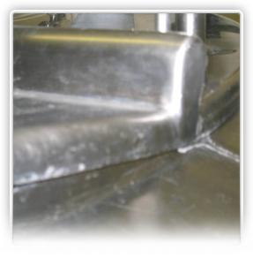
EQUIPMENT CONSTRUCTION
Covers
Covers of vat pasteurizers are constructed to prevent the entrance of surface contamination or foreign material.
Cover edges must be designed with overlapping “shoe box” style lids. This design prevents contaminates from entering when the cover is raised, and drains away splashes and drips to the outside of the vat pasteurizer.
Notes:
8

Slide 9
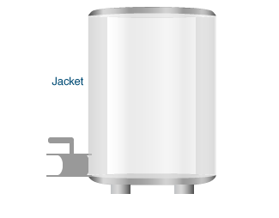
EQUIPMENT CONSTRUCTION
Jacket
The vat pasteurizer jacket is a double-walled covering. In the space between the walls, circulating water, steam, or heating coils of water and steam heat the product in the vat.
The product should be heated in as short a time as practicable, and in no case should this exceed 4 hours.
Notes:
9

Slide 10
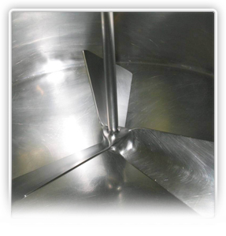
EQUIPMENT CONSTRUCTION
Agitators
All vats must be equipped with mechanical means of agitation.
An agitator is designed to keep milk or milk product moving at all times by running constantly during the pasteurization cycle. This results in uniform product and temperature throughout the vat.
The most efficient agitators push the product down and sweep it against the heat exchange surface on the sides and bottom of the vat.
Agitator shafts must be fitted with effective drip deflection shields to prevent contamination of the product. They must also be easily cleanable.
Notes:
10

Slide 11
EQUIPMENT CONSTRUCTION
Indicating Thermometers
The indicating thermometer is the “official” thermometer.
Indicating thermometers:
  Occupy an inlet port in the vat.
  Are graduated in 1 °F increments and accurate to within 0.5 °F.
  Span at least 25 °F.
  Are made of mercury in glass or are electronic resistance thermal devices (RTDs).
  Must be long enough to reach into the product zone during the pasteurization cycle. However, the probe should not reach the bottom of the vat.
Notes:
11

Slide 12
EQUIPMENT CONSTRUCTION
Air Space Thermometers
Air space thermometers measure the temperature of the air space above the product in the vat. These thermometers:
  Are shorter probes than indicator thermometers.
  Are graduated in 2 °F increments and must be accurate to within 1 °F.
  Span at least 25 °F.
The air space thermometer bulb must be positioned 2 to 3.5 inches from the bottom of the cover, and at least 1 inch from the top surface of the product during pasteurization.
Notes:
12

Slide 13
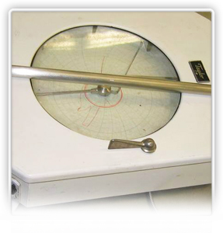
EQUIPMENT CONSTRUCTION
Recording Thermometers
The recording thermometer provides a record of the pasteurization cycle and heat treatment, including the holding time.
Recording thermometers:
  Are graduated in 1 °F increments between 140 °F and 155 °F.
  Span at least 20 °F.
  Must be accurate to within 1 °F.
Notes:
13

Slide 14
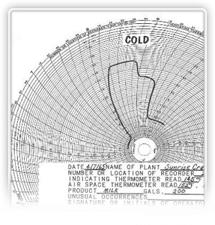
EQUIPMENT CONSTRUCTION
Recording Thermometer Chart
The recording thermometer chart must be graduated in time increments of not more than 10 minutes for a maximum record of 12 hours.
In addition, the recording thermometer chart should include:
  Name of plant
  Date
  Operator identification
  Vat identification
  Holding time
  Indicator reading at the start of the process
  Air space readings at start and end of the holding time
  Type and amount of product
  Any unusual occurrences
Notes:
14

Slide 15
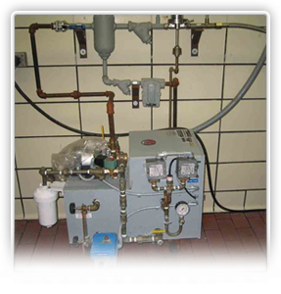
EQUIPMENT CONSTRUCTION
Air Space Heaters
The air space above the product in the vat must be maintained at least 5 °F higher than the minimum pasteurization temperature for the product being pasteurized.
An air space heater, typically an electric boiler with steam traps and filters to produce culinary steam (i.e., steam that has been properly filtered for use in food processing), may be necessary to maintain these minimum air space temperatures.
These heaters must:
  Be properly installed.
  Be easily cleaned.
Notes:
15

Slide 16
EQUIPMENT CONSTRUCTION
Valves
The inlet and outlet valves of the vat pasteurizer are normally constructed of solid stainless steel to:
  Permit adequate heat transfer
  Prevent accumulation of unpasteurized product when the valves are in closed position
The valve plug is also stainless steel allowing for thorough heat penetration to ensure that any milk that weeps into the area between the plug and the valve body gets full heat treatment
Non stainless steel plugs (e.g. rubber or plastic) must not be used as any milk that may have made its way around the sides of the plug will not be adequately heated
Notes:
16

Slide 17
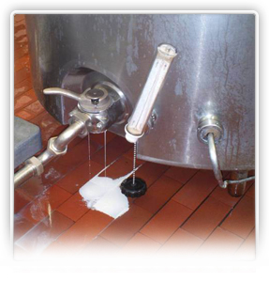
EQUIPMENT CONSTRUCTION
Valves
Valve bodies or valve plugs include leak detection grooves, which are designed to prevent leakage of raw milk past the valve body. These grooves are curved or placed at such an angle to allow proper draining, and must remain fully open and free from obstruction during pasteurization.
Any milk that is trapped inside the valve plug when the valve is shut will then be drained via the leak detection grooves.
Notes:
17

Slide 18
EQUIPMENT CONSTRUCTION
Holding Period
Remember that vats are operated so that every particle of product is heated for at least 30 minutes and no more than 4 hours at or above the required minimum temperature for that product.
To ensure that these requirements are reached, it is important that the operator:
  Maintain accurate charts.
  Take careful note of cooling periods, preheating, filling time, and emptying time.
Ensure that the sensors of both the recording and indicating thermometers are fully covered by the product during pasteurization.
In the event of any mechanical failure of any kind (e.g., a lifted cover or an agitator malfunction), the holding period must be restarted.
Notes:
18

Slide 19
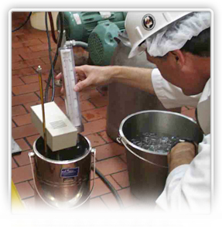
CCP’S
CCP’s for inspecting a Vat pasteurizer
There are various steps in food processing at which control measures can be applied to prevent, eliminate, or reduce a food safety hazard to an acceptable level.
When conducting an inspection of a vat pasteurizer, it is essential to focus on these critical control points. Critical control points are those points in processing where a preventive measure occurs at the last opportunity in processing for eliminating a hazard.
Notes:
19

Slide 20
CCP’S
To determine CCP’s ask yourself:
Was the equipment operated correctly
  The inlet line must be disconnected prior to start of pasteurization
  Covers must be in place during processing
Were any ingredients added after pasteurization?
  Only those specified, safe and suitable ingredients may be added after pasteurization
Were thermometer requirements met?
  All thermometers must be in place
  Thermometer readings must be made and recorded
Were time requirements met?
  The filling and emptying time are not included as a part of required holding time
Notes:
20

