Slide 1
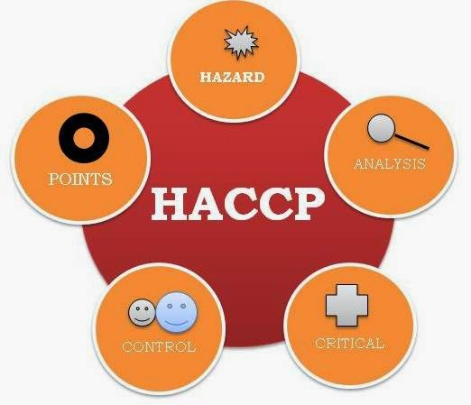
HAZARD ANALYSIS CRITICAL CONTROL POINT

Slide 2
AGENDA
1
Introduction
2
Food Safety and its responsibility
3
Hazard Analysis Critical Control Point
4
Components of HACCP
Notes:
2

Slide 3
INTRODUCTION
Hazard Analysis Critical Control Point
A food safety program developed nearly 30 years ago and is applicable to the food processing industry for controlling hazards that are likely to occur in the food processing chain.
It focuses on preventing hazards that could cause food-borne illnesses by applying science-based controls, from raw material to finished products.
Safety of the food supply is key to consumer confidence
The end objective of HACCP is to make the product as safe as possible and to be able to prove that the product was processed as safe as possible.
The assurance of safety comes from the process of identifying the hazards, establishing controls for the identified hazards, monitoring the controls and periodically verifying that the system works.

Slide 4
FOOD SAFETY & ITS RESPONSIBILITY
Food Safety
Who is responsible?
Prevention of hazards in food
  Physical
  Chemical
  Biological
  Allergens
Producer/grower
Manufacturer
Distributor
Transporter
Retailer
Consumer

Slide 5
FOOD SAFETY & ITS RESPONSIBILITY
HACCP
What, Where, How?
H: Hazard
A: Analysis
C: Critical
C: Control
P: Point
WHAT hazards involve with the product
WHERE do these hazards occur?
HOW can we control or eliminate these hazards?

Slide 6
HAZARD ANALYSIS CRITICAL CONTROL POINT
What is HACCP?
A systematic approach to the identification, evaluation, and control of food safety hazards.
System is based on assessing the natural hazards or risks in a particular product or process and designing a system to control them
Step wise process:
  Identifies hazards
  Installs preventative measures to eliminate or reduce hazards in foods
Proactive rather than reactive
Risk based

Slide 7
HAZARD ANALYSIS CRITICAL CONTROL POINT
What is HACCP?
Does not rely on end product testing
  hazards not be evenly distributed and can be missed in sampling
  need to test large quantities
  product would need to be destroyed or reworked
Starts from the beginning of the process
  Receiving of ingredients, packaging
Through process steps
To final product and shipping

Slide 8
COMPONENTS OF HACCP
Components
Pre-requisite programs
Hazard analysis
Pre-requisites
Foundation to a HACCP program
Includes Good Manufacturing Practices
Addresses food safety at all stages from receiving to shipping
  Including indirect hazards

Slide 9
COMPONENTS OF HACCP
Pre-requisite Programs
Premises
Transportation and Storage
Equipment
Personnel/Training
Sanitation and Pest Control
Recall
Allergen Control
Supplier Quality Assurance

Slide 10
COMPONENTS OF HACCP
Premises- What to consider?
Outside property and building
Design, construction & maintenance
Lighting
Ventilation
Waste disposal
Inedible areas
Employee & sanitary facilities
Water/Steam/Ice

Slide 11
COMPONENTS OF HACCP
Transportation & storage - What to consider?
Food Carriers
Temperature Controls
Receiving and Storage
  Incoming ingredients and packaging
  Non-Food Chemicals
Finished Product Storage

Slide 12
COMPONENTS OF HACCP
Equipment- What to consider?
Design
Installation
Maintainence
Calibration
Personnel- What to consider?
Trained for their job
Understand food safety

Slide 13
COMPONENTS OF HACCP
Sanitation & Pest Control - What to consider?
Sanitation
  Equipment & Utensils
  Floors
  Locker rooms
  Lunchrooms
  Washrooms
Pest Control
Recall- What to consider?
Product Identification
Locating product
Returning product

Slide 14
COMPONENTS OF HACCP
Allergen Control - What to consider?
Identification of Allergens
Control of Allergens
  Special Handling
  Segregate
  Special sanitation procedures
  Rework
  Proper labelling
Supplier Quality Assurance- What to consider?
Vendor approval process
Product specification
Inspect incoming materials

