Slide 1
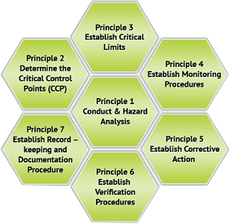
PRINCIPLES OF HAZARD ANALYSIS CRITICAL CONTROL POINT

Slide 2
AGENDA
1
Conduct hazard analysis
2
Determine critical control points (CCP)
3
Establish critical limits
4
Establish system to monitor control of CCP
5
Establish corrective action
6
Establish verification procedures
7
Establish documentation
Notes:
2

Slide 3

PRINCIPLE 1
Conduct hazard analysis
Hazard
A biological, chemical or physical agent in, or condition of, food with the potential to cause an adverse health effect
Hazard Analysis
The process of collecting and evaluating information on hazards and conditions leading to their presence to decide which are significant to food safety and therefore should be addressed in the HACCP plan
Notes:
3

Slide 4
TASKS REQUIRED TO APPLY PRINCIPLE 1
Conduct hazard analysis
Preliminary steps
Assemble HACCP Team
Assemble HACCP team
Describe Product
Identify intended usage
Construct flow diagram
Onsite confirm of flow diagram
List all potential hazards, conduct hazard analysis
Ensure availability of all required expertise - multidisciplinary team
Scope of HACCP plan must be decided
Notes:
4

Slide 5
TASKS REQUIRED TO APPLY PRINCIPLE 1
Conduct hazard analysis
Preliminary steps
Describe Product
Assemble HACCP team
Describe product
Identify intended usage
Construct flow diagram
Onsite confirm of flow diagram
List all potential hazards, conduct hazard analysis
A full description of the product should be prepared
All relevant safety information should be reported including: composition, physical/ chemical characteristics, packaging, storage conditions, etc.
Notes:
5

Slide 6
TASKS REQUIRED TO APPLY PRINCIPLE 1
Conduct hazard analysis
Preliminary steps
Identify intended use
Assemble HACCP team
Describe product
Identify intended use
Construct flow diagram
Onsite confirm of flow diagram
List all potential hazards, conduct hazard analysis
Specify expected use of the product
Where appropriate consider vulnerable groups of the population
Notes:
6

Slide 7
TASKS REQUIRED TO APPLY PRINCIPLE 1
Conduct hazard analysis
Preliminary steps
Flow diagram, onsite confirmation
Assemble HACCP team
Describe product
Identify intended use
Construct flow diagram
On-site confirmation of flow
diagram
List all potential hazards, conduct hazard analysis
Flow diagram for process should be constructed by HACCP team
The flow diagram should cover all steps in the operation
HACCP team should confirm the processing operation against the flow chart
Notes:
7

Slide 8
TASKS REQUIRED TO APPLY PRINCIPLE 1
Conduct hazard analysis
Preliminary steps
List potential hazards
Assemble HACCP team
Describe product
Identify intended use
Construct flow diagram
On-site confirmation of flow
diagram
List all potential hazards, conduct hazard analysis
HACCP team to list all hazards reasonably expected to occur at each step in the food chain
Assess hazards to determine which should be included in HACCP plan
Consider what control measures could be applied for each hazard
Notes:
8

Slide 9

CONDUCTING HAZARD ANALYSIS
Control Measure
Any action or activity that can be used to prevent or eliminate a food safety hazard or reduce it to an acceptable level
More than one control measure may be required to control a specific hazard and more than one hazard may be controlled by a specified control measure
Notes:
9

Slide 10
PRINCIPLE 2
Determine critical control points (CCP)
Critical Control Point (CCP)
A step at which control can be applied and is essential to prevent or eliminate a food safety hazard or reduce it to an acceptable level
Step
A point, procedure, operation or stage in the food chain, including raw materials, from primary production to final consumption
Notes:
10

Slide 11
TASKS REQUIRED TO APPLY PRINCIPLE 2
Conduct hazard analysis
The steps
Determine CCP’s
List all potential hazards, conduct hazard analysis
Determine critical control points
Establish Critical limits
Determination of CCPs can be facilitated by application of decision tree
There may be more than one CCP at which control is applied to address the same hazard
Notes:
11

Slide 12
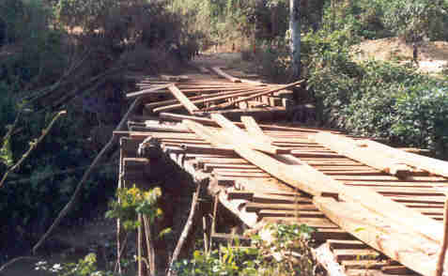
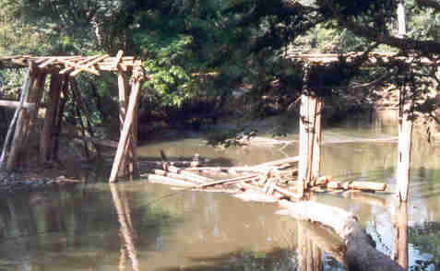
PRINCIPLE 3
Establish Critical limits
Critical Limit
A criterion that separates acceptability from unacceptability
Every process has its own critical limit which if crossed leads to a hazard
Maximum load: 1 tonne
Maximum speed: 15 km/h
If you exceed the critical limit ...
The bridge will break
Notes:
12

Slide 13
Tasks required to apply principle 3
Establish Critical Limits
The steps
Establish Critical Limits
Determine critical control points
Establish critical limits for each
CCP
Establish a monitoring system
Critical limits must be specified and validated for each CCP
More than one CL may be elaborated at a particular step
Criteria commonly used include Aw, time, pH, temperature, etc.
Critical limits are not necessarily numerical
Notes:
13

Slide 14
PRINCIPLE 4
Establish system to monitor control of the CCP
Control
The state wherein correct procedures are being followed and criteria are being met
Monitor
The act of conducting a planned sequence of observations or measurements of control parameters to assess whether a CCP is under control
Notes:
14

Slide 15
TASKS REQUIRED TO APPLY PRINCIPLE 4
Establish Critical Limits
The steps
Establish a monitoring system
Establish critical limits for each
CCP
Establish a monitoring system
Establish corrective action
Monitoring data should be evaluated by designated person with knowledge and authority to take action
Frequency of monitoring must be sufficient to ensure effective control
Notes:
15

Slide 16

PRINCIPLE 5
Establish corrective action
Corrective action
Any action to be taken when the results of monitoring at the CCP indicate a loss of control
Establish the corrective action to be taken when monitoring indicates that a particular CCP is not under control
Notes:
16

Slide 17
TASKS REQUIRED TO APPLY PRINCIPLE 5
Establish Critical Limits
The steps
Establish corrective actions
Establish a monitoring system
Establish corrective actions
Establish verification procedures
Specific corrective actions must be developed for each CCP in the HACCP system in order to deal with deviations when they occur
Actions must ensure that the CCP has been brought under control
Deviation and product disposition procedures must be documented
Notes:
17

Slide 18

PRINCIPLE 6
Establish verification procedures
Verification
The application of methods, procedures tests and other evaluations, in addition to monitoring, to determine compliance with the HACCP plan
Establish procedures for verification to confirm that the HACCP system is working effectively
Notes:
18

Slide 19
TASKS REQUIRED TO APPLY PRINCIPLE 6
Establish Verification procedures
The steps
Establish verification procedures
Establish corrective actions
Establish verification procedures
Establish documentation systems
Establish procedures, including random sampling and analysis to determine if the haccp system is working correctly
Validation should include actions to confirm the efficacy of all elements in the haccp plan
Notes:
19

Slide 20

PRINCIPLE 7
Establish documentation systems
Documentation
Recording results of procedures and processes
Establish documentation concerning all procedures and records appropriate to these principles and their application
Notes:
20

Slide 21
TASKS REQUIRED TO APPLY PRINCIPLE 6
Establish Verification procedures
The steps
Establish verification procedures
Establish verification procedures
Establish documentation and
Record keeping systems
Documentation and record keeping should be appropriate to the size and nature of the operation
Documentation includes
  Hazard analysis; CCP and CL determination
Records of
  CCP monitoring; Deviations and corrective actions
Notes:
21

Slide 22

PRACTICAL APPLICATION
On the job…
Watch for hazards and remove any that you find
If you are involved in CCP monitoring:
  Perform your checks as required
  according to procedure
  on time
Notes:
22

