Slide 1

ALLERGEN MANAGEMENT

Slide 2
AGENDAITEMS
1
Allergens & Food Allergy
2
Why is food allergy important to food industry?
3
Major allergens in food
4
Common symptoms of allergic reactions
5
Where do risks occur?
6
Allergen Labelling

Slide 3
ALLERGENS & FOOD ALLERGY
Allergens
Food Allergy
A substance, of protein or non protein origin that is capable of inducing allergy or specific hyper sensitivity in an individual.
Allergens can enter the body by being inhaled, swallowed, touched or injected.
E.g: Soy protein, peanuts, milk, eggs
Food allergy is an immune system reaction that occurs soon after eating a certain food.
Even a small amount of allergy causing food can trigger signs and symptoms.

Slide 4
WHY IS FOOD ALLERGY IMPORTANT TO THE FOOD INDUSTRY
Allergy & food industry
Food allergies are increasing in prevalence, are potentially life-threatening and there is no cure
Successful management is through avoidance of the food
Consumers lives are at risk from eating formulated foods (hidden ingredients)
Awareness, Education & Communication can prevent deaths & improve quality of life of food allergic consumers
“There is no cure for food allergies… Avoidance of
the food is the only protection”

Slide 5
MAJOR ALLERGENS IN FOODHE
Children
Adults
Peanuts
Tree- nuts
Soy
Milk
Eggs
Wheat
Peanuts
Tree-nuts
Crustacea (shrimp, crab, lobster)
Fish
Sesame

Slide 6
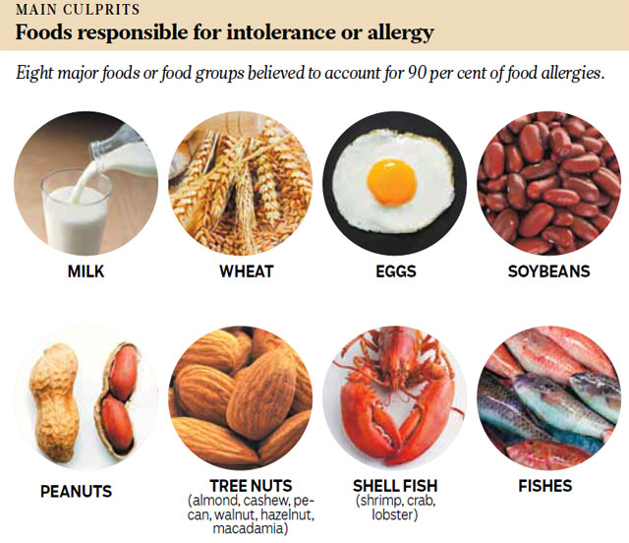
MAJOR ALLERGENS IN FOODHE

Slide 7
COMMON SYMPTOMS OF ALLERGIC REACTIONSE
Symptoms
Symptoms
Symptoms of food allergies typically appear from within minutes or up to 2 hours after a person has eaten the food to which they are allergic
Common symptoms:
  Swelling of the throat and vocal cords
  Difficulty breathing
  Drop in blood pressure
  Loss of consciousness
  Hives
  Flushed skin or rash
  Tingling or itchy sensation in the mouth
  Face, tongue, or lip swelling
  Vomiting and/or diarrhea
  Abdominal cramps
  Coughing or wheezing
  Dizziness and/or light headedness

Slide 8
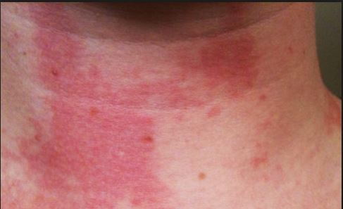
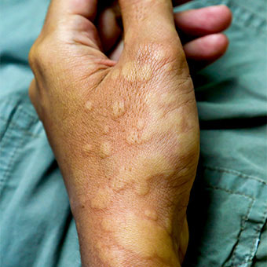

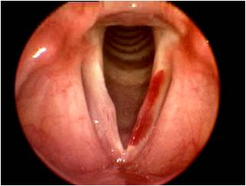
COMMON SYMPTOMS OF ALLERGIC REACTIONSE
  Flushed skin or rash
    Hives
  Face, tongue, or lip swelling
  Swelling of the throat and vocal cords

Slide 9

WHERE DO RISKS OCCUR?
Research & Development
Engineering & system design
Minimize use of allergenic ingredients
Design formula to add allergenic ingredients at end of process
Recommend accessible/cleanable equipment for new product design
Allow for adequate sanitation when testing on production lines
Ensure allergens will be readily identifiable on finished product labels
Design access for cleanouts and inspection
Isolate allergen addition points
Dedicate rework systems
Eliminate cross over and poor product containment points
Dedicate production systems and/or install parallel modules for units not cleanable
RISK

Slide 10
WHERE DO RISKS OCCUR?
Raw materials
Product scheduling
Assess allergens in all raw materials
Audit suppliers & co-packers, and help develop their awareness
Always ask the allergen question
Be vigilant in changes to ingredient specs
Review possible sources of contamination from other raw materials e.g.. recycled/reused containers
Dedicate production systems
Longer run times/minimize change-overs
Produce ‘Allergen’ containing products at end of production sequence
Where possible, control each allergen separately from other allergens
Allow for thorough clean out time between runs
Confirm correct packaging available
RISK

Slide 11
WHERE DO RISKS OCCUR?
Labelling & Packaging
Rework
Ensure label reflects current formula
Review label accuracy when:
  an ingredient change/substitution is made
  accelerating the intro of an “improved” formula
Appropriately manage excess packaging inventory/write offs
Ensure no mixed cartons
  supplier capability
  scanners at printer and in plant
Clearly label all rework
Ensure re-feed systems can be cleaned
Post instructions on the use of rework along with other operator instructions
Promptly report any misuse of rework
Audit rework periodically to ensure proper identification and use
Dedicate reefed/regrind systems
RISK

Slide 12
WHERE DO RISKS OCCUR?
Cleaning Practices
Human Error
Allow for adequate cleanout between runs
Disassemble and manually clean equipment that cannot be cleaned thoroughly in place
Properly clean accessory tools or equipment (i.e. scoops, bins, hoppers, etc.)
Dedicate equipment that is difficult to clean
Use alternative cleaning measures where wet wash is not viable e.g.. sugar or salt flush
Ensure proper training for all employees
Proper procedures andpolicies inplace
Effective plant communication
RISK

Slide 13
ALLERGEN LABELLING
Declare allergens when:
Label should be:
Present as:
  An ingredient
  an ingredient of a compound ingredient
  a food additive or component of a food additive
  a processing aid or component of a processing aid
Consistent & Legible
Near or in ingredients list
In common English language
Necessary detail e.g. “sunflower oil” rather than “vegetable oil” so consumers know it is safe for them
Avoid precautionary labelling such as “May contain”

Slide 14
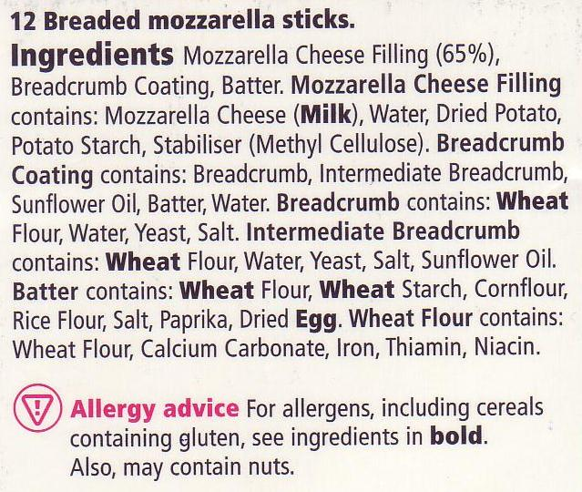
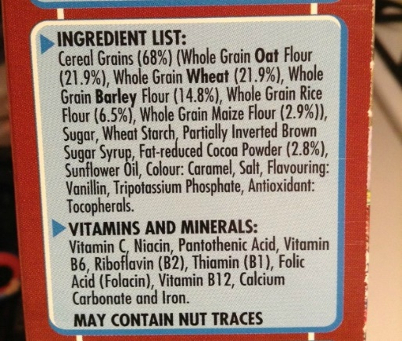
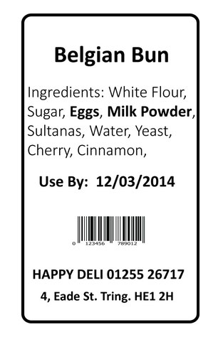
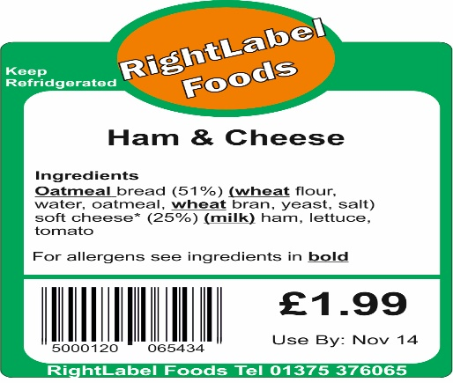
ALLERGEN LABELLING

Slide 15

About PMG Engineering
PMG Engineering is group of competent people with expertise in respective domains. Delivering commitments, exceeding expectations & creating value for clients in every interaction is our non-negotiable objective. Using the most advanced design & collaboration work systems, we aspire to become Inspirational business partners for our clients.
Get in touch
We would love to hear from you. Gauge our capabilities by speaking to us. You can visit us at our Noida Design Office or meet our representative at your location.
Our Office
A224, A Block, Sector 83,
Noida, Uttar Pradesh- 201305
Phone: +91-9871115995,
Email: info@pmg.engineering
abhinav.pandey@pmg.engineering

