Slide 1
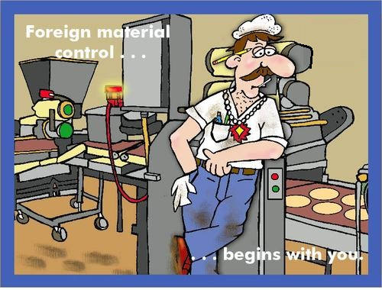
FOREIGN MATERIAL CONTROL

Slide 2
AGENDA
1
Foreign Material
2
Classification of foreign material
3
Sources of foreign material in food
4
Types of physical hazards
5
Preventing common physical hazards
6
Technology for detection of foreign particles
Notes:
2

Slide 3
FOREIGN MATERIAL
What is it?
Any extraneous matter, whether of a physical, chemical or biological nature, found in food.
Usually foreign bodies render the food unfit for human consumption.
Why control foreign material?
Foreign matter renders food adulterated
Any incidence of foregin matter harms the consumer, undermines confidence in the brand
An important factor in effective implementation of the company's food safety program, particularly the Hazard Analysis Critical Control (HACCP) system.
Notes:
3

Slide 4
CLASSIFIACTION OF FOREIGN MATERIAL
Basis of Classification
Low Risk
Classified on the basis of the level of control a food processor can exercise to eliminate the risk the foreign materials in food
If good control measures have been established, but minor infractions occur.
Medium Risk
High Risk
If some control measures were established, but inconsistencies occur.
If little or no control was established, major and critical infractions occur.
Notes:
4

Slide 5
SOURCES OF FOREIGN MATERIAL IN FOOD
Five Basic sources of foreign material in food
Inadvertent from the field (stones, metal, insects, undesirable vegetable matter such as thorns or wood, dirt, or small animals).
Inadvertent resulting from processing and handling (bone, glass, metal, wood, nuts, bolts, screening, cloth, grease, paint chips, rust, and so on).
Materials entering the food during distribution, such as insects, metal, dirt, or stones.
Materials intentionally placed in food (employee sabotage).
Miscellaneous materials, such as struvite and other materials in this class.
Notes:
5

Slide 6
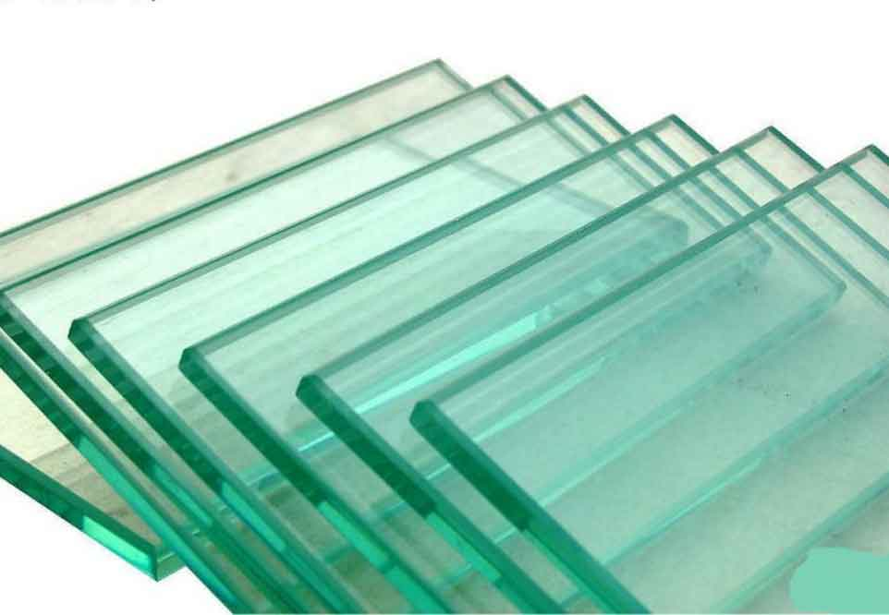
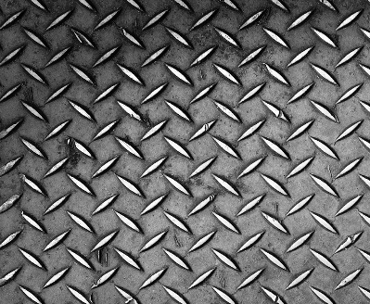
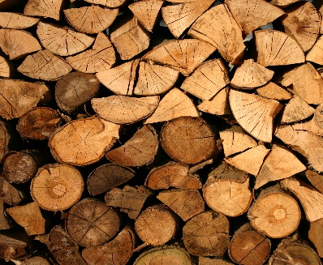


TYPES OF PHYSICAL HAZARDS
Type of foreign objects in food affects the technology needed to detect it
Glass: Sharp glass contamination often occurs during filling processes in glass containers if a container is accidentally broken. Another source, but less frequent, is light bulbs broken during building maintenance.
Metal: Sharp metal objects may include screws and equipment splinters, blades, broken veterinary needles, fragments and clippings of prior processing procedures.
Plastics: Soft and hard plastics may come from packaging material of an intermediary production phase.
Wood: Wood splinters may have their origin at the farm or may come from handling wooden pallets.
Stones: Small stones are common in crops like peas or beans contaminated during harvest.
Notes:
6

Slide 7
PREVENTING COMMON PHYSICAL HAZARDS
Controls to include the following
Inspection of raw materials and ingredients, looking for field contaminants
Provision of good storage facilities, usage of lamp covers to avoid bulb breakage and maintenance of effective pest control
Development of specifications and controls for all ingredients and components
Effective detection and elimination systems for physical hazards, such as metal detectors or magnets to remove metal particles; use of X-ray and low-power microwave systems to detect nonmetallic materials
Periodic training of employees engaged with shipping, receiving, storing, handling and equipment maintenance that encompasses the entire food production chain.
Notes:
7

Slide 8
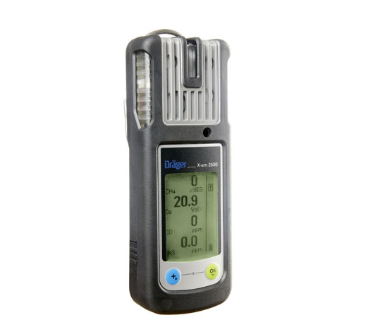
TECHNOLOGY FOR DETECTION OF FOREIGN PARTICLES
Detection devices:
Metal detectors: Metal detectors find splinters from machinery, fractions of broken cutters and blades, needles, screws or fragments of clips.
X-ray detectors: These respond to metal, stone, bone, hard plastics and Teflon. Both systems can screen the product after the filling procedure. X-ray detectors may find glass pieces that result when a jar or bottle is crushed during malfunction of the packaging line.
Near-field radar response: Foreign bodies are detected in embedding material by transmitting low-power microwaves through the material.The system uses a microwave sensor designed for emulsions and pumpable products. It measures the dielectric properties of the food flow of processing equipment. Foreign materials produce a deviation from the norm, activating a pneumatic rejection unit.
Notes:
8

