Slide 1
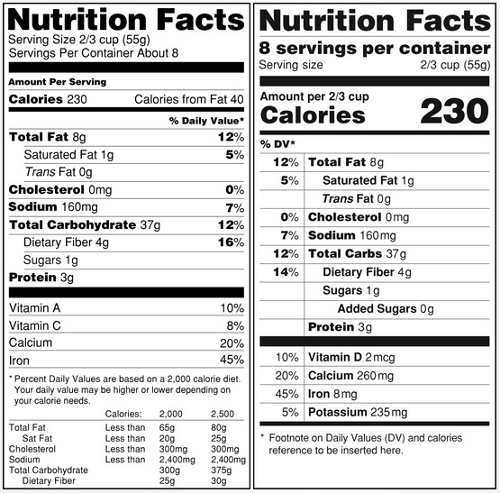
NET QUANTITY CONTROL

Slide 2
AGENDA
1
Definitions
2
Objectives of Packaging
3
Types of Packaging
4
Considerations for packaging
5
Objectives for labelling
6
Labelling: Do’s & Dont’s
7
Common symbols used on food packaging
Notes:
2

Slide 3

DEFINITIONS
Net Content Control
A process check that determines the accuracy of the contents contained in a packaging.
Net Quantity
In relation to commodity contained in a package, it means the quantity by weight, measure or number of such commodity contained in that package, excluding the packaging or wrapper
Notes:
3

Slide 4
DEFINITIONS
Maximum allowable variation (MAV)
It is the maximum weight deviation allowed from the label stated weight on the individual package of the food product.
Products that weigh below the MAV value are not acceptable
Label Weight
The weight that is declared on the label of the package.
This weight indicates the net contents of the package and is seen by customers when they buy food products.
Notes:
4

Slide 5
DEFINITIONS
Labelling
Any written, electronic or graphic communications on the packaging or on a separate but associated label
Display of information about a product on its container, packaging or the product itself.
Packaging
The science, art and technology of enclosing or protecting products for distribution, storage, sale & use
It is the activities of designing and producing the container for a product
Notes:
5

Slide 6

OBJECTIVES OF PACKAGING
Physical Protection
Physical Protection
  The objects enclosed in the package may require protection from things, shock, vibration, compression, temperature etc. Eg. Eggs, Bottles
Notes:
6

Slide 7
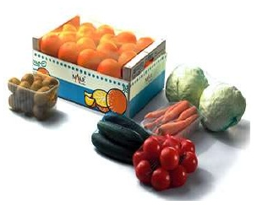
OBJECTIVES OF PACKAGING
Barrier Protection
Barrier Protection
  A barrier from oxygen, water vapor, dust etc is often required for foods. Controlled atmospheres are also maintained in some food packages to keep the contents clean & fresh. E.g. Fruits & Vegetables
Notes:
7

Slide 8
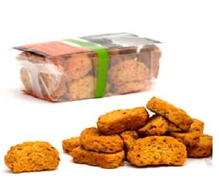
Objectives of Packaging
Containment/ Agglomeration
Containment or Agglomeration
  Small objects are typically grouped together in one package for reasons of efficiency. E.g. Chocolates, biscuits
Notes:
8

Slide 9
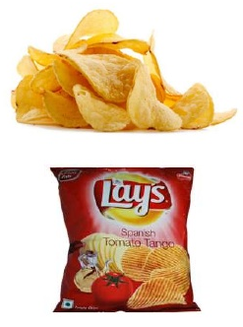
OBJECTIVES OF PACKAGING
Marketing
Marketing
  The packaging & labels can be used by marketers to encourage potential buyers to purchase the product
  Package graphic design and physical design are an important phenomenon
Notes:
9

Slide 10
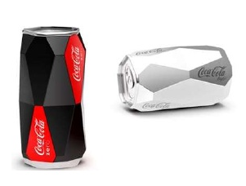
OBJECTIVES OF PACKAGING
Security
Security
  Packages can be made with improved tamper resisitance to deter tampering and also can have tamper evident features to help indicate tampering. Eg. Coke Drinks, Water bottles
Notes:
10

Slide 11
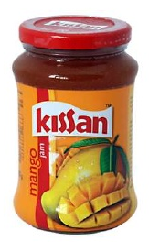
OBJECTIVES OF PACKAGING
Convenience
Convenience
  Packages can have features that add convenience in distribution,handling, stacking, display, sale, reclosing, reuse, disoensing etc. E.g. Sauce, jams
Notes:
11

Slide 12
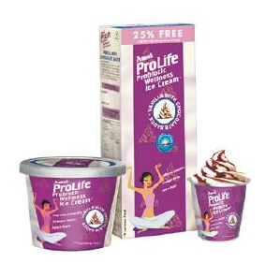
OBJECTIVES OF PACKAGING
Portion Control
Portion Control
  Single serving packaging has precise amounts of content to control usage
  Commodities can be divided into packages that are for a more suitable size for individual house holds. E.g. Milk. Ice-creams
Notes:
12

Slide 13
TYPES OF PACKAGING
Primary, Secondary, Tertiary
Primary Packaging
  The material that first envelopes the product and hold it
  This is usually the smallest unit of distribution or use and is the package which is in direct contact with the contents
Secondary Packaging
  It is the outside of primary packaging, used to group primary packages together
Tertiary Packaging
  Tertiary packaging is used for bulk handling, ware house storage & transport shipping.
  The most common form is a palletized unit load that packs tightly into containers
Notes:
13

Slide 14
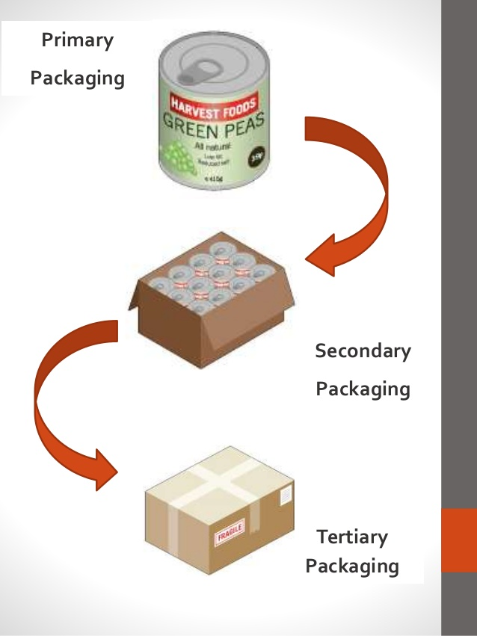
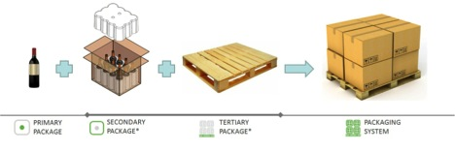
TYPES OF PACKAGING
Primary, Secondary, Tertiary
Notes:
14

Slide 15
CONSIDERATION FOR PACKAGING
Packaging- What to consider?
Prevention
  Use packaging where needed
Minimization
  Minimize mass & volume
Reuse
  Encourage reuse of packages
Recycling
  Reprocess materials into new products
Disposal
  Use disposable, eco friendly packages.
Notes:
15

Slide 16
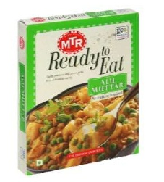
OBJECTIVES FOR LABELLING
Brand Identification
Labelling helps in the identification and principal place of business of the person by or for whom the prepackaged product was manufactured, processed produced or packed for resale.
Notes:
16

Slide 17
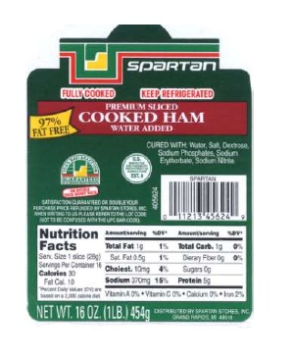
OBJECTIVES FOR LABELLING
Description
Labels provide the information regardingthe food product
It describes the contents, nutritional values, cost, product usage methods, shelf life etc.
Notes:
17

Slide 18
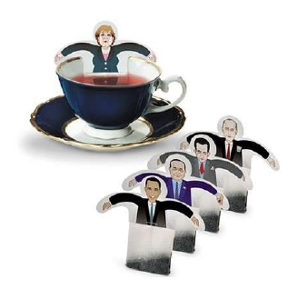
OBJECTIVES FOR LABELLING
Promotion
Labels help in promoting the product through attractive and brigh graphics replacing paper labels glued on cans and bottles
Notes:
18

Slide 19
LABELLING: DO’S & DONT’S
Do’s
Don’t’s
Name of the food
List of ingredients in descending order
Nutritional information per 100gm/ml
Name and complete address of
manufacturer
Net content by weight or Volume
Lot no/Batch identification
Date of Manufacturing /Packing
Use Stickers
Forget Legal Metrology
Make false claims
Use Pictures/ Graphics that mis represent product
Notes:
19

Slide 20
LABELLING: DO’S & DONT’S
Do’s
Don’t’s
Best Before Date
Veg/ Non Veg logo of appropriate
dimensions
Specific declaration of flavours
Name and completed Address of Importer, in case of Imported Food
Country of Origin for Imported food
FSSAI Logo & License Number
Use Stickers
Forget Legal Metrology
Make false claims
Use Pictures/ Graphics that mis represent product
Notes:
20

Slide 21
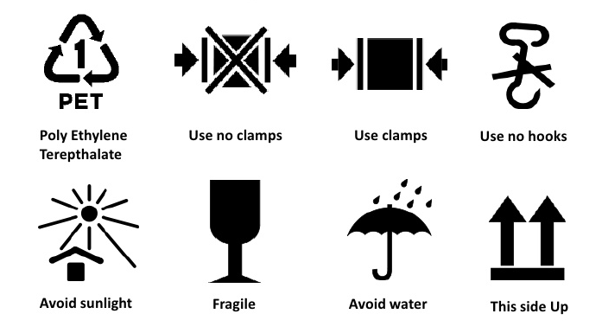


COMMON SYMBOLS USED ON FOOD PACKAGING
Promotion
Notes:
21

