Slide 1
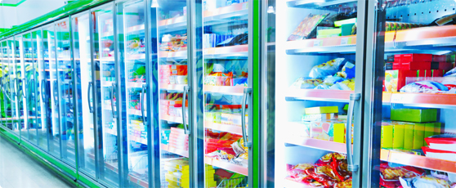
FOOD STORAGE CONDITIONS

Slide 2
AGENDA
1
Safe Storage guidelines
2
Cleaning & chemical storage
3
Storage conditions for food
4
Factors to consider in storage areas
5
Good warehousing practices
Notes:
2

Slide 3

SAFE STORAGE GUIDELINES
Food Storage hygiene- Why?
When food is not properly stored or it is not used in a timely manner, it could become unsafe to eat.
Unsafe storage practices could allow for contaminants to get into food. Unsafe
storage temperatures could allow for bacteria that might be naturally present in potentially hazardous food to grow.
To keep food safe during storage, make safe storage practices part of your food safety plan.
Notes:
3

Slide 4

SAFE STORAGE GUIDELINES
Keep in mind
Never remove the labels of commercially processed food. If they are removed, label the side of the container with the name of the contents.
Rotate products to ensure that the oldest food is used first.
Discard food that is past dated.
Check temperatures of stored food and storage areas each day.
Store food only in designated storage areas.
Keep all storage areas clean and dry.
Notes:
4

Slide 5
CLEANING & CHEMICAL STORAGE
Keep in mind
Store cleaning supplies and other chemicals separate from all food, dishes, utensils, linens, and single-use items.
Keep supplies and chemicals in their original containers.
If supplies and chemicals are not in their original containers, clearly label the side of the holding container with the name of the contents.
Do not label the lid because lids are interchangeable.
Notes:
5

Slide 6
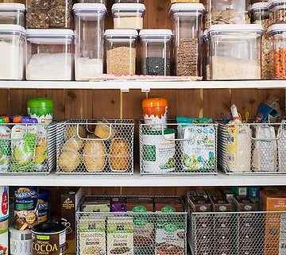
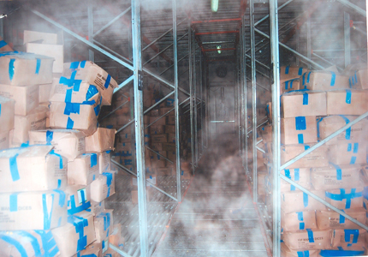
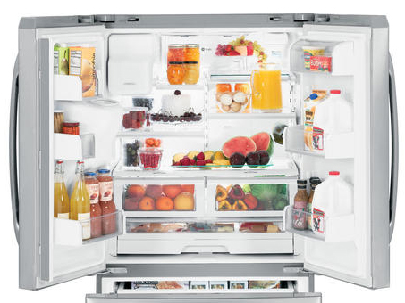
STORAGE CONDITIONS FOR FOOD
Types of Storage
Dry Storage
Dry Storage
Frozen Storage
Refrigerated Storage
Keep storerooms cool, dry, and well ventilated.
Store dry food away from walls and at least six inches off the floor.
Keep dry food out of direct sunlight.
Store food in durable containers that cannot be damaged by water or pests
Set temperature between 50°F and 70°F (10°C and 21°C).
Maintain humidity levels between 60% and 70%.
Keep the area clean.
Notes:
6

Slide 7
STORAGE CONDITIONS FOR FOOD
Frozen Storage
Refrigerated Storage
Keep freezer temperature at -18°C.
Place a freezer thermometer near the front of the freezer.
Do not overload freezers.
Check freezer temperatures daily.
Place frozen food deliveries in the freezer as soon as they have been inspected.
Do not put warm food inside the freezer.
Store food to allow for good air circulation.
Defrost freezers regularly.
Keep temperature at 4°C or below. Potentially hazardous food must be at 5°C or colder to prevent bacterial growth.
Place a refrigerator thermometer on the top shelf near the door.
Check refrigeration temperatures daily.
Store food to allow for good air circulation.
Do not line shelves with foil or other materials because this prevents food air circulation.
Notes:
7

Slide 8
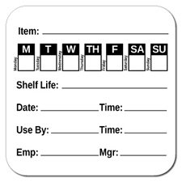
FACTORS TO CONSIDER IN STORAGE AREAS
Food Rotation
The best advice in the effective use of a dry goods storeroom is: rotate, rotate, rotate.
Date all foods and food containers.
The first food in should be the first food out: FIFO.
It takes a bit of imagination and craft to position foods within a storeroom to best implement this principle.
Keep a handy and readily visible record of the “use by” and “sell by” dates of the received foods and the shelf life in general.
Notes:
8

Slide 9

FACTORS TO CONSIDER IN STORAGE AREAS
Humidity
Ideally, storage areas should have a humidity level of 15% or less.
Maintain stored foods in their original packages whenever possible.
Most packaging is designed for the food it contains and will remain in good condition for their given shelf-life in the absence of temperature and humidity abuse.
For instance, the cardboard box will help cushion jars and other glass containers from breakage.
Oxygen is a major threat to the quality of food. The chances are that moisture-proof packaging is also airtight. The less head gas (<2% O2) in a package, the longer its shelf life is maintained.
Notes:
9

Slide 10
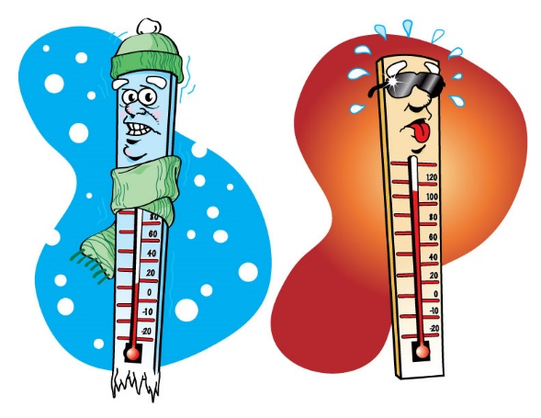
FACTORS TO CONSIDER IN STORAGE AREAS
Temperature
Keep storerooms cool, dry and well ventilated.
The temperature should be between 50°F and 70°F. The cooler, the better. The storage lives of most foods are cut in half by every increase of 18°F (10°C).
Cool storage reduces respiratory activity and the degradation of enzymes; it reduces internal water loss and inhibits the growth of decay producing organisms.
For maintaining optimal temperature, adequate ventilation should be provided (some air exchange rate is absolutely essential).
The storeroom should be free of un-insulated steam and water pipes, water heaters, transformers, refrigeration condensing units, steam generators or other heat producing equipment.
Notes:
10

Slide 11

FACTORS TO CONSIDER IN STORAGE AREAS
Sunlight
Avoid storing foods in direct sunlight.
Sunlight promotes oxidation and the subsequent loss of the food’s nutritional value and quality.
Fat-soluble vitamins, such as A, D, E and K are particularly sensitive to light degradation.
It is far better to block sunlight on windows and skylights and rely on artificial illumination for the time the storeroom is in use
Notes:
11

Slide 12

FACTORS TO CONSIDER IN STORAGE AREAS
Vermin
To prevent the entry of insects, rodents and birds into the storeroom, doors and windows should be rodent and insect-proofed and kept closed whenever possible.
Any opening to the outside should be sealed and all structural cracks and crevices promptly repaired.
Bait boxes, if needed, should be regularly monitored and any damaged bait boxes and spilled bait should be carefully cleaned up and removed.
If fumigation is absolutely essential, rely only on experienced licensed control operators
Along these lines, the exterior of the building in which the storeroom is located should be maintained free of fire hazards, pest infestations and to preclude any security problems.
Notes:
12

Slide 13
GOOD WAREHOUSING PRACTICES
While storing finished goods in ware house- Remember
All items should be stored to avoid direct contact with the floor (e.g. on pallets, slip sheets, or racks). Sitting or standing on product shipping cases is not acceptable. Over stacking of product must be avoided.
Products must not be stored immediately adjacent to containers for waste or non-product items (e.g. cleaning compounds).
Soiled and dusty exteriors of cartons or other product containers shall be cleaned before they are conveyed into the warehouse or to customers.
Broken or spilled product should be cleaned up in a timely manner
Doors and gates (e.g. cargo doors) should not be left open when not in use
Fork lift trucks (FLT) shall be in good repair, clean, free from leaks. FTL utilized inside a facility shall preferably be electric powered. Liquid Petroleum Gas (LPG) is acceptable. Gasoline or diesel powered FTL only allowed to be used outside facility
Notes:
13

Slide 14
GOOD WAREHOUSING PRACTICES
While storing finished goods in ware house- Remember
FLT batteries shall be stored in a designated area in such a way as to avoid risk of material or product contamination. New technology batteries, which have a lower risk level, may require less strict segregation.
All materials and products should be properly identified and labelled.
Activities which could lead to product contamination are not permitted in product handling areas. This includes eating or drinking, chewing gum or tobacco, smoking, holding objects in the mouth (e.g. toothpicks), and spitting.
Controls shall be in place to ensure that employees wash their hands when necessary e.g. prior to returning to work from breaks or as they become soiled.
Garbage facilities / compactors shall be adequately covered (e.g. the food source that attracts birds to warehouses is generally around the dumpster or compactor, or along the truck docks. Effective sanitation programs that eliminate these food sources must be maintained.
Notes:
14

Slide 15
GOOD WAREHOUSING PRACTICES
While storing finished goods in ware house- Remember
Glass and brittle materials including hard plastic components and equipment should be avoided in product areas where possible. If their use is necessary a glass and hard plastic inspection program and breakage procedure shall be in place and documented.
Pallets must be stored in areas that are free of moisture, dirt and litter and free of bird, insect or rodent contamination.
Pallets should not be stored outside (i.e. exterior to the building). If pallets are stored outside they must be checked before entering the warehouse
A pallet inspection program should be in place to verify that pallets are suitable for use (e.g. clean, dry, free from mold, off-odors and infestation, no broken wood or loose nails).The program shall cover:
  New pallets
  Incoming goods pallets
  Shipped product pallets
  Waste/ disposable pallets
Notes:
15

