Slide 1
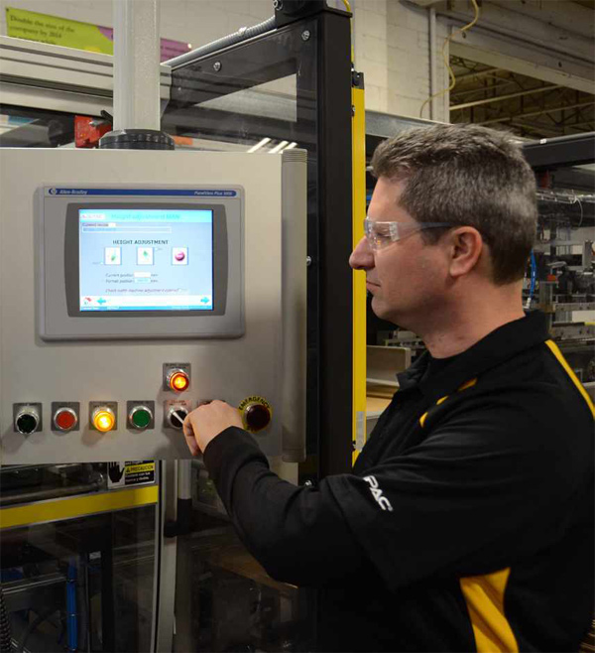
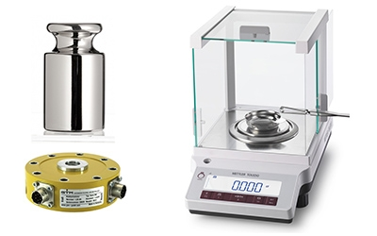
CALIBRATION OF MEASUREMENT
&
MONITORING EQUIPMENT

Slide 2
AGENDA
1
General Requirements
2
Roles & Responsibilities
3
Implementation
Notes:
2

Slide 3

GENERAL REQUIREMENTS
General Rules
Basic Elements
The calibration program should address the following:
  Ensure product safety & quality
  Ensure safety of workplace and environment by ensuring the accuracy and reliability of measuring systems used in monitoring safety parameters.
  Ensure the accuracy and reliability of measuring systems used to measure benchmarks for line optimization.
Measuring Loop Inventory & Calibration Quality Requirements
Calibration procedures
Scheduling system
Labeling/tagging system
Measurement traceability
Test & reference standards
Personnel Training
Calibration certificates
Documentation
Periodic Review of Calibration Program
Notes:
3

Slide 4
ROLES & RESPONSIBILITES
Factory Engineer
Factory Electricity & Automation
The Factory engineer takes overall responsibility for ensuring that an effective and sustainable instrument calibration program is implemented in their plant.
Management and maintenance of the instrument calibration program
Creation and maintenance of the measuring loop inventory
Creation, update, and safekeeping of instrument calibration historical records and certificates
Compliance of Calibration Program Quality Requirements
Planning, scheduling and performing instrument calibrations
Define the Calibration Program Quality Requirements together with Quality, Manufacturing and Safety
Notes:
4

Slide 5
ROLES & RESPONSIBILITES
Quality Assurance
Manufacturing
Definition of critical measuring loops which are affecting food safety and food quality, particularly the Critical Control Points and Control Points, in close coordination with the manufacturing group
Providing assistance in finalizing the Calibration Quality Requirements
Setup and implementation of internal quality audits for instrument calibration.
Definition of critical measuring loops which are affecting operational performance.
Providing assistance in the definition of critical measuring loops which are affecting food safety and food quality, particularly the Critical Control Points and Control Points
Providing assistance in finalizing the Calibration Quality Requirements
Implementation of operational procedures to quickly and periodically validate the accuracy and reliability of critical measuring loops.
Notes:
5

Slide 6
ROLES & RESPONSIBILITES
Safety
Approving Technical Authority
Definition of critical measuring loops which are affecting safety and environmental protection.
Providing assistance in finalizing the Calibration Quality Requirements
Provide assistance in the setup and implementation of internal quality audits for instrument calibration
These are the people responsible for the approval of critical calibration quality requirements such as the Calibration Interval and Maximum Permissible Error in Measurement.
Notes:
6

Slide 7

IMPLEMENTATION
Definition of Calibration program elements
Purpose:
  The prioritization of instruments or measuring loops is well defined
  Calibration intervals and calibration quality requirements are set
  Instrument calibration schedule is well established
  Calibration procedures and forms are well defined
Notes:
7

Slide 8
IMPLEMENTATION
Measuring Loop Inventory
The list of measuring loops (or chains) in the manufacturing process (including test and reference instruments) has to be prepared, complete with all the relevant information relating to the instrument(s) in the measuring loop.
The Measuring Loop Inventory must include all calibratable instruments or measuring systems. This must include the following:
  Field installed measuring instruments (installed in the process lines)
  Test and reference measuring instruments (reference standards)
Notes:
8

Slide 9
IMPLEMENTATION
Calibration Procedures
The calibration procedure defines the process of performing the actual calibration. It provides the following information:
  The equipment required
  The physical medium to be used for calibration
  The type, number and settings for input signals
  The required accuracy
  The test and reference instruments needed
  The number of tests required
  Other information related to the instrument
Notes:
9

Slide 10
IMPLEMENTATION
Scheduling System
Purpose:
  To sustain the effectiveness of the calibration program, a scheduling system has to be put in place.
  The scheduling system will provide the information on which measuring loop has to be calibrated and at which date.
  The system must also be designed so as to properly distribute the calibration activities within one calibration cycle, taking into consideration the calibration intervals, shutdown schedules, working standards, and manpower resources.
Notes:
10

Slide 11
IMPLEMENTATION
Labeling/ Tagging System
Purpose:
  Tagging of instruments or measuring loops is put in place to facilitate identification of instruments.
  This tag number is also used as a key reference in the instrumentation database. This is also the reference key for traceability.
Tagging Convention:
  Each measuring loop should have a unique tag number. A measuring loop may contain one or more instruments.
  The tag number should be linked to the asset number where the measuring loop belongs.
  All instruments belonging to one loop must have the same numeric tag (the letter prefix may vary depending on the function. This is important because the calibration will be done on a per loop basis, and the recording system (in either manual or electronic) is also on a per loop basis.
Notes:
11

Slide 12
IMPLEMENTATION
Measurement Traceability
Purpose:
  Traceability is defined as the property of the result of a measurement or the value of a standard whereby it can be related to stated references, usually national or international standards, through an unbroken chain of comparisons all having stated uncertainties.
  The proof of measurement traceability is important to guarantee the quality of our products and processes and to ensure the safety of work place and environment
Calibration certificates or reports must state the traceability to a national or international standard of measurement and must provide the measurement results and associated uncertainty of measurement and/or a statement of compliance
Notes:
12

Slide 13
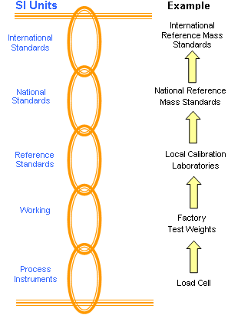
IMPLEMENTATION
Measurement Traceability
Instrument calibration traceability requirements
Notes:
13

Slide 14
IMPLEMENTATION
Test & Reference Standards
Purpose:
  Test and reference measuring devices (working standards) are essential to facilitate the calibration of field instruments
  These devices must be periodically sent to certified external bodies for calibration
  These test and measuring devices that are used for field calibration, guarantee the traceability of the calibration of our measuring systems.
Types of instruments:
  Thermometers
  Pressure calibrators
  Signal generators (current, voltage, interval, etc.)
  Resistance boxes
  Multi-function calibrators or meters
  Reference weights or masses
Notes:
14

Slide 15
IMPLEMENTATION
Personnel Training
Purpose:
    Instrument calibration involves complicated and highly technical systems and procedures. In order to have an effective instrument calibration program, it is imperative to have competent technical staff to manage and implement the program.
The person(s) managing the calibration program and doing the actual measurement and calibration must have undergone the appropriate training on metrology and calibration.
The level of competency and the kind of training required will have to be adopted locally according to legal requirements and available training programs.
On a periodic basis, the calibration personnel must be updated with the current technology and procedures.
Notes:
15

Slide 16
IMPLEMENTATION
Calibration Certificates
Purpose:
        Calibration certificates provide the proof of calibration. It is also used as a reference for the current accuracy of the instrument and the error corrections made & as the basis for the determination of the next calibration schedule.
This document certifies that the instrument performs within the acceptable error tolerance limits
This certificate must be provided by the authorized external calibration bodies or by the instrument or device supplier.
The calibration certificate must always be traceable to national or international reference standards.
Notes:
16

Slide 17

IMPLEMENTATION
Documentation
Purpose:
        To facilitate traceability, it is important to have an efficient filing system. The fast and accurate retrieval of calibration information must be ensured. The use of calibration software facilitates this task. The filing system consists of two parts.
          Measuring Loop Inventory database. A calibration software is very useful for this purpose
          Calibration certificates – this is mandatory and each instrument must have on file a valid calibration certificate.
Notes:
17

Slide 18
IMPLEMENTATION
Documentation
Instrument inventory database: An inventory database of all field instruments and all test and reference instruments must be put in place. The database contains the following information for each measuring loop
  Tag number
  Description of instrument
  Location (area where installed)
  Operating value or range
  Maximum Permissible Error in Measurement
  Instrument brand and model
  Calibration Class
  Calibration Interval
  Process Medium
  Calibration schedule
  Maintenance History of the measuring loop or instrument.
Notes:
18

Slide 19
IMPLEMENTATION
Documentation
Records:The records must be retained for the years as specified in the record retention policy of the factory concerned.The records must include:
  Identification of the instrument
  Location
  Calibration History
  Traceability Documentation
  Test Equipment Used
  Who Performed the Calibration
  Date of Calibration
Notes:
19

Slide 20
IMPLEMENTATION
Periodic Review of Calibration Program
Purpose:
        The periodic review is needed to fine tune and re-validate the following:
          Measuring Loop Inventory
          Calibration Class
          Maximum Permissible Error in Measurement
          Calibration Interval
          Instrument Calibration Schedule
Persons to conduct the review:
        The following groups must be represented in the review process:
          Quality Assurance
          Safety
          Manufacturing
          Engineering (Electricity & Automation)
Notes:
20

