Slide 1
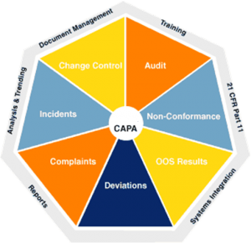
CORRECTIVE AND PREVENTIVE ACTION (CAPA)

Slide 2
AGENDA
1
Purpose of CAPA
2
Why is CAPA important?
3
Definitions
4
The CAPA Process
5
Implementing Changes
Notes:
2

Slide 3

PURPOSE OF CAPA
CAPA helps to
Collect and Analyze Information based on appropriate statistical methodology as necessary to detect recurring quality problems
Identify and Investigate Existing and Potential Product and Quality Problems
Take Appropriate, Effective, and Comprehensive Corrective and/or Preventive Actions
Notes:
3

Slide 4
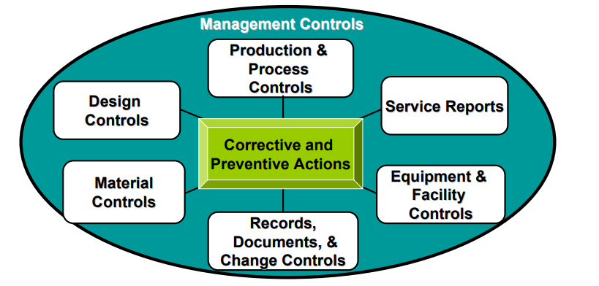
PURPOSE OF CAPA
The CAPA system applies to
Notes:
4

Slide 5
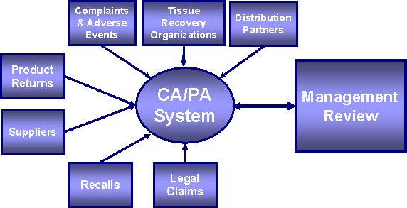
WHY IS CAPA IMPORTANT?
The CAPA system
Ensures problems are detected and resolved
It is also linked to various other requirements such as
  Complaint Files
  Non conforming product
  Acceptance activities
  Servicing
  Audits
  Reports of correction and removal (recall)
Notes:
5

Slide 6
DEFINITIONS
Correction
Corrective Action
Repair, rework, or adjustment and relates to the disposition of an existing nonconformity
The action taken to eliminate the causes of an existing nonconformity, defect or other undesirable situation in order to prevent recurrence.
Preventive Action
Non conformity
Action taken to eliminate the cause of a potential nonconformity, defect, or other undesirable situation in order to prevent occurrence
Non-fulfillment of a specified requirement.
Notes:
6

Slide 7
The CAPA Process
The CAPA process
INPUTS
ELEMENTS
Analyze Data
Investigate cause
Identify Action
Verify/ Validate effectiveness
OUTPUTS
Internal/
External Sources
Implement Changes
Disseminating Information
Submit for management review
Document
Notes:
7

Slide 8

The CAPA Process
Data Analysis
Analyzing processes, work operations, concessions, quality audit reports, quality records, service records, complaints, returned product, and other sources of quality data to idnonconforming product, or other quality problems.
Appropriate statistical methodology is to be employed where necessary to detect recurring quality problems.
Notes:
8

Slide 9
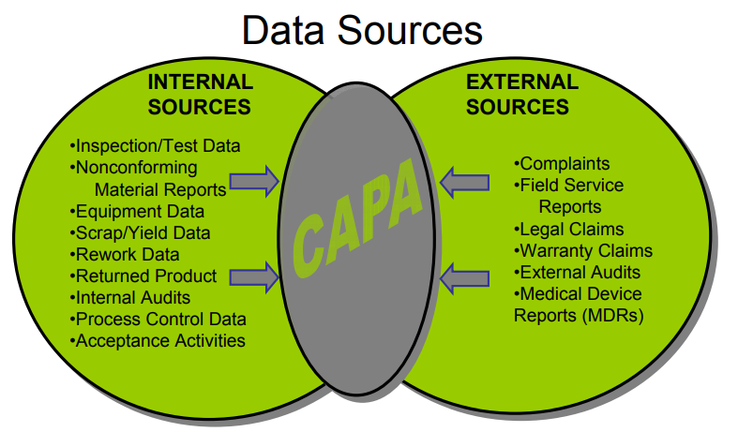
The CAPA Process
Data Analysis
Establishing data resources
Notes:
9

Slide 10
THE CAPA PROCESS
Data Analysis
Common Statistical Techniques for data analysis
  Pareto charts
  Run charts
  Control charts
  Mean and standard deviation
  Graphical methods (fish bone diagrams, histograms, scatter plots spreadsheets, etc)
Notes:
10

Slide 11

THE CAPA PROCESS
Investigate Cause
Investigating the cause of nonconformities relating to product, process, and the quality system is a must
Investigation steps to be followed
  Identify the problem and characterize
  Determine scope and impact
  Investigate data, process, operations and other sources of information
  Determine root cause if possible
Notes:
11

Slide 12
THE CAPA PROCESS
Possible root causes
Root cause analysis tools
Training
Design
Manufacturing
Management
Change control
Purchasing/ Supplier quality
Testing
Documentation
Maintenance
Commonly used tools
  Fish bone diagrams
  5“why’s”
  Fault tree analysis
Notes:
12

Slide 13

THE CAPA PROCESS
Identify Action
Identify the action(s) needed to correct and prevent recurrence of non-conforming product and other quality problems.
Afetr identifying action, take action by
  Identifying Solutions
  Develop action plan for corrective action/ preventive action
  Consider the risk possed by the problem
    Not all problems require the same level of investigation and action
    It is appropriate to “elevate” some issues at the expense of others
Notes:
13

Slide 14
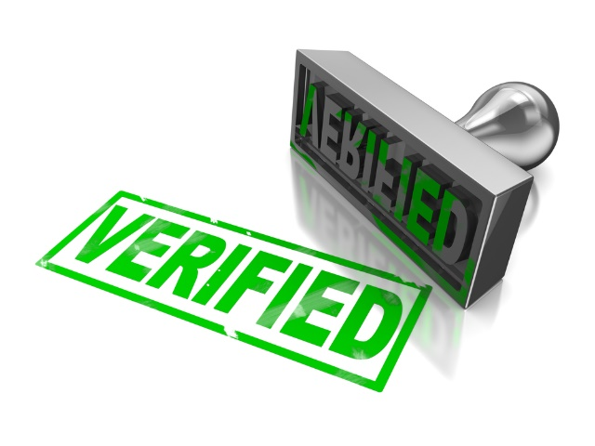
THE CAPA PROCESS
Verify/ Validate Effectiveness
Verifying or validating the corrective and preventive action to ensure that such action is effective and does not adversely affect the finished product.
Check the effectiveness of CAPA by seeking answers to the following:
  Did my solution work?
  Did it create other potential non conformances?
Verify that verification/validation protocols were established
Review data associated with verification or validation activities
Review the effectiveness of the corrective and preventive actions by reviewing data to determine if similar quality problems exist after implementation
Notes:
14

Slide 15

IMPLEMENTING CHANGES
Implement changes to
CAPA implementation to
  Document control for products and processes
  Change control
Ensure that controlled documents are reviewed and approved if changes are made
Verify process by viewing actual process and equipment
Implemented changes may directlylink to design or production and process control
  Document control for products and processes
  Change control
Notes:
15

