Slide 1
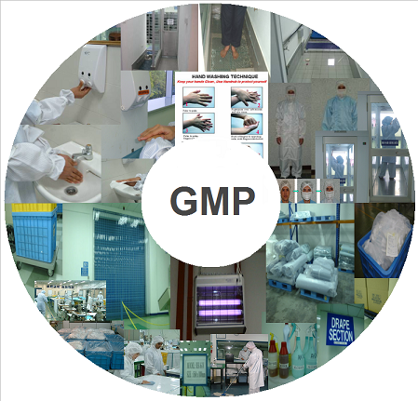
GOOD MANUFACTURING PRACTICES

Slide 2

AGENDA – 6 ITEMS
1
What are Good Manufacturing Practices
2
Principles of Good Manufacturing Practices
3
Personal hygiene
4
Building and facilities
5
Equipment
6
Production and process control

Slide 3

WHAT ARE GOOD MANUFACTURING PRACTICES?
What are Good Manufacturing Practices?
Food product contamination can take place by:
GMP are practices that ensure conformance to recommended guidelines by agencies controlling autorization and licensing of food manufacture and sale
In simple terms, these practices are the minimum requirements that a food manufacturer should meet for assurance of high quality product and prevent risk to consumers.
People
Other food materials (Allergens)
Packaging materials
Hazardous material
Miscellaneous material

Slide 4
PRINCIPLES OF GOOD MANUFACTURING PRACTICES
Principle 1
Design and construct facilities and equipments properly
Principle 2
Follow written procedures and instructions
Principle 3
Document work
Principle 4
Validate work
Principle 5
Monitor facilities and equipments

Slide 5
PRINCIPLES OF GOOD MANUFACTURING PRACTICES
Principle 6
Write step by step operating procedures and work on instructions
Principle 7
Design, develop and demonstrate job competence
Principle 8
Protect against contamiantion
Principle 9
Control components and product related processes
Principle 10
Conduct planned and periodic audits

Slide 6
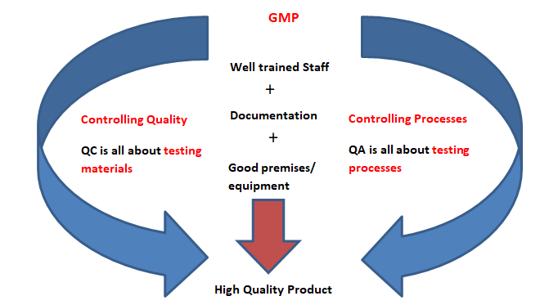
BUILDING BLOCKS OF GOOD MANUFACTURING PRACTICES

Slide 7
PERSONAL HYGIENE
What is personal hygiene?
Personal hygiene involves those practices that are performed by an individual to care for ones bodily health and well being through cleanliness.
Benefit of good personal hygiene
Good personal hygiene helps to prevent food contamination by people
Areas of focus
Personnel practices
Clothing and personal equipment
Hands
Hair

Slide 8
PERSONAL HYGIENE
Personnel Practices
Do’s
Don’t’s
Daily bathing before work
Nails to be kept clean and properly trimmed
Jewelery not permitted on production floor
If hand is bandaged or cut, wear gloves
Report of any employee suffering from any communicable disease
Spitting, chewing tobacco & smoking on production floor not permitted
Eating and drinking in processing area
Storing food in processing area
Running, horse play and riding on equipment.

Slide 9
PERSONAL HYGIENE
Clothing and personal equipment
Do’s
Don’t’s
Uniforms to be kept neat and clean
Uniform and personal equipment to be removed before using restroom
Change over of uniform when moving between raw and cooked product area
All personal equipment to be cleaned at end of each shift
Boots to be cleaned before entering process area
Pants to be tucked in boots
Use of contact lenses mandates use of restricted safety glasses
Pockets not permitted above waist line
Production area uniform not to be worn outside of plant
No pens, pencils, thermometers to be carried above waist line
Open toed, heels and deep grooved shoes not permitted
Uniforms not to contain buttons, zippers/ grippers preffered
Soiled uniform not to be worn in production area

Slide 10
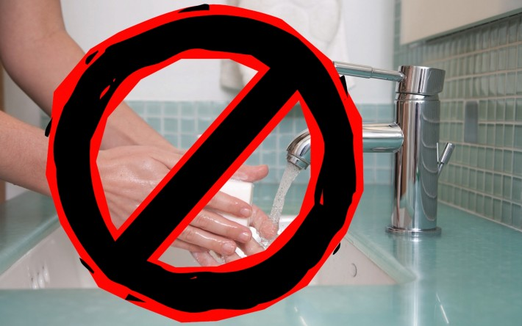
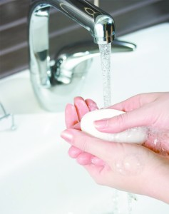
PERSONAL HYGIENE
Hands
Do’s
Don’t’s
Hands to be washed and sanitized
  Before starting work
  After sneezing/coughing
  After eating
  Afetr touching anything unsanitary (pallets, floors, boxes)
Follow proper hand washing procedure
Don’t use bare hands to touch faucet after washing
Don’t wash hands directly under running water
Don’t forget to wash in between fingers, under the nails and top of hands

Slide 11
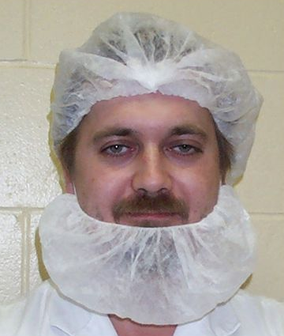
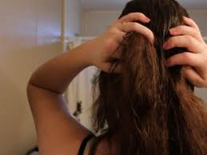

PERSONAL HYGIENE
Hair
Do’s
Don’t’s
Hair to be covered with hair bonnets before entering processing area
New and unused hair bonnets to be used
Facial snoods to be worn if unshaved
Reuse of hair bonnets
Avoid contact of hair with hands
Length of hair not to extend past the top of shirt collar for men

Slide 12
BUILDING AND FACILITIES
Plant and plant grounds
Do’s
Don’t’s
Immediate vicinity of plant to be kept free from trash and refuse
Roads and parking lots associated with facility to be paved
Grass/ weeds to be eliminated for unwanted pest harbourage
Adequate ground drainage facility to be maintained
NA

Slide 13
BUILDING AND FACILITIES
Plant construction and design
Do’s
Don’t’s
Easy cleaning and sanitization of plant is a must
Sufficient room for proper cleaning and sanitization
Floor, walls and ceilings to be easily cleanable
Floors to be slightly sloped to avoid water accumulation and proper drainage
Lighting and ventillation to be adequate
Lights without safety fixtures
Cracks in doors and windows
Suspension of fixtures, pipes an ducts in working areas
Loose sills of windows
Uncovered drains and pest traps

Slide 14
EQUIPMENT
Do’s
Don’t’s
Food contact surfaces to be inert, smooth & non porous (SS preferred)
Equipment contact surfaces to be easily cleanable & sanitizable
Equipment installation to have 3 feet around clearance & to be 6 inches off the floor
Equipment assembly parts like bolts, nuts, gaskets etc not to be kept near equipment during operation
Mobile equipment cleaning and storage not to be done in processing area
Non food grade lubricants for equipments not to be used
Defective equipment not to be kept in processing area

Slide 15
PRODUCTION AND PROCESS CONTROL
Do’s
Do’s
Follow sanitary principles during operations (receiving, production, transportation, processing & storage)
Raw materials to be inspected & separated from processed products
Raw material containers need to be inspected
Ice if used for food production must be sanitary
Regular inspection & cleaning of food processing equipment
Processing factors such as time, temperature, humidity, pressure & other relevant variables to be properly controlled & documented
Testing procedures to be in place for checking finished product quality & safety
Packaging materials to be approved & provide appropriate protection
Finished goods to be coded to ensure traceability
Production records to be maintained

