Slide 1
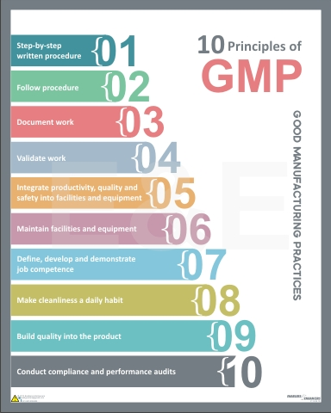
10 PRINCIPLES OF
GOOD MANUFACTURING PRACTICES

Slide 2
AGENDA
Principles of Good Manufacturing Practices
1
Step by step written procedures
2
Follow procedure
3
Document work
4
Validate work
5
Integrate productivity, quality & safety into facilities & equipments
6
Maintain facilities & equipment
7
Define, develop & demonstrate job competence
8
Make cleaning a daily habit
9
Build quality into the product
10
Conduct compliance & performance audits

Slide 3
PRINCIPLE 1 & 2
Step by step written procedures
Follow procedures
Standard operating procedures
Importance of written procedures
Standard operating procedures are established methods that are to be followed routinely for the performance of the designated operations
All operating procedures and work instructions should be written down and made available to employees for better understanding of the facility working procedures
In the food industry it is critical that good procedures are in place to ensure a controlled and consistent performance
Written procedures to be concise, and logical
No shortcuts to be taken, they lead to deviation from the procedure which may lead to hazards

Slide 4
PRINCIPLE 3 & 4
3. Document work
4. Validate work
What is Documentation?
What is validation?
Written material that provides official information or serves as a record
E.g. Equipment user manual, GMP Manual
Establishing documentary evidence that the procedure, process or activity and production maintains the desired level of compliance at all stages
Document &validate procedures
Why document & validate work?
Document work for compliance & traceability
Validation provides proof that system is doing what it is supposed to do
To prove that processes & equipment consistently do what they are supposed to do
Maintain & check consistent performance
What requires documentation & validation
How is it to be achieved?
New facilities & equipment
Significant changes to existing system
Validation activities to be well planned & defined clearly
Correctly following written procedures
Properly maintaing & calibrating equioment

Slide 5
PRINCIPLE 5 & 6
5. Integrate productivity, quality & safety into facilities & equipment
6. Maintain facilities & equipment
Facility design
Always aim to
Develop a good design for facility & equipment from the start
Properly maintain facility & equipment
Design, locate & maintain equipment to suit its intended use
Remove unnecessary traffic in the production area. It could result in hazardous environment
Segregate materials, products & their components to minimize confusion & potential for mix-up & errors
Product quality is impacted by
Proper maintenance schedules
Air
Water
Lightning
Ventillation, temperature
Help prevent equipment breakdown
Reduces risk of product contamination and maintains the validated state of the faciltiy or equipment

Slide 6
PRINCIPLE 7 & 8
7. Define, develop & demonstrate job competency
8. Make cleanliness a daily habit
How to achieve employee competence
Cleanliness in facility
Training to be provided to all employees whose activities could affect product quality
Training to be inclusive of basic training on theory & practice of GMP as well as role related training.
Employees to demonstrate competence by producing quality products in a safe & efficient manner
“Effective implementation of GMP makes for competent employees”
Protect products against contamination by practicing good hygiene.
Always practice good personal hygiene (wash hands, wear protective garments)
Inform supervisor if ill. It may be hazardous for product
Minimize contact with product, equipment
Follow cleaning & sanitization procedures
Report condition that may cause product contamination

Slide 7
PRINCIPLE 7 & 8
7. Define, develop & demonstrate job competency
8. Make cleanliness a daily habit
Food Contamiantion
Particulate Contamination
It refers to presence of harmful chemicals or microorganisms that can cause consumer illness
Product made impure by any particle that doesn’t belong in it
Most common contamination
E.g. Dust, dirt, fiber etc in food
Microbial Contamination
Cross Contamination
It refers to the non-intended or accidental introduction of infectious material like bacteria, yeast, mold, fungi, virus, prions, protozoa or their toxins and by-products into food
When traces of other materials or products are unintentionally transferred from one product to another posing a hazard
E.g. Allergens

Slide 8
PRINCIPLE 9 & 10
9. Build quality into the product
10. Conduct compliance & performance audits
Product Quality
Product quality can be achieved by
Every step in the products life cycle requires effective controls to ensure the quality of the product.
Controlling components
Controlling the manufacturing process
Packaging & labeling controls
Holding and distribution controls
Controlling components
Controlling manufacturing process
Check all materials & components to ensure they meet defined specifications
Idenetify components & store them in quarantine area for sampling & testing
Every product must have
  Master record outlining specifications
  Individual batch/ history records

Slide 9
PRINCIPLE 9 & 10
9. Build quality into the product
10. Conduct compliance & performance audits
Packaging & labeling control
Holding & distribution controls
To enable traceability
  Assign batch no. to all products
  Inspect packaging & labeling before processing new batch
Proper controls to be in place against
  Contamination
  Mix-ups & errors
Prepare procedures for handling, storage & distribution of products
Conduct complaince & performance audits
Audits must be conducted to asses whether the faciltiy is following GMP.
External audits are conducted by external bodies such as FDA etc
Internal/ in-house audits to be conducted to ensure GMP compliance

