Slide 1

UTILITIES MANAGEMENT

Slide 2
AGENDA
1
Utility Services
2
Environmental air
3
Compressed air
4
Water
5
Steam
Notes:
2

Slide 3

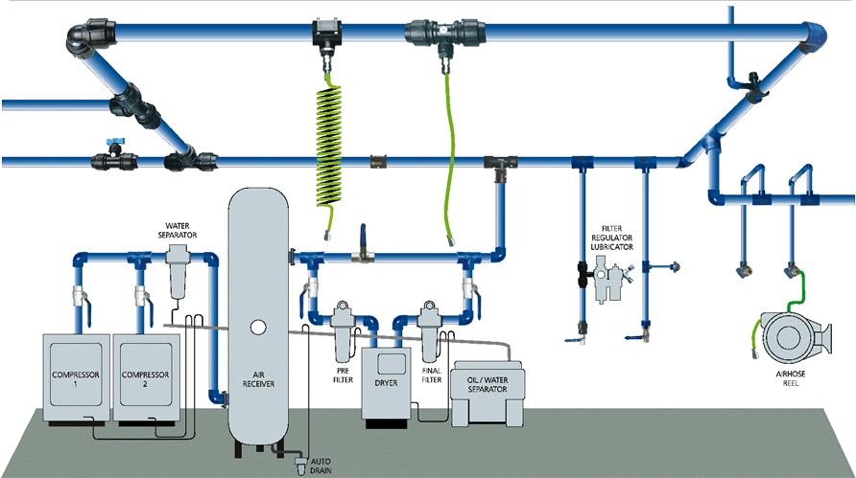
UTILITY SERVICES
Ensure
Safe provision of utility services in a food production area
Utility services in a food plant include
  Environmental Air
  Compressed Air
  Water
  Steam
Notes:
3

Slide 4
ENVIRONMENTAL AIR
What to keep in mind?
Visually examine all exterior air ports for physical integrity from time to time.
Integrity of air filters should be checked as a part of preventive maintenance
Maintain suitable air pressure differentials between adjacent areasin relation to positive, negative, and ambient airflow to prevent contamination
Air for controlled or high controlled zones not to be sourced from unprocessed (raw) areas.
Regular monitoring, trending and review of air quality by appropriate personnel to ensure suitable microbiological quality.
All sampling locations, action limits, corrective actions to be described.
Air blown on surface of microbiologically sensitive material to be sourced from within processing area
Notes:
4

Slide 5
ENVIRONMENTAL AIR
What to keep in mind?
Air sourced from outside to be filtered to the level required for the product
Air supplied to the filler in an aspetic filling system (for beverages) to be filtered through a HEPA filter (H13)
If air is used to transport non microbiological sensitive material with a further kill step, it must be filtered to F5
If air is used to transport sensitive ingredients with no further kill step, F7 filter to be used.
Notes:
5

Slide 6
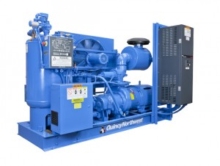
COMPRESSED AIR
What to keep in mind?
Compressed air for general applications to be dry,oil free, and filtered to remove foreign particles.
Compressors providing air for direct contact with food to be of oil free design. If unavoidable, food grade oil to be used.
When used as an ingredient, or in contact with microbiological sensitive substance, compressed air to be filtered to 0.3µ at point of use.
Prior to kill step, compressed air to be filrtered to 1.0µ
Distribution piping to be of approved material
Preventive maintenance of air filters to be documneted
Notes:
6

Slide 7
WATER
What to keep in mind?
Potable water supply system should meet all local and national regulatory requiurements.
Water moicrobiological quality to be controlled and meet specific requirements
Microbiological tests to be performed periodically
Watter used in the product to be analyzed weekly
Test all water (reclaim water, hand wash water, water for brine solutions, recirculated cooling water, water as sanitation final rinse) to be tested for TVC (Total Viable Count) and coliform
Recommended limits are TVC< 500 cfu/ml and coliforms <1cfu/100ml
Initiate corrective action for out of standard results.
Test ozone & chlorine periodically for chlorinated water
Notes:
7

Slide 8
STEAM
What to keep in mind?
Process steam is the steam used indirectly during processing( e.g steam for jacketed equipment)
Steam to be produced using boiler chemicals or water treatment that is apporoved under local/ national regulations
Culinary steam or clean steam is suitable for direct product contact and can be directly injected into product.
Culinary steam to be produced only using approved food grade boiler chemicals.
The piping assembly for direct steam should:
  Contain an entrainment separator capable of removing particles of 30 micron size
  Be delivered through stainless steel pipework to the point of use
Condensate quality to be evaluated routinely for turbidity
Notes:
8

